Slide 1
The Pathways to Opportunity Plan:
Data-Informed Initiatives
May 17, 2022
Emily Salmon
Senior Associate for Strategic Planning and Policy Studies

Slide 2
Objectives for Today
Highlight key findings from the baseline measures data.
  Enrollment
  Degree Awards
Connect baseline data to specific initiatives.
Discuss areas of emphasis for additional priority initiatives.

Slide 3
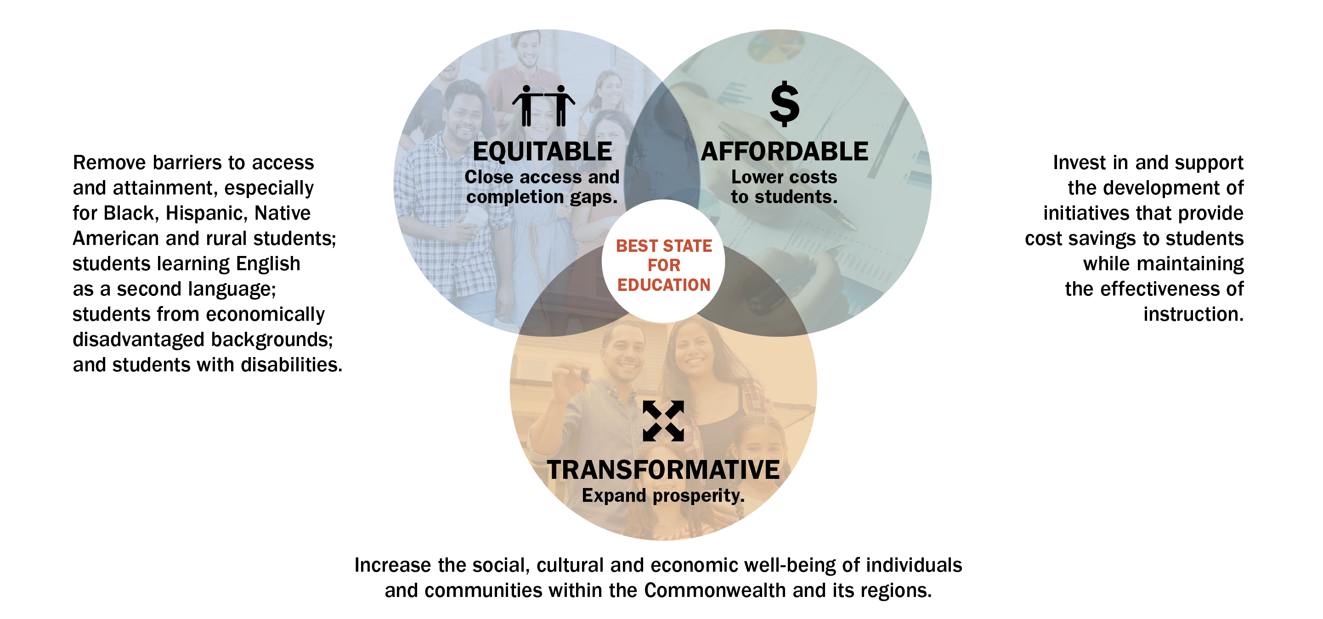
Pathways to Opportunity Plan - Goals

Slide 4
Plan Goals, Strategies and Initiatives
Strategies
Initiatives
Goals
What The Plan is trying to achieve.
Broad methods to achieve the goals.
Specific (short-term) actions to implement the strategies and support the goals.

Slide 5
Pathways to Opportunity Plan - Measures
Measures to Assess Goal Fulfillment
Goals | Measure | Definition | Target | Desired Outcome
Goal 1 - Equitable: Close access and completion gaps. | Attainment | Percent of 25- to 64- year-olds with an associate degree or higher.* | Close gaps in attainment of selected groups. | Improved attainment for all.
 | Enrollment | Fall headcount of public and private undergraduates. | Close enrollment gaps of selected groups to reflect the population. | Improved access for all.
Goal 2 - Affordable: Lower costs to students. | Awards | Undergraduate degrees and credentials produced each year. | Close award gaps of selected groups to reflect enrollment. | Improved success for all students.
 | Borrowing | Average debt of graduates. | Close gaps in borrowing of selected groups. | Improved affordability for all students.
Goal 3 - Transformative: Expand prosperity. | Wages | Graduates' wages 10 years after graduation. | Close gaps in earnings of selected groups. | Improved prosperity for all graduates.
*Note: The Plan includes an overarching attainment objective as well as an attainment measure (above). The 70% attainment objective includes the percentage of 25- to 64- year-olds with a postsecondary certificate, certification or higher. The attainment measure includes the percentage of 25- to 64- year-olds with an associate degree or higher.

Slide 6

Enrollment Measure: Close Access Gaps
Enrollment Measure, Total Fall Enrollment, 2019-20: 421,240
Official fall headcount of public and private undergraduates.
The following undergraduate enrollment gaps exist:
  By race/ethnicity – Black, Hawaiian Islander/Pacific Islander, Non-Resident Alien and White
  By region of origin – Hampton Roads and Shenandoah Valley
  By income – Middle income.
  By gender – Men

Slide 7
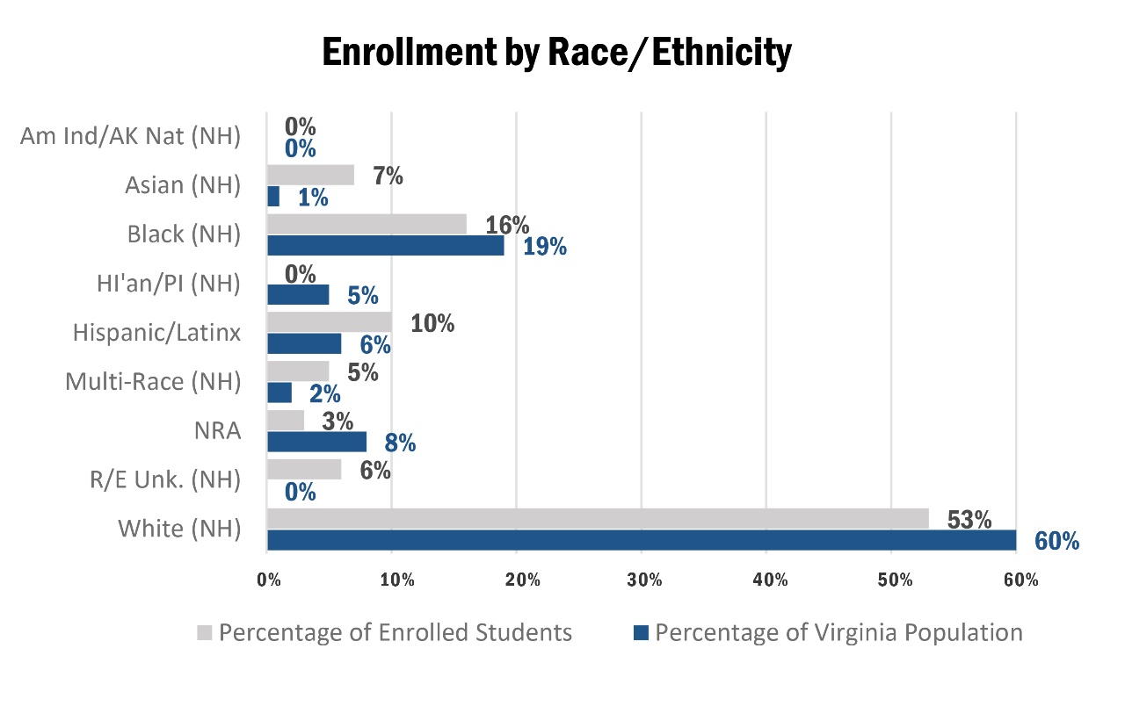
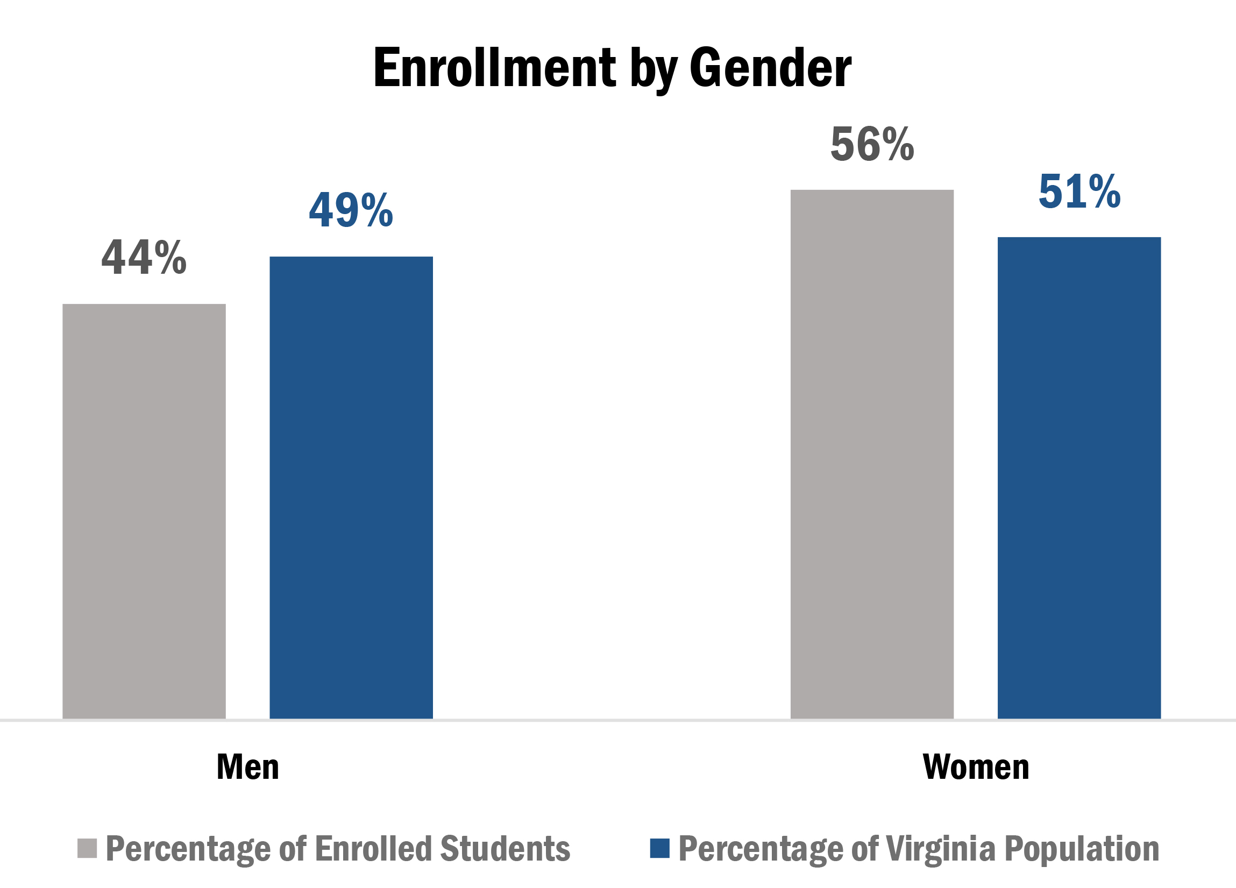
Enrollment Measure: Close Access Gaps
Note: Total undergraduate enrollment for American Indian/Alaska natives in Virginia is 1,142; Native Hawaiian/other Pacific Islander is 771. Total population of American Indian/Alaska Natives is 7,604. Total population Unknown/non-Hispanic is 6,504.

Slide 8
Goal 1: Equitable – Close Access Gaps
Priority Initiative
I.1: Form an enhanced partnership between VDOE and SCHEV through the commitment of a shared goal to increase post-secondary enrollments to include a shared position and strategic planning. Postsecondary Access and Success Specialist Access Strategic Plan

Slide 9
Awards Measure: Close Completion Gaps
Award Measure, Total Degrees and Certificates Awarded, 2019-20: 89,904
Undergraduate degrees and credentials produced each year. Noncredit workforce credentials are not included.
Identified success gaps may include:
  By race/ethnicity – Black, Multi-Race, Hispanic/Latinx
  By region of origin – Greater Richmond, Hampton Roads and Northern Virginia
  By income – Lower income
  By gender – Men

Slide 10
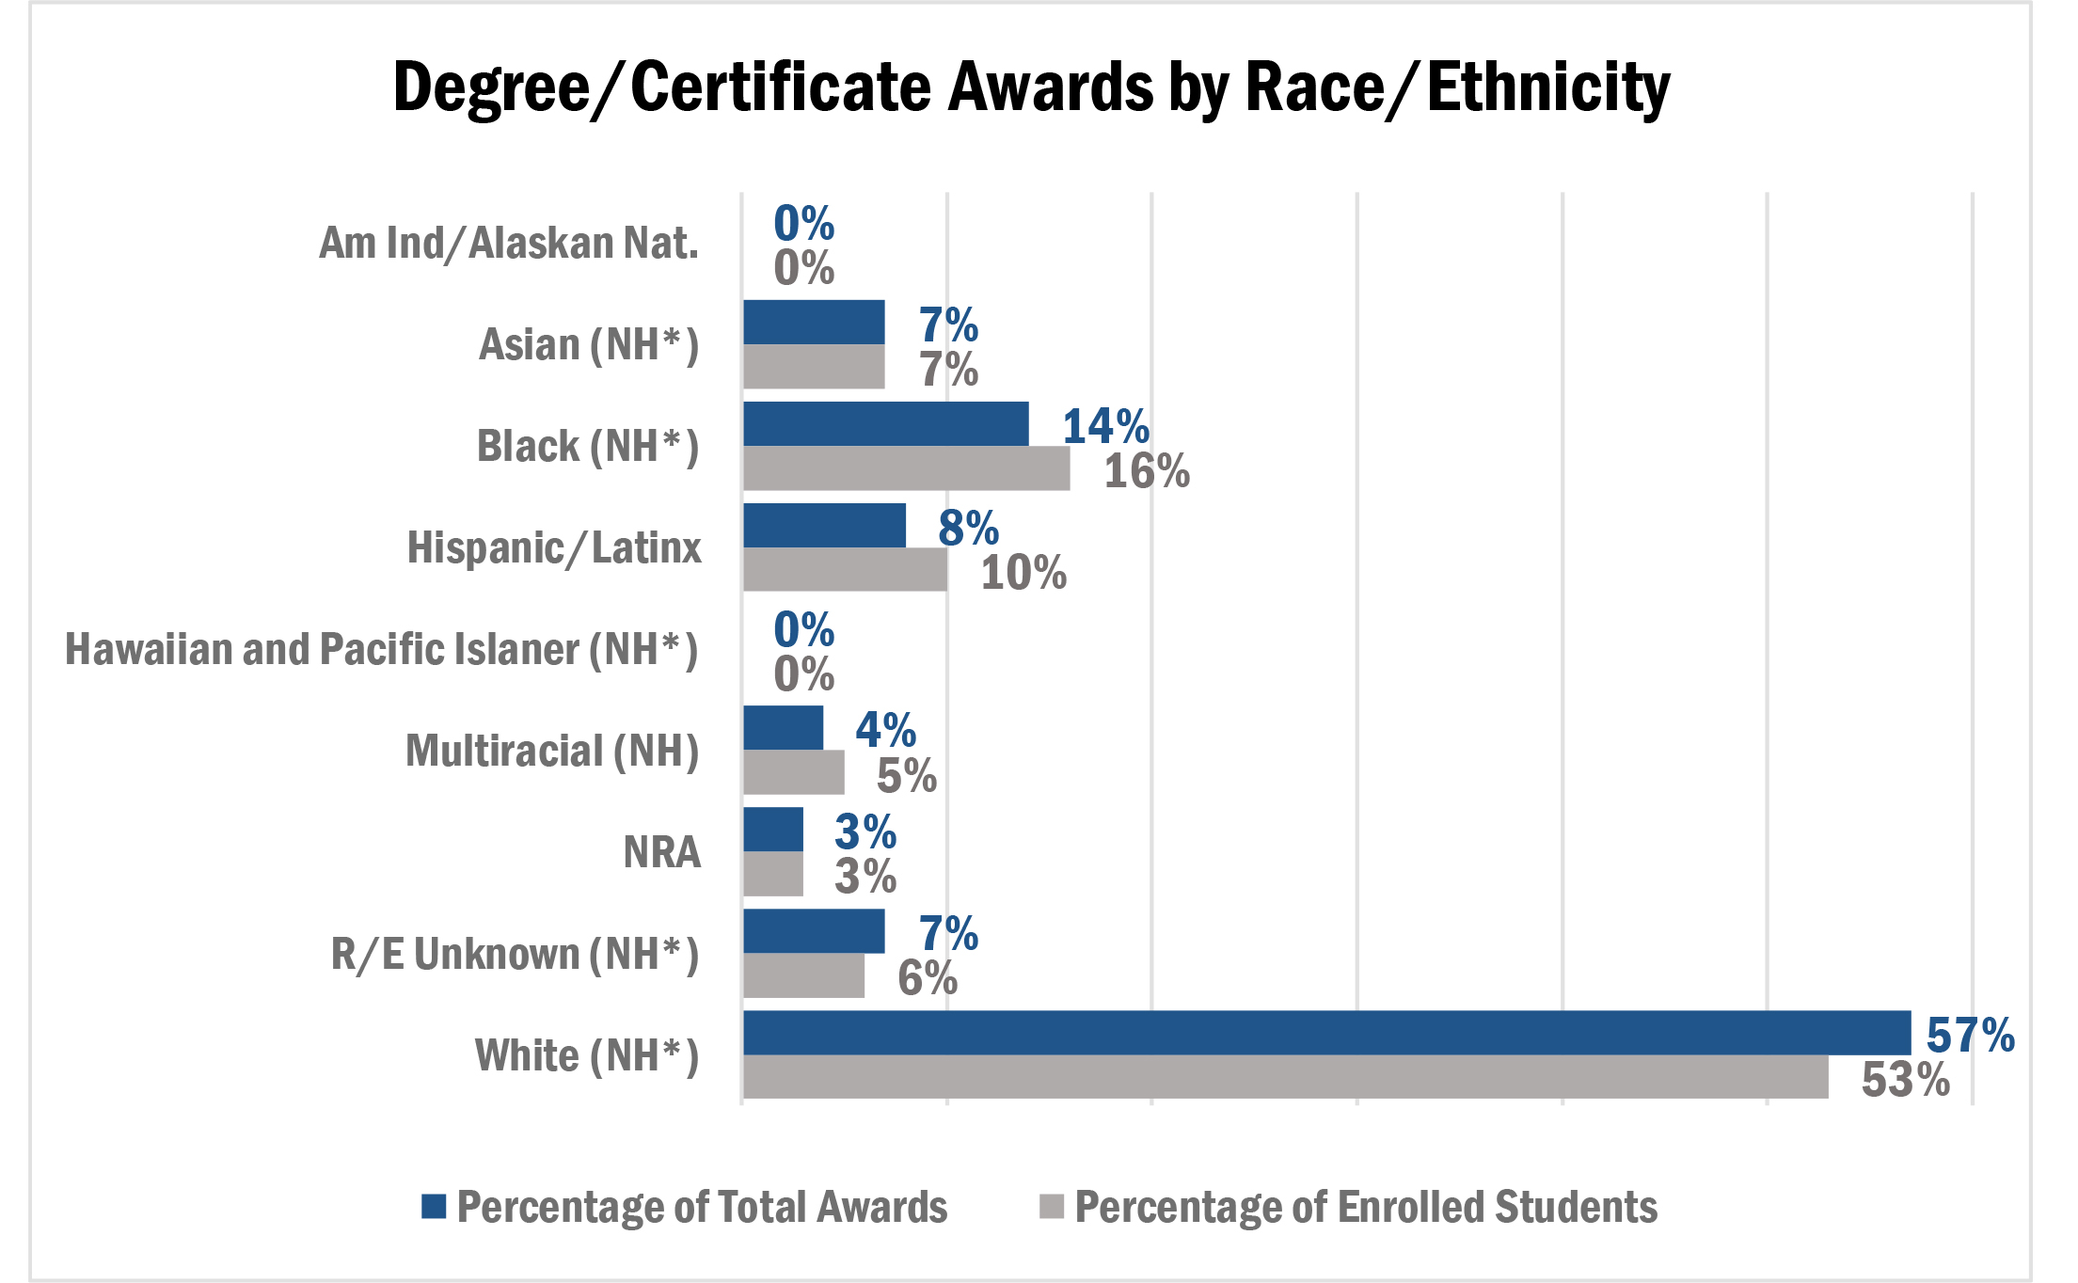
Awards Measure: Close Completion Gaps
Note: Total undergraduate awards for American Indian/Alaska natives in Virginia is 228; Native Hawaiian/other Pacific Islander is 163.
(NH*) = Non-Hispanic

Slide 11
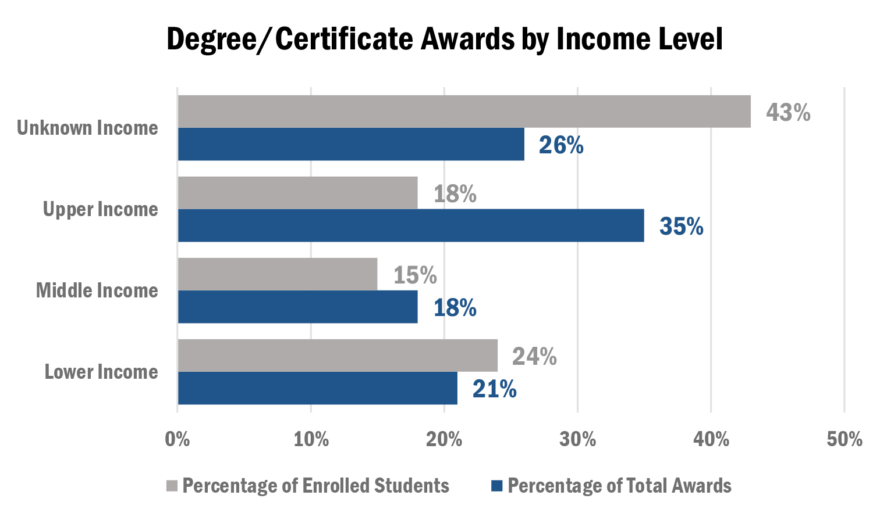
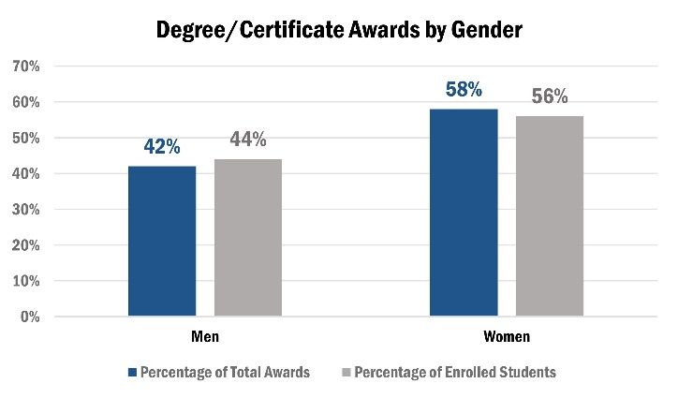
Awards Measure: Close Completion Gaps

Slide 12
Goal 1: Equitable – Close Completion Gaps
Priority Initiatives
I.3: Identify critical student-support-services issues and formulate recommendations that will positively affect the student experience, persistence and completion. Underway Budget language introduced this General Assembly session. “Action Plan to Address Barriers faced by Students with Disabilities”

Slide 13
Next Steps – Summer into Fall
Highlight key findings from the baseline measures data (July Council meeting).
  Borrowing (Affordable Goal)
  Wages (Transformative Goal)
Seek Council’s input on potential priority initiatives for the upcoming year (July).
Present proposed priority initiatives for input and action (September).

