Slide 1
Critical Issues Impacting Student Well-being, Persistence and Completion
Private College Advisory Board
May 16, 2022
Emily Salmon, Senior Associate

Slide 2
Objectives
Provide topical context for the review.
Present questions for consideration.
Summarize next steps.

Slide 3
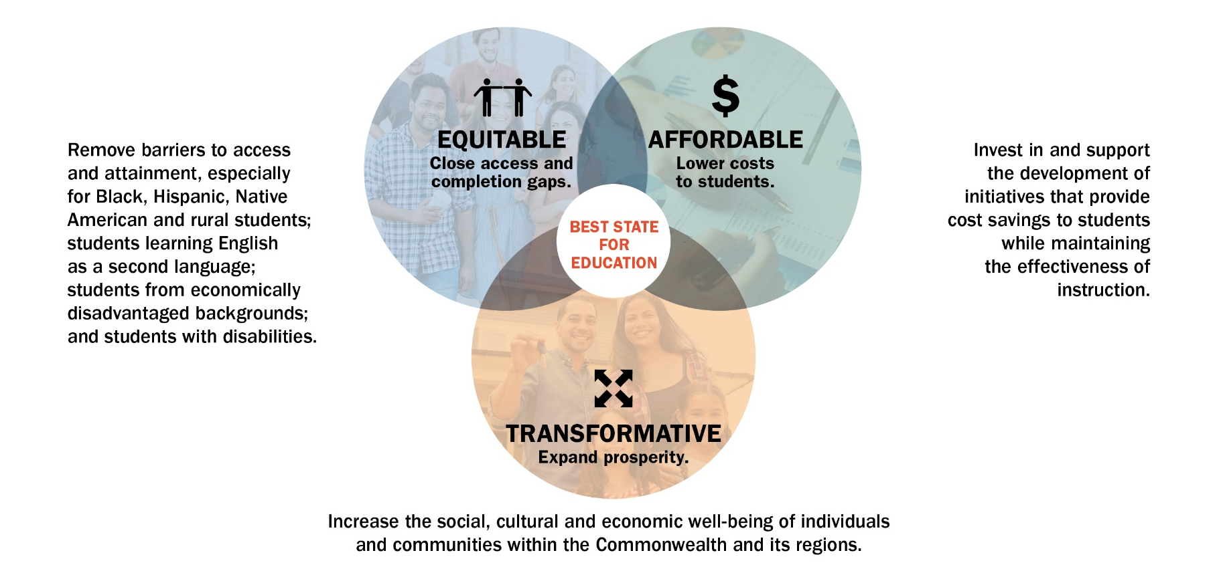
Pathways to Opportunity - Goals
Notes:
Vision: “Best State for Education”
Target: 70% educational attainment by 2030, with a concerted focus on equity.
Mission: Virginia will advance equitable, affordable and transformative higher education.

Slide 4

Goal 1: Equitable – Close Gaps
Supporting Strategies
S3. Strengthen student support services for persistence and completion: mental health, mentoring, career services, social, student basic needs, information technology, disability support and other services.

Slide 5
Plan Goals, Strategies and Initiatives
Strategies
Initiatives
Goals
What The Plan is trying to achieve.
Broad methods to achieve the goals.
Specific (short-term) actions to implement the strategies and support the goals.

Slide 6
SCHEV Priority Initiatives
In September 2021, Council approved the following priority initiative to implement strategy S3 of the Pathways to Opportunity Plan Equity Goal.
“Identify critical student-support-services issues and formulate recommendations that will positively affect the student experience, persistence and completion.”

Slide 7
Questions for Consideration
What are the most critical issues facing students that impact their well-being, persistence and completion?
What are the most critical issues facing Virginia’s higher education student-support services that impact student well-being, persistence and completion?

Slide 8
Next Steps
SCHEV staff will:
  Obtain additional input from stakeholders;
  Provide updates on emergent themes and potential recommendations; and
  Submit the final report to Council by November 2022.

