Slide 1
Action Plan to Address Higher Education Barriers faced by Students with Disabilities
May 17, 2022
Emily Salmon
Senior Associate for Strategic Planning and Policy Studies

Slide 2
Objectives
Provide topical context for the action plan.
Highlight three domain areas and primary goals of the action plan.
Summarize next steps.

Slide 3
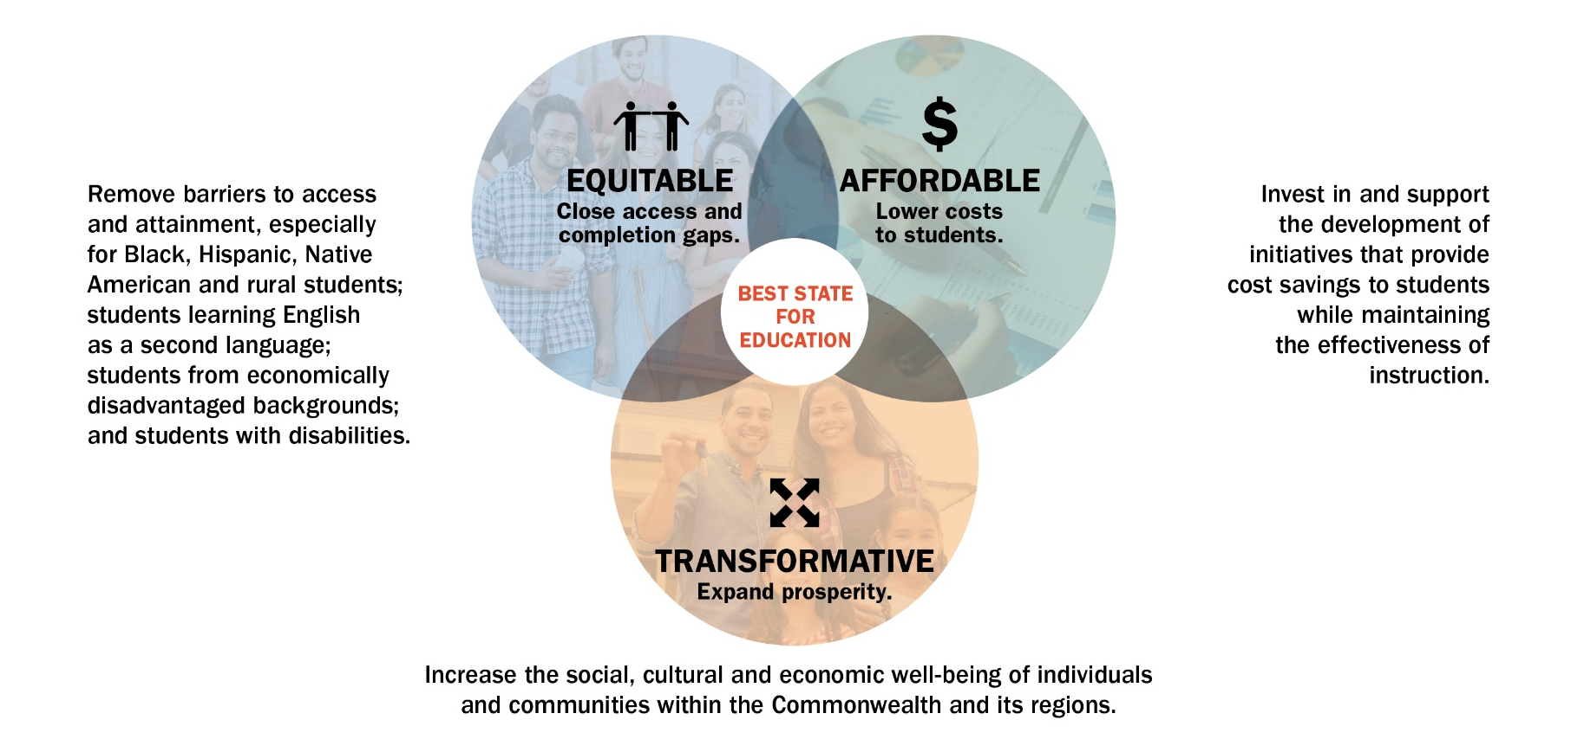
Pathways to Opportunity - Goals
Notes:
Vision: “Best State for Education”
Target: 70% educational attainment by 2030, with a concerted focus on equity.
Mission: Virginia will advance equitable, affordable and transformative higher education.

Slide 4
Answer to Current Policy Priorities
Pathways to Opportunity Plan supporting strategies:
S1: Expand postsecondary opportunities and awareness to Virginians who may not view higher education as an option.
S3: Strengthen student support services for persistence and completion: mental health, mentoring, career services, social, student basic needs, information technology, disability support and other services.
Governor Youngkin’s Executive Order 10:
Responsibilities of Virginia’s Chief Diversity, Opportunity & Inclusion Officer “to expand entrepreneurship and economic opportunities for disadvantaged Virginians, including Virginians living with disabilities.”

Slide 5
The Case for Action
During the current 2021-2022 school year, 169,578 students with disabilities are enrolled in K-12.
  ~13% of the total K-12 enrollment.
Of those students, 14,116 entered 12th grade this year.
  Equivalent to 40% of the total number of first year students entering Virginia institutions this year.
Any postsecondary credential improves one’s earning power.
  Increases earnings by 84% over a lifetime.
  Labor force participation rates: 36.7% for those with disabilities and 76.6% for those without.
  Degree completion rates (within 6 years): 41% for students with disabilities and 51% for those without.
Notes:
16-64 year-olds.

Slide 6
Disabilities Action Plan Domain Areas
Data Collection
Access to Higher Education
Success in Higher Education

Slide 7
Data Collection
Goal:
Establish new, standardized guidelines for data collection on students with disabilities at the institution level and incorporate into SCHEV’s regular ongoing data collection responsibilities, in accordance with the Code of Virginia § 23.1-203(9).
Notes:
Underway via workgroup activity.

Slide 8
Access to Higher Education
Goals:
Develop guidelines for accommodation practices.
Develop budget recommendations for the 2023 General Assembly.
Explore the feasibility of actions to assist students with the transition from K-12 to higher education.
Notes:
Develop guidelines for accommodation practices, including, but not limited to:
Standardized testing.
Enhanced consistency across and within institutions.
“Regulatory relief” for students’ utilization of accommodations, reducing barriers to access.
Systematized information about accommodation practices.
Develop budget recommendations for the 2023 General Assembly. Potential examples:
Expand the number of Comprehensive Transition and Postsecondary Programs in Virginia.
Recommendations identified by Council, the Committee and other stakeholders.
Explore the feasibility of actions to assist students with the transition from K-12 to higher education. Potential examples:
Implement final summary assessments of student experiences and postsecondary accommodations for secondary students with an Individualized Education Program (IEP) that can be used to help higher education institutions establish postsecondary accommodations for students.
Pathways partnerships between districts/schools and higher education institutions with a specific focus on disability issues.

Slide 9
Success in Higher Education
Goals:
Explore funding and statutory basis for enhanced universal training for university faculty and staff.
Investigate the feasibility of developing and sharing transportable documentation…to reduce unnecessary duplication of efforts by students seeking accommodations.
Explore and assess emerging technology and statewide cost-sharing initiatives for potential use and adoption.
Develop guidelines for ensuring that students and parents understand their options for enabling parental support.

Slide 10
Next Steps
SCHEV staff will:
  Seek advisory committee input on implementation of the Action Plan; and
  Identify and present pertinent initiatives to Council that inform any subsequent budget and policy recommendations.

