Slide 1
Data-Informed Initiatives for The Pathways to Opportunity Plan Part Two: Measures regarding Borrowing and Wages
July 19, 2022
Emily Salmon
Senior Associate for Strategic Planning and Policy Studies

Slide 2
Objectives for Today
Highlight key findings from the baseline measures data.
Borrowing
Wages
Connect baseline data to specific initiatives.
Discuss areas of emphasis for priority initiatives.

Slide 3
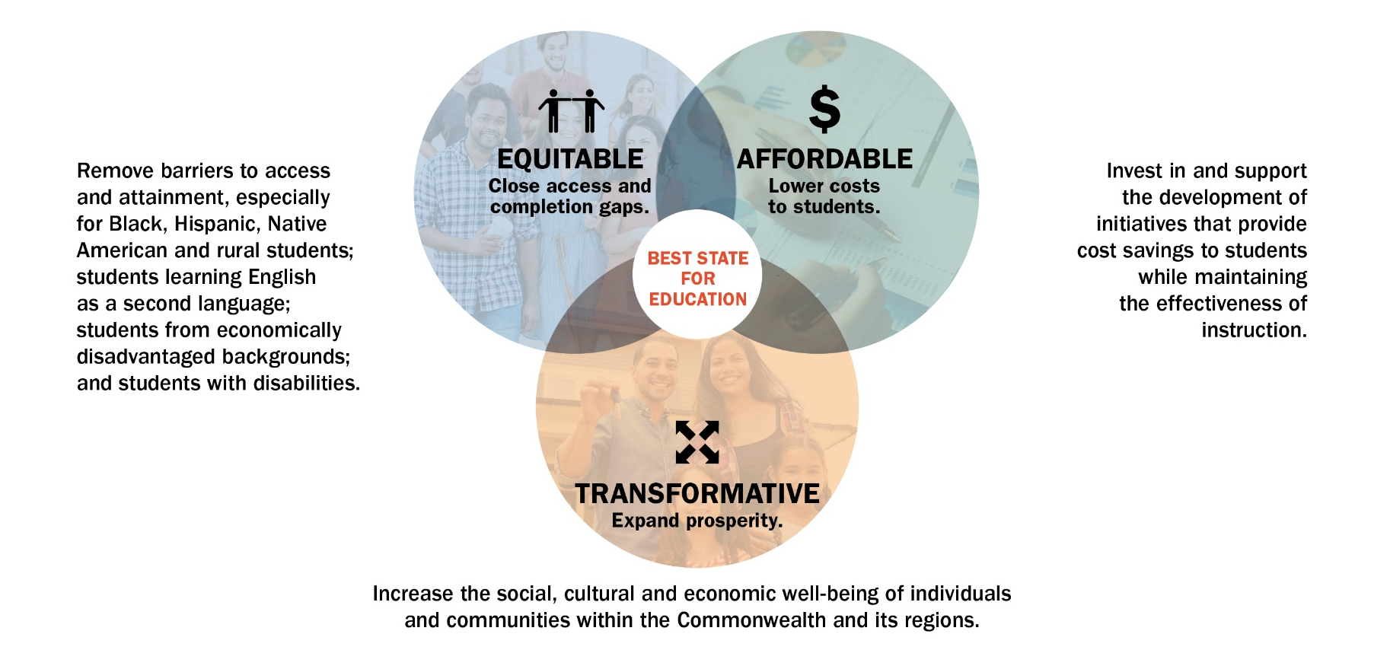
Pathways to Opportunity Plan - Goals

Slide 4
Plan Goals, Strategies and Initiatives
Strategies
Initiatives
Goals
What The Plan is trying to achieve.
Broad methods to achieve the goals.
Specific (short-term) actions to implement the strategies and support the goals.

Slide 5
Pathways to Opportunity Plan - Measures
Measures to Assess Goal Fulfillment
Goals | Measure | Definition | Target | Desired Outcome
Goal 1 - Equitable: Close access and completion gaps. | Attainment | Percent of 25- to 64- year-olds with an associate degree or higher.* | Close gaps in attainment of selected groups. | Improved attainment for all.
 | Enrollment | Fall headcount of public and private undergraduates. | Close enrollment gaps of selected groups to reflect the population. | Improved access for all.
Goal 2 - Affordable: Lower costs to students. | Awards | Undergraduate degrees and credentials produced each year. | Close award gaps of selected groups to reflect enrollment. | Improved success for all students.
 | Borrowing | Average debt of graduates. | Close gaps in borrowing of selected groups. | Improved affordability for all students.
Goal 3 - Transformative: Expand prosperity. | Wages | Graduates' wages 10 years after graduation. | Close gaps in earnings of selected groups. | Improved prosperity for all graduates.
*Note: The Plan includes an overarching attainment objective as well as an attainment measure (above). The 70% attainment objective includes the percentage of 25- to 64- year-olds with a postsecondary certificate, certification or higher. The attainment measure includes the percentage of 25- to 64- year-olds with an associate degree or higher.

Slide 6
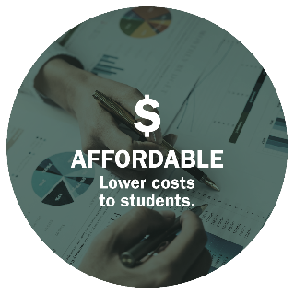
Borrowing Measure: Close Affordability Gaps
Borrowing Measure, Average Annual Student Borrowing, 2019-20: $8,118
Average annual borrowing is derived from SCHEV’s annual student-financial-aid collection.
Those groups with the largest percentage of undergraduates who are borrowing include:
By race/ethnicity – Black (46%) and Race/Ethnicity unknown (42%)
By region of origin – Hampton Roads (36%)
By income – Middle income (67%)
By gender – Women (34%)
Notes:
The following baseline data serve to measure progress toward achieving The Pathways to Opportunity Plan goals. The following charts come from SCHEV and American Community Survey (ACS) data. Each of the five measures below include aggregate baseline data and data disaggregated by race/ethnicity, income, GO Virginia regions and gender.
Baseline data are from the 2019-20 academic year for all undergraduate students (in-state and out-of-state) from the grand total of all reporting institutions, public and private, 2-year and 4- year.
Average annual debt comes from SCHEV’s annual student financial aid collection and includes students that borrowed $0 and that used federal or private loans for higher education.
Note: borrowing is a barometer of affordability which is a complex issue (E.g., not all debt is bad). Student borrowing represents the student-centric (Parent PLUS loans are excluded for undergraduates) loans for a year and represent the number of unique students borrowing and the total unduplicated headcount for the academic year (which is always higher than the fall headcount). The percentage of unduplicated student enrollment with loans, during the 2019-20 academic year is 32%.
Note: borrowing is a barometer of affordability which is a complex issue (E.g., not all debt is bad). The target is to close gaps in borrowing of selected groups.

Slide 7
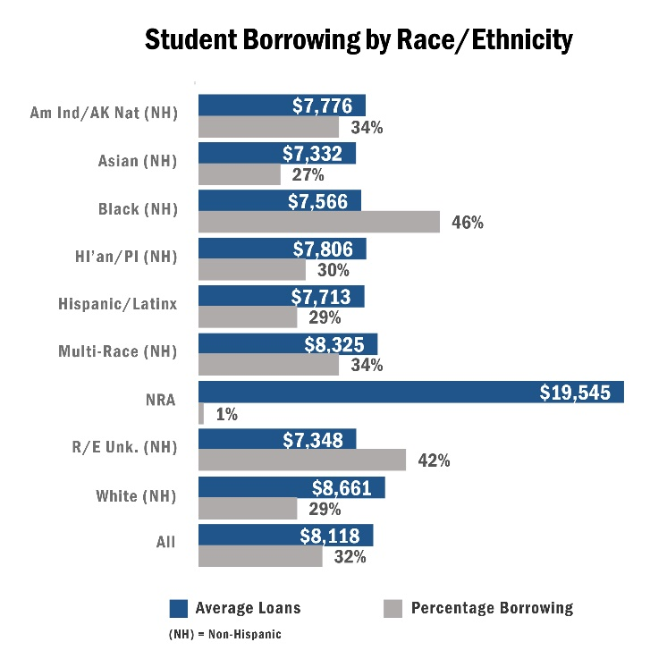
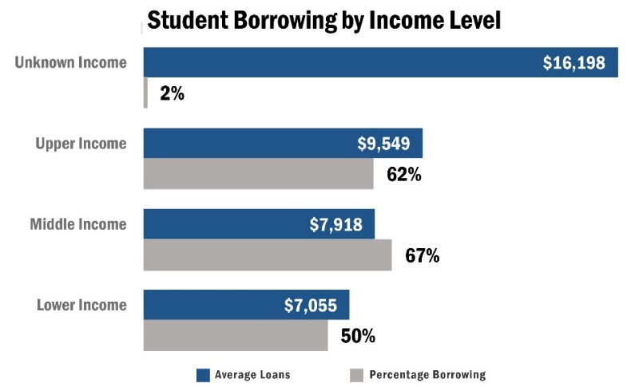
Borrowing Measure: Close Affordability Gaps

Slide 8
Goal 2: Affordable – Lower Costs to Students
Priority Initiative
I.4: Determine strategies to better assess higher education costs and implement approaches to allocate limited public resources to institutions through the cost and funding need study. Underway

Slide 9

Wages Measure: Close Earnings Gaps
Wages Measure, Graduates’ median wages 10 years after graduation, 2008-09 graduates: $56,492
Wages after graduation are based on graduate-record matches of degree completers with quarterly wage data reported for unemployment insurance purposes by Virginia-based employers.
Those groups with the widest gaps include:
By race/ethnicity – Black and American Indian/Native Alaskan
By region of origin – Southwest and Southside
By income – Lower income
By gender – Women
Notes:
The following baseline data serve to measure progress toward achieving The Pathways to Opportunity Plan goals. Baseline data are from the 2019-20 academic year for all undergraduate students (in-state and out-of-state) from the grand total of all reporting institutions, public and private, 2-year and 4- year. Awards include degrees and certificates but not workforce credentials. Wage data are from all undergraduate degree completers.
The Plan’s wages measure is defined as graduates’ wages 10 years after graduation. The target is to close gaps in earnings of selected groups. Basic data are reported on the EOM 18 report.
Wages are the individual earnings of graduates, not household earnings, 10-years post completion. While wages signal prosperity in a financial sense, other aspects of prosperity (civic engagement, happiness, etc.) also exist; however, such data are less reliable or are more difficult to access and measure.
Even though wide gaps in wages are not “levers” that higher education can control in terms of long-term outcomes, such gaps are worthy of attention because they persist within each subgroup. These gaps signal that some groups are not experiencing the same social mobility benefits of higher education as other groups.
Wages after graduation are based on graduate record matches of degree completers with quarterly wage data reported for unemployment insurance purposes by Virginia-based employers. This constitutes 44% of graduates (2008-09) with a reportable wage. Only wage-earners with at least three quarters of employment are used in the calculations. Wages are not adjusted for inflation.

Slide 10
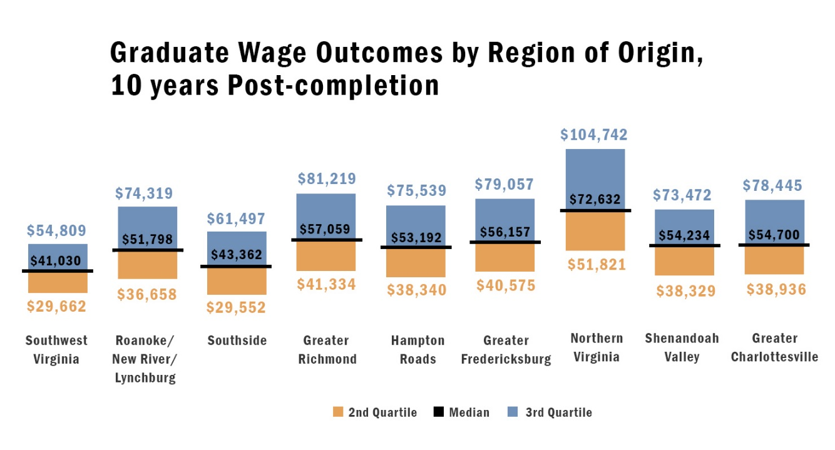
Wages Measure: Close Earnings Gaps

Slide 11
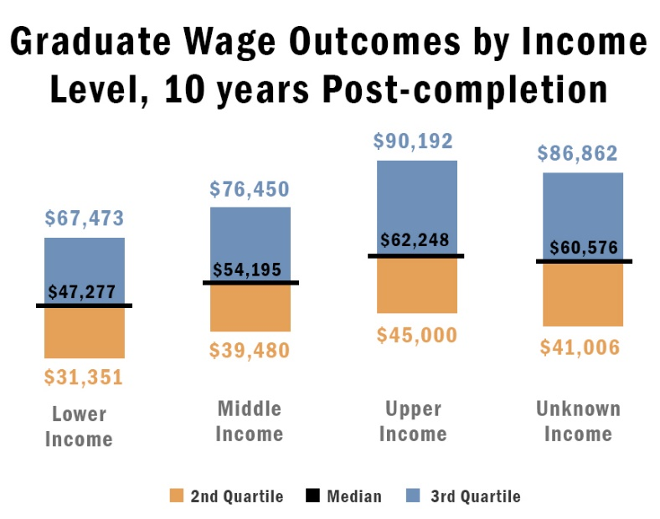
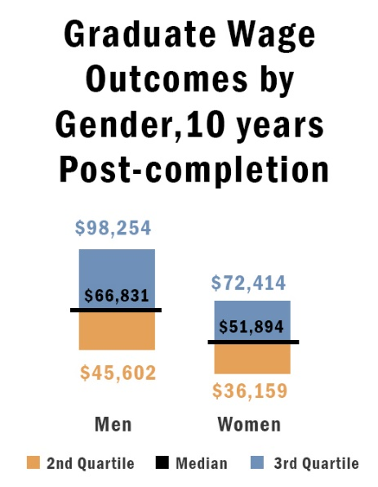
Wages Measure: Close Earnings Gaps
Notes:
Data for the above charts include students borrowing for associate and bachelor’s degrees. It is worth noting that variations in median wages within race/ethnicity, income and gender subgroups were wider for graduates with four-year bachelor’s degrees.

Slide 12
Goal 3: Transformative – Expand Prosperity
Priority Initiatives
I.8: Facilitate collaboration between the Virginia Office of Education Economics (VOEE) and institutions of higher education, and identify new ways to integrate VOEE tools and resources with SCHEV initiatives and processes—these may include: use of graduate outcomes survey results; development of labor market criteria for evaluating academic programs and assessing the need for proposed academic programs; and relationship building between higher education and business. VOEE supply/demand model under development Virginia Educated Action Plan

Slide 13
Next Steps
Review the list of biennial priority initiatives and actions; provide input on additional or modified actions to implement the initiatives (September).
Review proposed actions to continue implementation of initiatives and to align with Council’s budget and policy recommendations, where applicable (October).

