Slide 1
Review of Student Issues and Support Services: Draft Recommendations
Joint Meeting of
SCHEV Council and Council of Presidents
September 19, 2022
Emily Salmon, Senior Associate

Slide 2
Objectives
Provide topical context for the review.
Present core student issue areas.
Seek input on draft recommendations.

Slide 3
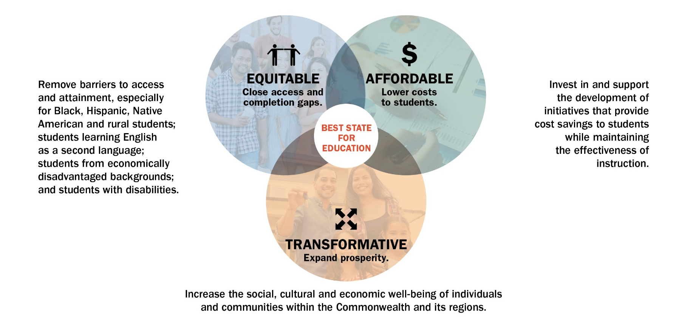
Pathways to Opportunity - Goals
Notes:
Vision: “Best State for Education”
Target: 70% educational attainment by 2030, with a concerted focus on equity.
Mission: Virginia will advance equitable, affordable and transformative higher education.

Slide 4

Goal 1: Equitable – Close Gaps
Supporting Strategies
S3. Strengthen student support services for persistence and completion: mental health, mentoring, career services, social, student basic needs, information technology, disability support and other services.

Slide 5
SCHEV Priority Initiatives
In September 2021, Council approved the following priority initiative to implement the third strategy (S3) of the Pathways to Opportunity plan’s equity goal.
“Identify critical student-support-services issues and formulate recommendations that will positively affect the student experience, persistence and completion.”

Slide 6
Scope and Process
Broad, two-pronged scope that identifies:
Issues affecting the student experience, well-being, persistence and completion.
Challenges that student support services face when working to address student issues.
Process:
Use qualitative and quantitative data to identify critical issues.
Examine best practices.
Obtain subject matter expertise.
Formulate recommendations for action at the state and institutional level to address critical student issues.

Slide 7
A Closer Look at the Review Process
Input from a broad spectrum of stakeholders and subject matter experts:
SCHEV Council and advisory committees
Students
Personnel at Virginia institutions (public & private; two-year & four-year)
Deans of Students
Student Affairs Vice Presidents
Admissions Vice Presidents
Student Support Services administrators, faculty and staff
Additional subject matter experts in Virginia and beyond
Clinicians and researchers
Advocacy groups
SREB Student Success Advisory Council
Review of academic research and mainstream literature

Slide 8
Core Student Issues
The review identified four core student issues that impact the student experience, persistence and completion:
College/life preparedness
Sense of belonging
Basic/human needs
Mental health & well-being

Slide 9
Draft Recommendations
 | General Recommendation | System-level Recommendation
Cross-Cutting: Apply to all four issue areas | Establish a statewide consortia of student affairs vice provosts to exchange best practices, offer continual input on issues, policy and practice recommendations. | Implement state – “system” – level efficiencies to create economies of scale, foster collaboration, innovation and maximize impact.

Slide 10
Draft Recommendations (cont’d)
Student Issues | General Recommendations
College/Life Preparedness | Improve the transition between high school and college.
Sense of Belonging | Focus resources and efforts on marginalized student groups, particularly first generation students and students with disabilities, recognizing the inherent benefits to all students.
Basic/Human Needs | Take advantage of the flexibility granted to states in SNAP benefit and award criteria. Expand student usage of SNAP benefits. Broaden the definition of and supports for basic needs to include broadband, digital access, childcare for students who are parents and accommodations for students with disabilities.
Mental Health & Well-being | Provide additional mental health resources to students, faculty and staff.

Slide 11
Next Steps
SCHEV staff will:
Incorporate Council and COP input into the draft recommendations (September);
Seek action by Council on final recommendations (October); and
Produce final report with the recommendations for distribution (October/November).

