Slide 1
Promoting Democracy, Civility and Free Expression
Jodi Fisler, Ph.D.
Senior Associate for Assessment Policy & Analysis
Joint Meeting of SCHEV & Council of Presidents
September 19, 2022

Slide 2
Presentation Outline
Foundation of SCHEV’s civic engagement work
June 2022 “Day of Dialogue”
(Possible) next steps
Discussion

Slide 3
Foundation of SCHEV’s civic engagement work

Slide 4
What is civic engagement?

Slide 5
“Civic engagement [is] an array of knowledge, abilities, values, attitudes, and behaviors that in combination allow individuals to contribute to the civic life of their communities.”
Source: Policy on Student Learning Assessment and Quality in Undergraduate Education, p. 4 (SCHEV, 2017)

Slide 6
Framework for 21st Century Civic Learning & Democratic Engagement
Knowledge | Skills | Values | Collective Action
Key democratic texts & principles | Critical inquiry, analysis & reasoning | Respect for freedom & human dignity | Integration of knowledge, skills & values to inform actions taken with other people
Political systems & levers for influencing change | Seeking & being informed by multiple perspectives | Empathy | Navigation of political systems & processes
Cultures, histories & religious traditions that have shaped US society | Deliberation & bridge-building across differences | Open-mindedness | Public problem-solving with diverse partners
Sources of identity & their influence on civic values & responsibilities | Collaborative decision-making | Ethical integrity | Compromise, civility & mutual respect
Excerpted from: A Crucible Moment: College Learning and Democracy’s Future, p. 4 (AAC&U, 2012)

Slide 7
Why civic engagement?

Slide 8
Code of Virginia § 23.1-203
“[The Council shall…] in cooperation with public institutions of higher education, develop guidelines for the assessment of student achievement. Each such institution shall use an approved program that complies with the guidelines of the Council and is consistent with the institution’s mission and educational objectives in the development of such assessment. The Council shall report each institution’s assessment of student achievement in the revisions to the Commonwealth’s statewide strategic plan for higher education.”

Slide 9
The Virginia Plan (2014)
Goal #2: Optimize Student Success for Work & Life
“Strengthen curricular options to ensure that graduates are prepared with the competencies necessary for employment and civic engagement.”
Priority initiative #4:
“Collaborate with institutions to measure the quality of undergraduate education, including civic engagement of graduates and relevance to demand occupations across regions of the state.”

Slide 10
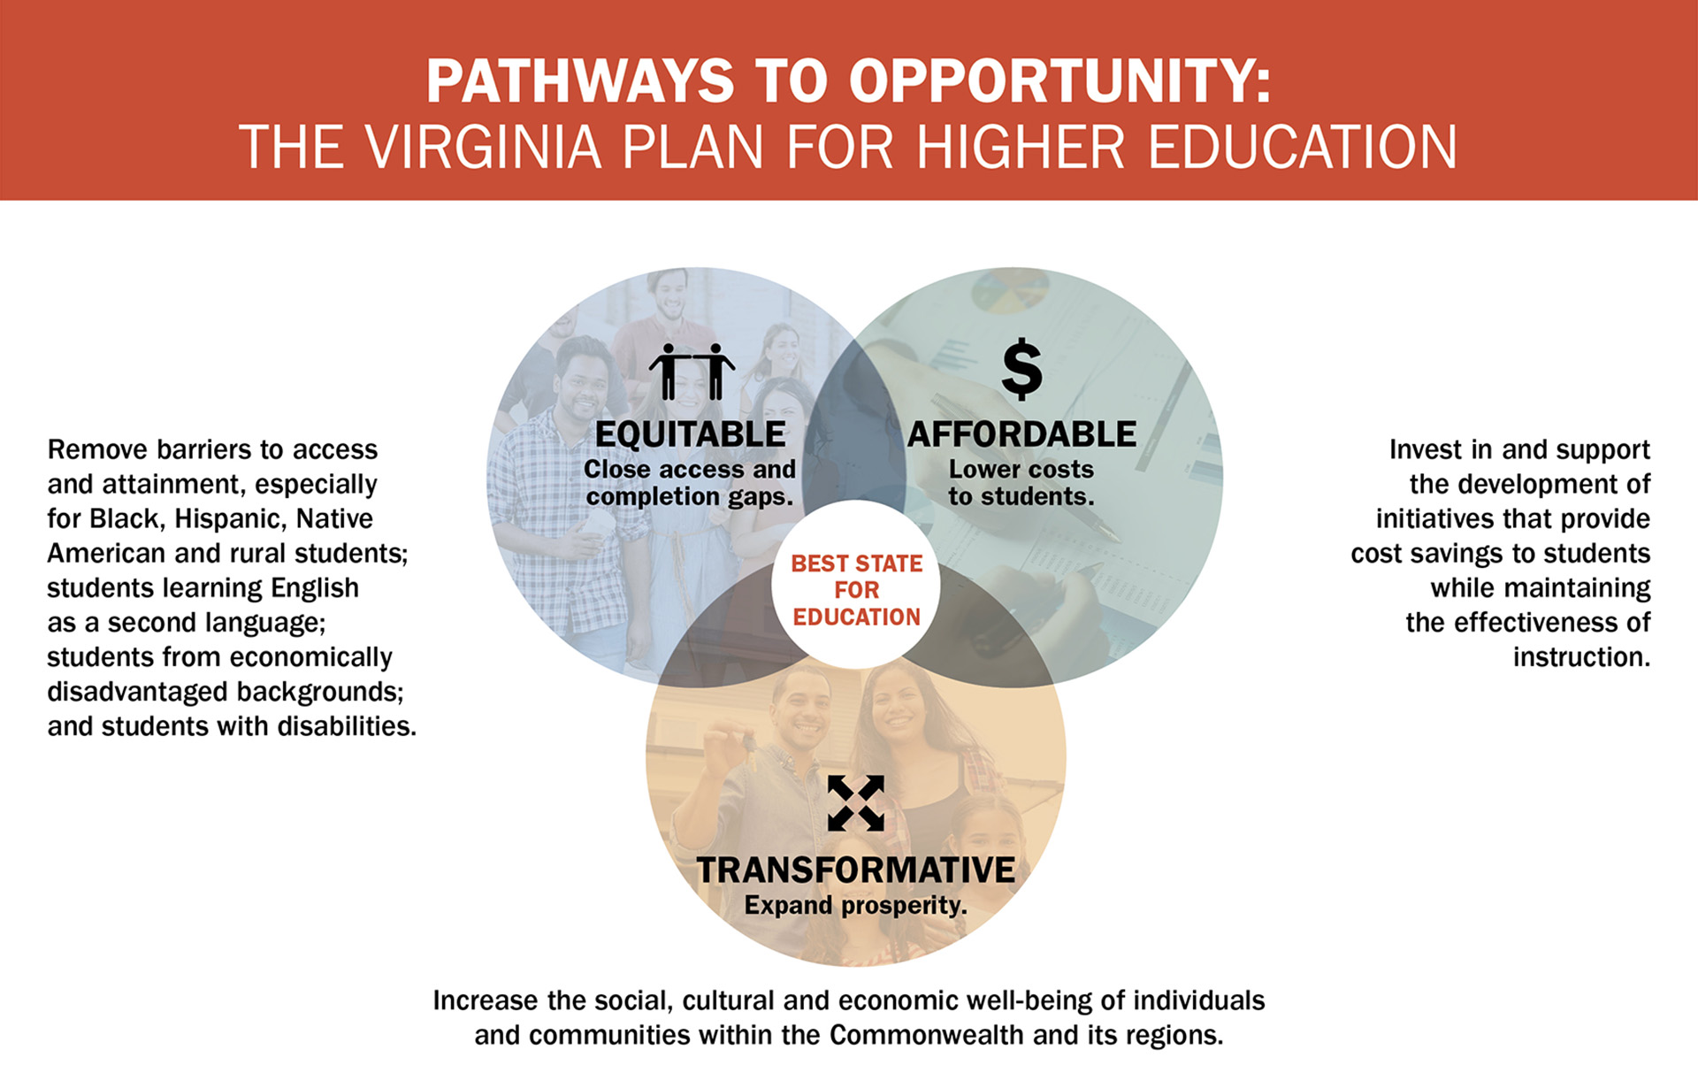
The Virginia Plan (2020)

Slide 11
Most employers under the age of 40 are much more “likely to consider hiring a graduate” with community-based experience.
 | Much more likely
 | All employers | Employers under 40 | Employers 50 & up
Internship or apprenticeship | 49% | 51% | 43%
Working in community settings with people from diverse backgrounds or cultures | 47% | 53% | 34%
Community-based or service-learning project | 41% | 54% | 20%
Source: Finley, A. (2021). How college contributes to workforce success: Employer views on what matters most. AAC&U.

Slide 12
Younger employers consider different skills and mindsets to be “very important” for college graduates.
Source: Finley, A. (2021). How college contributes to workforce success: Employer views on what matters most. AAC&U.

Slide 13
June 2022 “Day of Dialogue”

Slide 14
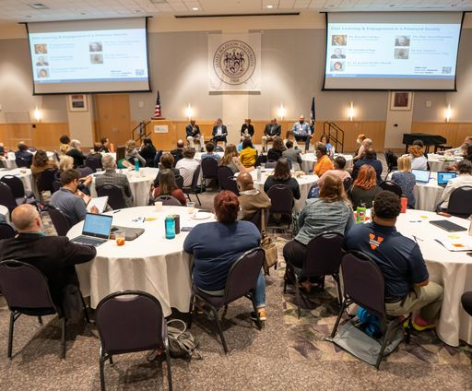
Day of Dialogue: June 2, 2022
Panels
Facilitated breakout discussions
Informal networking
Photo credit: JMU University Marketing & Branding

Slide 15
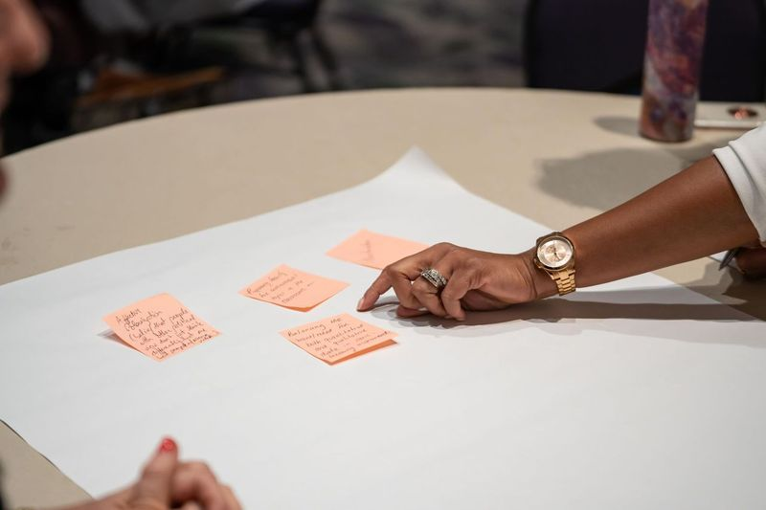
Keep in mind…
This was not designed as a research study.
The findings may not surprise you.
Photo credit: JMU University Marketing & Branding

Slide 16
General Observations
Energy around debate → discussion → dialogue
Actors: “The institution” vs individuals within the institution
Relationships:
Surrounding community
Faculty/Staff
The institution
Students
Notes:
“Dialogue” encompasses skills like active listening and structures like deliberative dialogues, courageous conversations, etc.

Slide 17
Challenges/Barriers
Silos/Lack of communication
Between institutions
Within institutions
Between higher ed & K12

Slide 18
Challenges/Barriers (cont.)
Lack of trust
Among students
Between faculty/staff & students
Between faculty/staff & administrators
Between institutions & local communities
Between institutions (including faculty/staff) & the public

Slide 19
Challenges/Barriers (cont.)
Inconsistent attention
Faculty/staff/administrator turnover
Competing priorities, burnout
Insufficient capacity
Money, staffing, time
Skills, confidence
Unclear definitions

Slide 20
Opportunities/Actions
Create regular opportunities for talking, sharing, collaborating
Embed civic learning/engagement into culture, curriculum & programs
Provide resources & recognition
Develop skills among faculty/staff as well as students – people need models

Slide 21
SCHEV’s goals:
Identify, support and leverage work being done by others at national, state and institution levels.
Fill in the gaps where we can.

Slide 22
(Possible) Next Steps

Slide 23
Constructive Dialogue Institute: Perspectives
Goal: To equip students with practical skills for navigating conversations across differences
Online educational program, free for classroom use
8 online modules, option for peer-to-peer conversations
Campus cohort model
Large-scale implementation, multiple campuses
Cross-institutional sharing and support
Assessment/Research built in

Slide 24
Civic Evidence Project
Run by AAC&U, VALUE Institute
Assessment using authentic student work
100 artifacts per institution
Faculty development & training
Institution- and state-level reporting
$6,000 per participating institution (possible funding support from Lumina Foundation)

Slide 25
Questions/Discussion

