Slide 1
Discussion of Student Enrollment Trends
September 19, 2022
Resources and Planning Committee

Slide 2
Overview
Enrollments in higher education have been declining since 2010.
Virginia enrollment trends and projections are similar to national trends and projections, regardless of changes in the magnitude of enrollment.
In Virginia, the percentage of male first-time in college (FTIC) students in four-year institutions has been ~45% since 1992 and ~47% at two-year colleges.
Women are responding to clear economic signals by enrolling in college.
Virginia institutions deploy a variety of male-targeted admission programs, generally focused on under-represented groups.
SCHEV staff are involved through GEAR-UP, The Virginia Plan for Higher Education and joint efforts with VDOE.

Slide 3
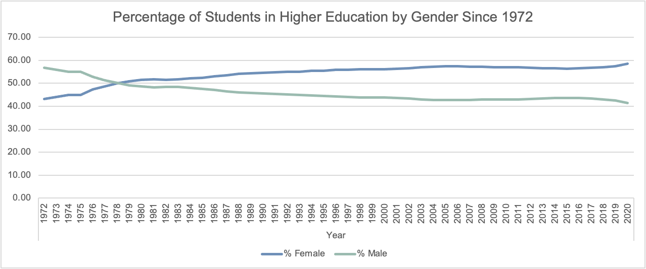
Enrollment by Gender in the U.S.
All students, all levels, all institutions

Slide 4
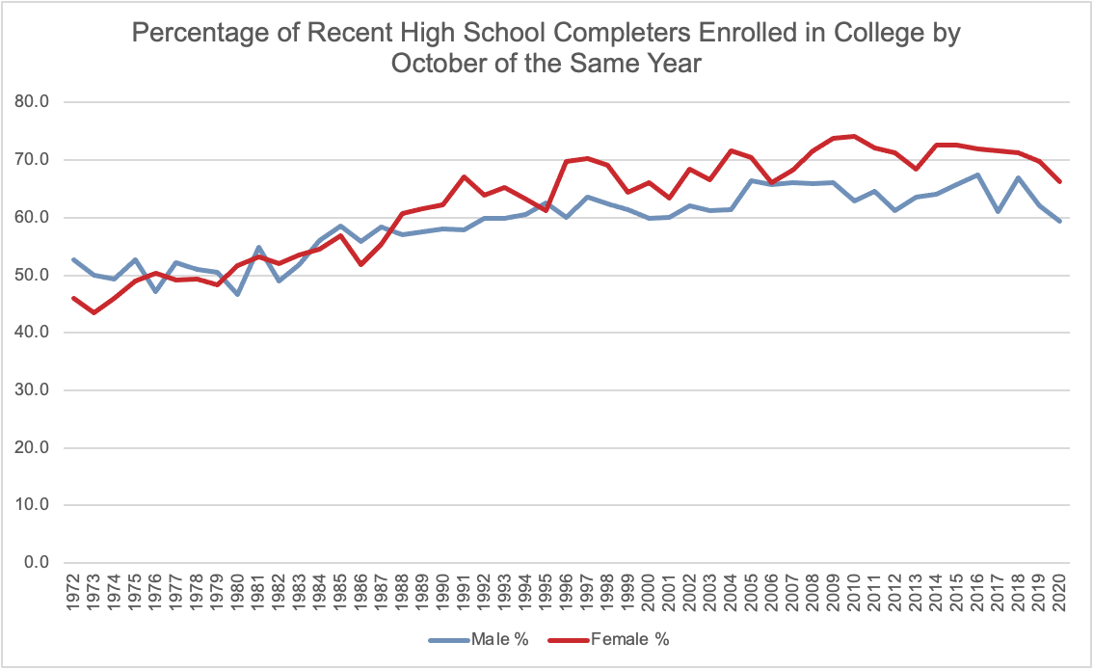
H.S. Grads Going Directly to College

Slide 5
Virginia Undergraduates By Gender

Slide 6
Men, FTIC at Two-years, Trend

Slide 7
Men, FTIC at Two-years, by Race/Ethnicity

Slide 8
Men, FTIC at Four-years, Trend

Slide 9
Men, FTIC at Four-years, by Race/Ethnicity

Slide 10
Retention to Year 2, Two-year Colleges

Slide 11
Retention to Year 2, Four-year Insts.

Slide 12
Examples of Institutions’ Efforts
Institution | Program | Goal/Focus
George Mason | Black Male Success Initiative | Increase retention and completion; foster a supportive environment addressing the needs and challenges facing black males
Hampton | HOPE (Hampton Opportunity Program for Enhancement) | Admit Black males who have potential for college, but do not meet the full academic requirements
Longwood | Call Me Mister (Men Instructing Students Toward Effective Role Models) | Increase representation of males in Virginia’s teaching force
Old Dominion | B2B (Brother to Brother) | Provide peer mentoring to assist men of color to excel
Southside Virginia | Make It Happen | Recruitment and retention of Black males
University of Virginia | BMI (Black Male Initiative) | Increase the academic and social success of Black males through more interaction and dialogue between Black male students, faculty, staff and alumni
Virginia Commonwealth | MOC (Men of Color) Initiative | Enrollment, student success, and post-graduate outcomes for Black and Latino males
Virginia State (with Virginia Union) | RVA Men Teach | Residency program for minority male teachers in Richmond
Virginia Tech | Black Male Excellence Network | Increase student success and alumni engagement of Black males

Slide 13
Examples of SCHEV’s Efforts
A shared position with the Virginia Department of Education focused on postsecondary access and success
GEAR UP Virginia (Gaining Early Awareness and Readiness for Undergraduate Programs): a seven-year, $24.7 million federal college-access grant. Targeting over 8,000 students in Virginia’s highest-need middle and high schools
The 1-2-3 Go! statewide access campaign: -- College Nights in Virginia (college planning events); -- Virginia College Application Week (hands-on college application assistance; -- Super FAFSA Project (hands-on FAFSA completion assistance); and -- Go! Decision Day (a day to make and celebrate post-high school decisions)
Level Up Virginia: a free online resource for students, HS staff and access providers to support college and career advising
Professional development through the Virginia College Access Network
Campus Visit Pilot Fund: aimed to increase the presence of middle school students (grades 6-8) from low income communities on college campuses
FAFSA Completion Project: sharing individual-level data with access providers and schools to increase FAFSA completions
Additional FAFSA-completion offerings, such as simultaneous FAFSA/VASA application and tax assistance events, and virtual one-on-one FAFSA/VASA application assistance

Slide 14
Societal Shifts in College Participation

Slide 15
Economic Reasons
 | Male Hourly Wage | Difference in the Female Hourly Wage Relative to the Male Wage
Those with Only a High School Diploma | $11.93 | -24.4% [$9.02]
Difference in Wage for Those with an Associate Degree, Relative to Those with a HS Diploma | 22.3% [$14.59] | 5.3% [$15.36]
Difference in Wage for Those with a Bachelor’s Degree, Relative to Those with a HS Diploma | 62.2% [$19.35] | 5.3% [$20.38]
SOURCES: St Louis Federal Reserve Bank article, 2015 ACS data and authors’ calculations.

Slide 16
Closing
The percentage of male first-time in college students in Virginia four-year institutions has been ~45% since 1992 and ~47% at the two-year colleges.
Virginia’s trends are like national trends and projections, regardless of changes in the magnitude of enrollment.
Women are responding to clear economic signals by enrolling in college.
Institutions offer a variety of programs, generally focused on men from under-represented groups.
SCHEV staff are involved through Access & Success initiatives, the statewide strategic plan and joint efforts with VDOE

Slide 17
Next Steps
Continue to monitor gaps in enrollment and attainment through the statewide strategic plan’s Progress Tracker.
Pursue further study into the choices made by high school students and graduates (surveys, focus groups).
Develop a better picture of Virginia’s entry points into the workforce after high school and where postsecondary education plays a role.

