Slide 1

Virginia Office of Education Economics (VOEE) Data Activities
Beaver Dam Farm,
Roanoke Region
September 20, 2022

Slide 2
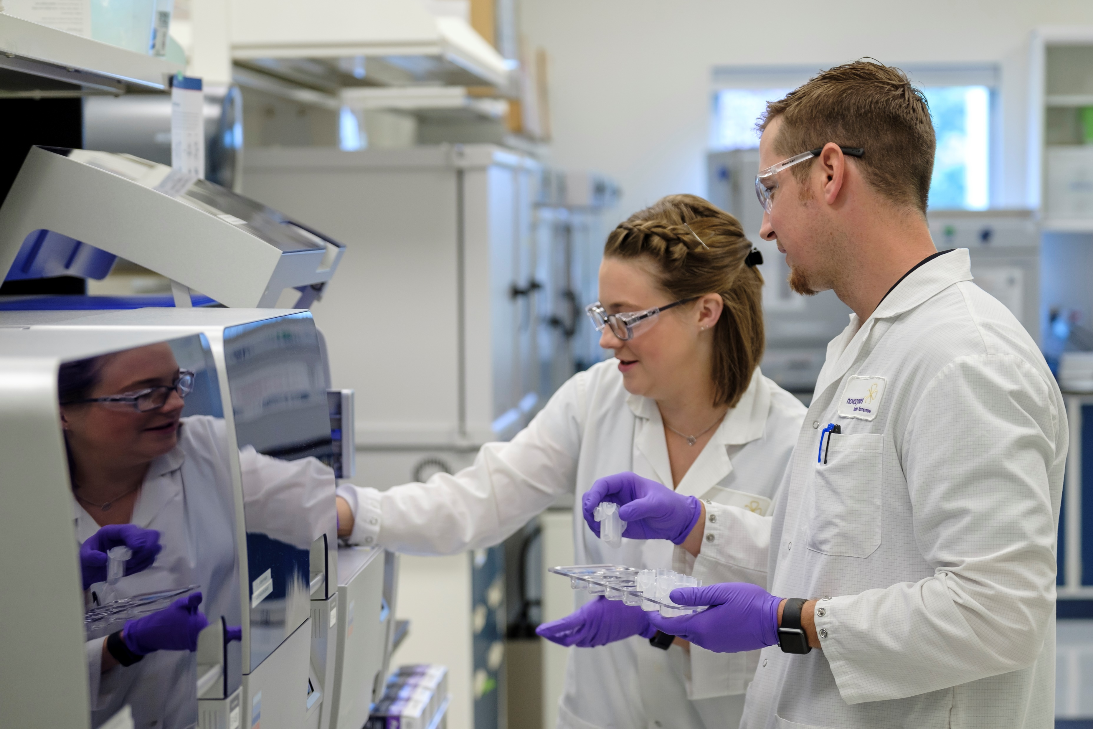
What we Do
In January 2021, SB1314 created the new office of education and labor market alignment at VEDP, with two complementary functions:
    Provide a unified, consistent source of analysis for policy development and implementation related to talent development
    Offer resources and expertise related to education and labor market alignment
  We work closely with key partners to accomplish our mandate. VOEE’s key partners include the Virginia Dept of Labor, the Virginia Secretariat of Commerce & Trade, SCHEV, Higher education institutions, Virginia Dept of Education, Virginia Employment Commission, GO Virginia, Virginia Board of Workforce Development, and other workforce partners
Novozymes

Slide 3
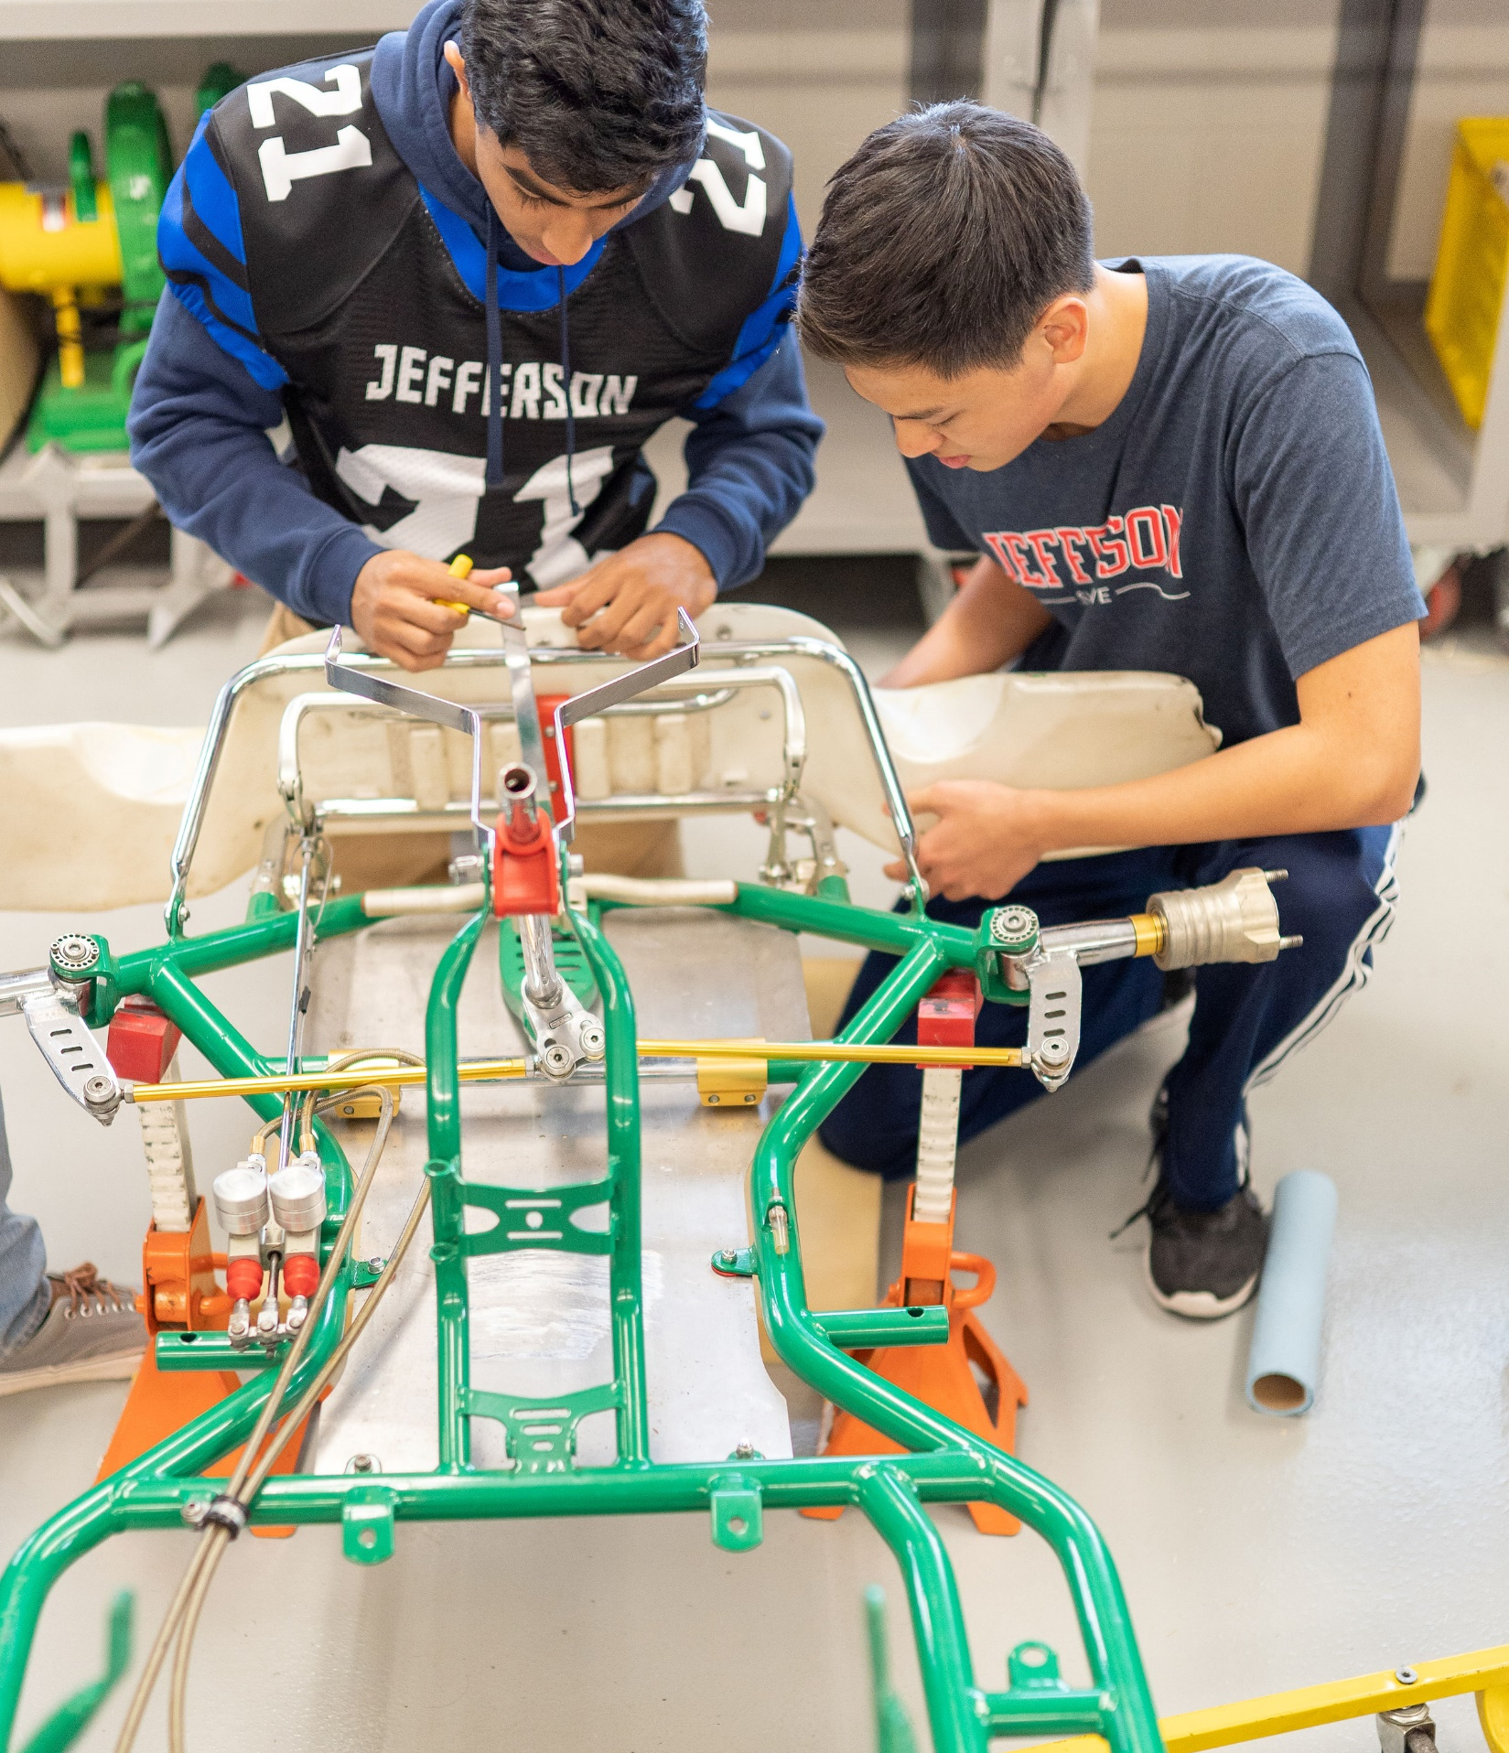
VOEE WILL ENABLE VIRGINIA TO TACKLE AMBITIOUS CHALLENGES, AS A NATIONAL LEADER ON A NUMBER OF FRONTS
    Credible and consistent labor market data and analysis to inform policy decisions
    Data on state and federal programs for workforce development and education
    More sustainable funding models for education (e.g., including more performance-based higher education funding components)
    Transparent, skills- and competency data
    Improve career navigation to better guide Virginians through the complex education / training / job landscape
Thomas Jefferson High School for Science and Technology

Slide 4
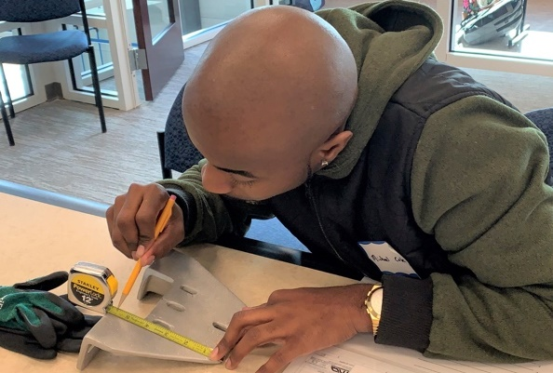
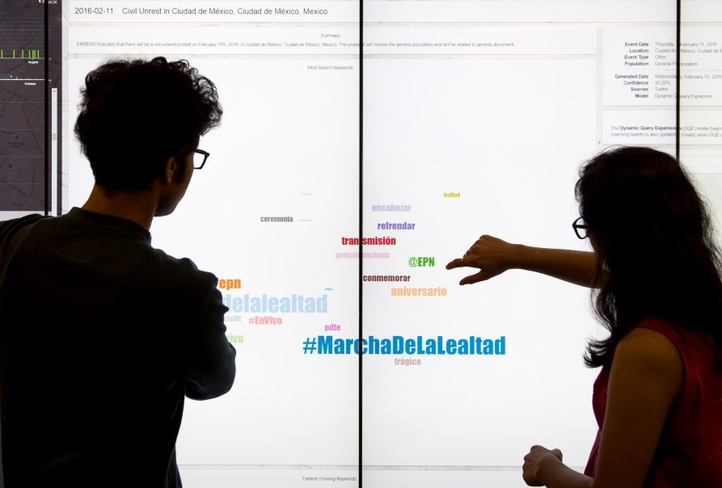
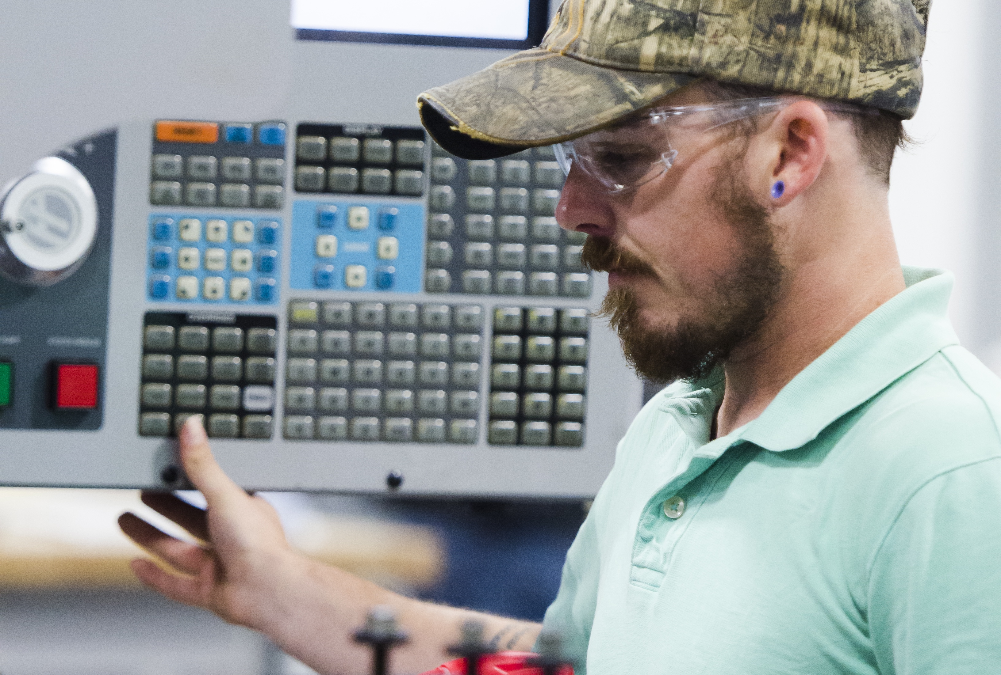
Current Areas of Focus
Virginia State-Wide Supply-Demand Comprehensive Labor Market Data Analysis​
Virginia Skills Initiative
Other Activities: Virginia Infrastructure Academy, Career Navigation, Legislative Mandates

Slide 5
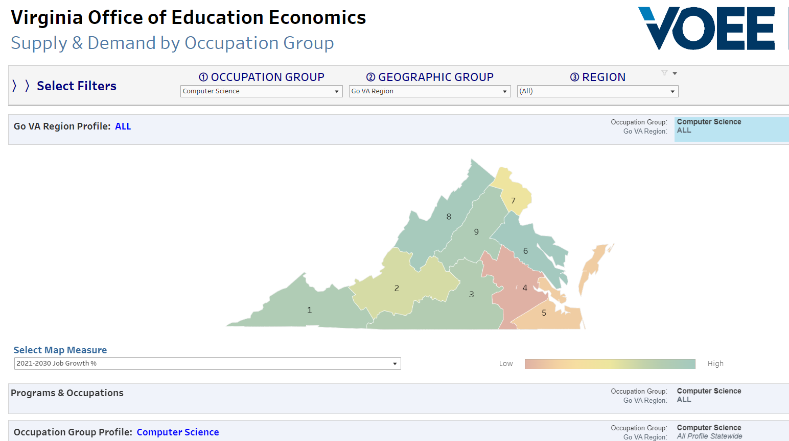
Graduate Supply Demand Dashboard

Slide 6
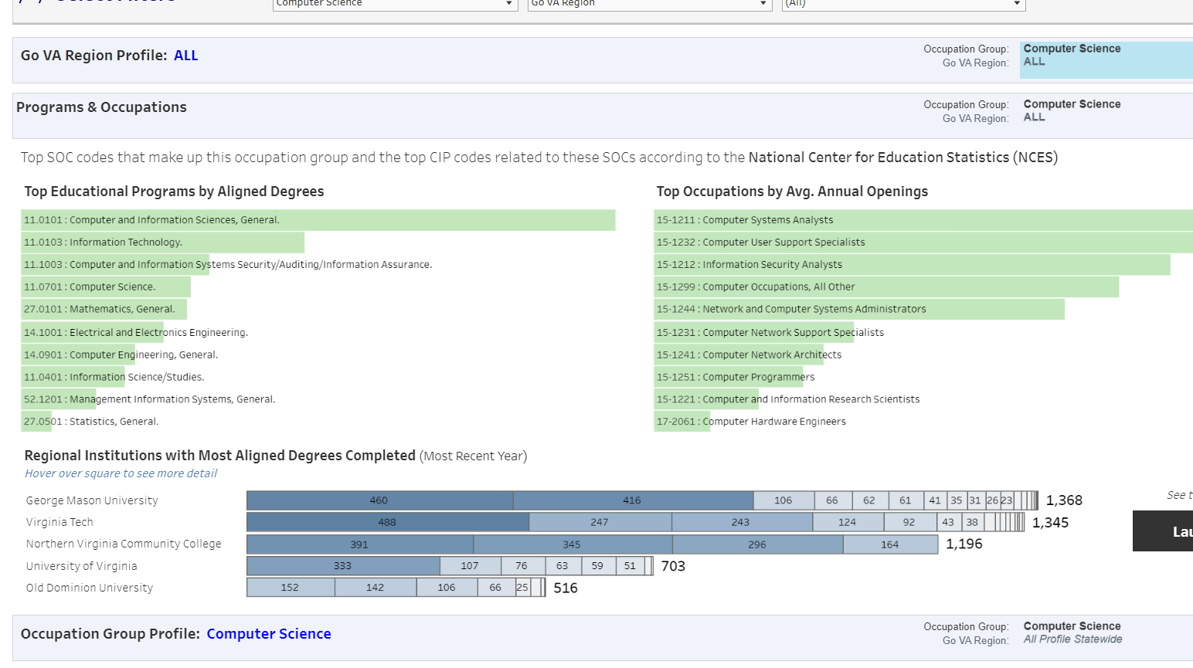
Graduate supply demand dashboard

Slide 7
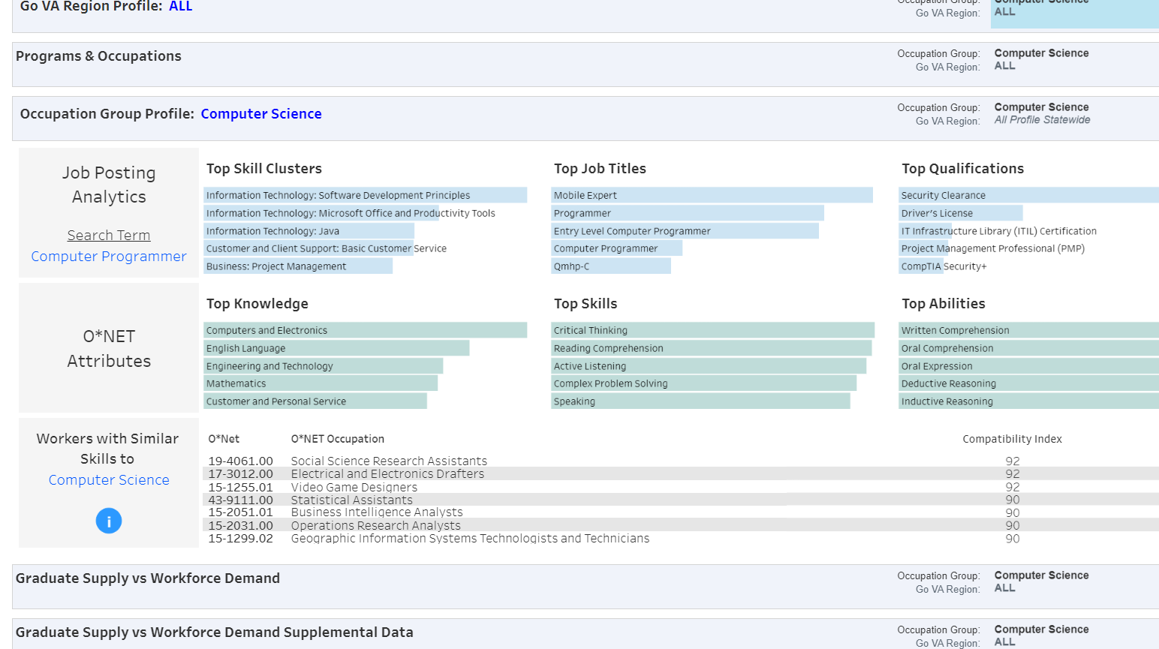
Graduate Supply Demand Dashboard

Slide 8
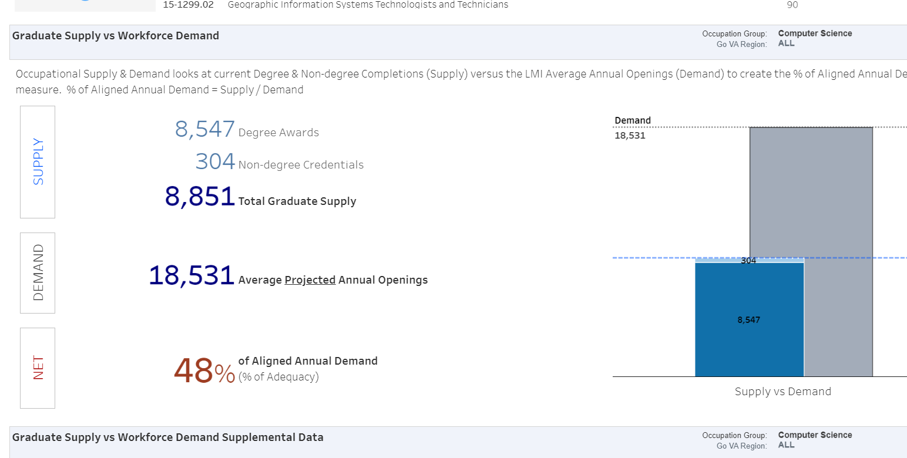
Graduate Supply Demand Dashboard

Slide 9

VIRGINIA SKILLS & COMPETENCIES Data SETs
With dollars through the Workforce Investment and Opportunity Act and in partnership with SCHEV and VCCS –
VOEE will develop two new data sets on skills for Virginia:
  ALUMNI TRACKING: Track up to 8 years of graduates from Virginia higher education institutions through social media profiles to collect data on:
    Occupation/s
    Location
    Skills
    Non-degree credentials
  EDUCATIONAL PROGRAMMING: Work with institutions to develop a Virginia specific data set on skills and competencies taught in credit and non-credit programs throughout Virginia.
Virginia Highlands Community College

Slide 10
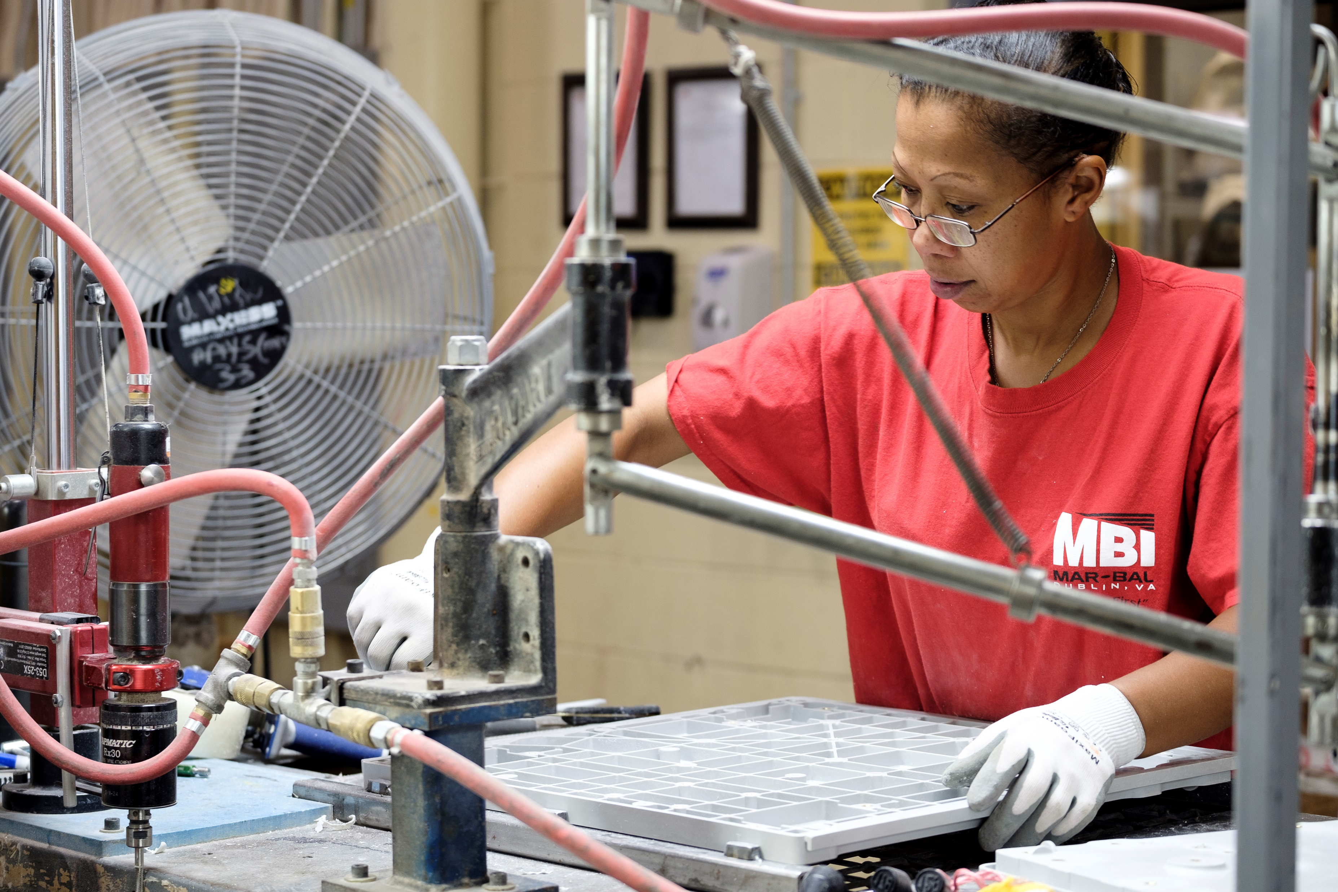
Other Research Activities
Career Navigation in K-12
OECD is beginning research in Virginia in September to examine best practices in career navigation and make recommendations
Virginia Infrastructure Academy
Great partnership with VCCS
Example of how VOEE can help with labor market information for projects
Mar-Bal, Inc.

Slide 11
VOEE’s new initiatives from the 2022 General Assembly Sessions (1 of 2)
 | Initiative (Item) | Description | Conference Report ($M)
 |  |  | FY22 | FY23 | FY24
VEDP | Offshore Wind/Maritime Talent Attraction Study (125 #9c) | Complete a study of strategies to attract skilled out-of-state talent to fill maritime jobs in Hampton Roads in support of the shipbuilding, ship repair, and offshore wind industries by 11/1/22 |  | 0.2
DHCD | GO Virginia Talent Pathways Planning (114 #1c/115 #3c) | Provides grants to GO Virginia regions to identify business needs for workers in strategic industries. DHCD shall work with VOEE to make recommendations. VOEE shall provide analytical support to regional councils. The language continues in the biennium for any unspent one-time funds | 2.5 | Lang. | Lang.
DOLI | Apprenticeship Data to Virginia Office of Education Economics (364 #1c) | Directs the Office of Registered Apprenticeship to provide data to the Virginia Office of Education Economics on or before December 31, 2022, and quarterly thereafter |  | Lang. | Lang.
VCCS | G3 Missing Language (213 #1c) | Adds language that VOEE shall evaluate the skills and training needed for Virginians to fill jobs available in certified regional council areas. Based on the evaluation, VOEE will make recommendations to the Governor and GA what programs should be offered in each region that qualify for financial assistance under the G3 Program |  | Lang. | Lang.
Central Approps. | Workforce Development (487.50 #1c)¹ | Provides funding to support workforce development programming across Virginia including: $3M in FY23 and $10M in FY24 for the Innovative Internship Fund and Program at SCHEV, $8M in FY23 for G3 Innovation Grants at VCCS in collaboration with VOEE, and $2.5M for Advanced Manufacturing Talent Investment Program and Fund pilot at VEDP |  | 16.0 | 17.0
  Corresponds to SB667 (Hashmi) and HB565 (O’Quinn)/SB685 (Mason). See next slide

Slide 12
VOEE’s new initiatives from the 2022 General Assembly Sessions (2 of 2)
 | Initiative (Item) | Description | Conference Report ($M)
 |  |  | FY23 | FY24
VEDP | HB217 (Simonds) VOEE; required to review federal occupational categories | Requires VOEE to review the occupational categories in the U.S. Bureau of Labor Statistics' to determine occupational categories not captured in the Commonwealth's existing STEM+C workforce profile and the gaps in the Commonwealth's tracking of careers in these occupational categories for the purpose of better aligning K-16 education priorities; Report to GA 10/1/22
VEDP | HB565 (O’Quinn)/SB685 (Mason) Advanced Manufacturing Talent Investment Program and Fund (Item 487.50 #1c) | Creates the Advanced Manufacturing Talent Investment Program and Fund to assist qualified institutions in reaching a goal of increasing by at least 25,000 new eligible credentials, which are noncredit workforce credentials awarded by a qualified institution in a high demand advanced manufacturing field as identified by VEDP |  | 2.5
SCHEV | SB667 (Hashmi) Innovative Internship Program; Virginia Office of Education Economics (Item 487.50 #1c) | Directs the State Council of Higher Education for Virginia to partner with the VOEE to collect and utilize data that includes the gaps that are most significant in hindering the Commonwealth from achieving its goals that its funds are intended to accomplish under the Innovative Internship Program, and provides other directives to the Council and VOEE to collaborate on and accomplish for the Innovative Internship Program | 3.0 | 10.0
Workforce Dev. Board | HB718 (Filler-Corn)/SB661 (Lucas) Apprenticeship program; Bd. of Workforce Development to prepare recs for primary office | Directs the Virginia Board of Workforce Development to collaborate with the Department of Labor and Industry, the Department of Education, and the Secretaries of Labor, Education, and Commerce and Trade and rely on data from the Office of Education and Labor Market Alignment in reviewing the performance of current apprenticeship programs in meeting high-demand industry needs.
DOE | HB1299 (Coyner)/ SB738 (Morrissey) High school students; instruction concerning post-graduate opportunities | Requires the DOE to collect and distribute to public schools and publicly post on its website information that assists high school students in making more informed decisions about their futures after graduating from high school and in doing so ensure that such students are aware of the costs and benefits of different educational and certificate programs. The bill directs the Department to annually collect and compile such information in consultation with the SCHEV and any other entity that can assist the Department with collecting and compiling such information and to update its distribution materials accordingly each year.

Slide 13
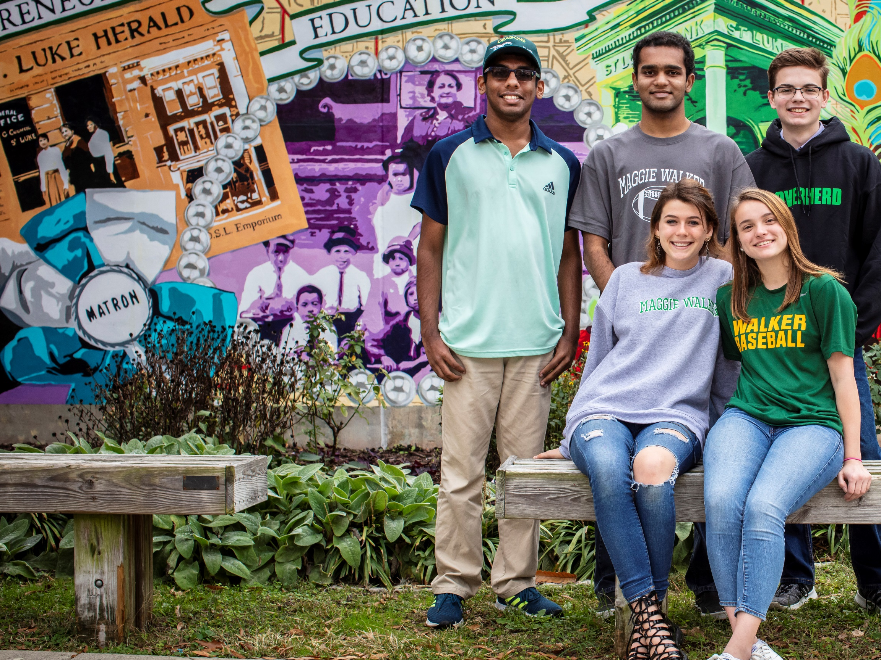
Questions? Get in touch
Heather McKay
Executive Director
hmckay@vedp.org
Maggie L. Walker Governor’s School, Richmond

