Slide 1

Cover Slide

Slide 2
Agenda
Background
Purpose
Goal
Resources Developed for:
    Student Readiness
    Employer Readiness
    Institutional Readiness
How to get involved

Slide 3
Virginia Talent + Opportunity Partnership
The Virginia Talent + Opportunity Partnership (V-TOP) is a formally-established collaboration between SCHEV and the Virginia Chamber of Commerce. V-TOP is funded through the Commonwealth Innovative Internship Fund ($5M in FY2023 and $12M in FY2024).
In 2020 and 2021, V-TOP convened six workgroups (over 200 members) to identify areas of emphasis, deliverables and a work plan to scale its efforts. Today, workgroups continue to emerge and support the initiative. These workgroups include members from public and private colleges and universities, executive agencies, non-profit organizations and the business community.
The Virginia Chamber Foundation maintains externally the V-TOP website (https://virginiatop.org), a freestanding online resource for students, employers, and institutions of higher education.

Slide 4
Virginia Talent + Opportunity Partnership: Connecting Students to Work-Based Learning Statewide
Grants to institutions to expand paid and credit-bearing student internships and other work-based learning opportunities in collaboration with Virginia employers.
Statewide initiative to facilitate the readiness of students, employers, and institutions of higher education to participate in internship and work-based learning.
V-TOP’s Purpose is grounded in statute.

Slide 5
Virginia Talent + Opportunity Partnership: Connecting Students to Work-Based Learning Statewide
Goal
One goal of the statewide V-TOP initiative is to retain students in the state after graduation to contribute to the goal that 70% of the adult population have a post-secondary credential by 2030, which will help ensure the availability of talent for companies.
Big goal: 100,000 new internship slots by 2033

Slide 6
Virginia Talent + Opportunity Partnership
MAKING VIRGINIA THE TOP STATE FOR BUSINESS, EDUCATION AND TALENT

Slide 7
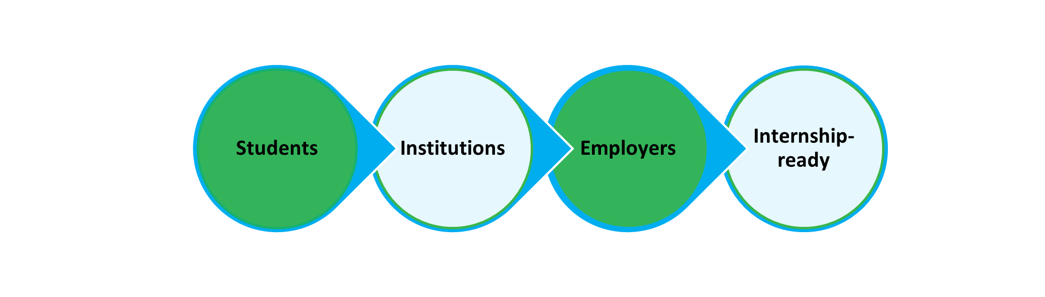
Virginia Talent + Opportunity Partnership
TOP State for Talent
Distinguish the Commonwealth of Virginia as the leading state for higher education and talent pathways
Most internship-ready students, employers, and institutions of higher education
Goal drafted by a workgroup of the Council of Presidents: Every student enrolled at a Virginia institution of higher education will have an opportunity to graduate with a paid, employment-based, authentic, applied learning experience.

Slide 8
V-TOP Regional Collaboratives
Resources at the State Level are Directed to the Regions
Region 1: Bristol, Galax, Wise
UVA-Wise – Recently awarded
Region 2: Roanoke, Blacksburg, Lynchburg
VT – Quina Weber-Shirk, Project Manager
  quina@vt.edu Regional Internship Collaborative
Region 3: Mecklenburg, Halifax, Danville
In progress
Region 4: Richmond, Chesterfield, Dinwiddie
Sean Walden, V-TOP Coordinator, RVA Collab
  swalden2@vcu.edu
Salisa Nolan, Program Manager, RVA NOW
  salisa.nolan@chamberrva.com
Region 5: Chesapeake, Norfolk, Virginia
ODU – Michelle Simmons, Project Manager mysimmon@odu.edu 757 Regional Internship Collaborative
Region 6: Fredericksburg, Middle Peninsula, Northern Neck
UMW – Recently awarded
Region 7: Alexandria, Arlington County, Fairfax
NOVA – Recently awarded
Region 8: Buena Vista, Harrisonburg, Shenandoah
JMU – Recently awarded
Region 9: Culpeper, Rappahannock, Charlottesville
UVA - Maeve Konouck, V-TOP Project Coordinator
  mek4ea@virginia.edu
V-TOP Regions

Slide 9
V-TOP Regional Collaboratives
Regional Collaborative
Concept:
Funds one or two people who are responsible for thinking every day about how to:
Identify and link existing work-based learning activities
Present those opportunities to employers
Support employers
Support students
Required Partners
Model:
GO VA regions
PK-12
Public and private colleges and universities
Regional chambers of commerce
Economic development partnerships
Industry groups
Employers
Other relevant organizations which will vary by region
V-TOP Regions

Slide 10
Virginia Talent + Opportunity Partnership
Resources
Statewide initiative to facilitate the readiness of students, employers, and institutions to participate in internship and work-based learning (Va. Code § 23.1-903.4).
Student Readiness:
  Launched student career-readiness modules (free, online resources)
  Secured proclamation by Governor Youngkin of July 28, 2022, as Virginia Intern Day
Employer Readiness
  Launched employer readiness modules (free, online resources)
  Awarded Regional Collaborative Grants to eight regions (up to $250,000 over two years); award grants to one remaining region (in progress)
  Procured staffing agency for small businesses
  Allocate the matching funds to employers during summer internships (in progress)
Institutional Readiness
  Awarded Vision Grants to eight institutions ($25,000 each); award additional grants (in progress)
  Developed a Federal Work-Study toolkit
  Award the first grants to institutions to transform Federal Work-Study into internships [allocated funds in the amount of $630,0000 for FY 2023 and $930,000 for FY2024] (in progress)
  Complete the work for the Council of Presidents Workgroup on Data Governance (in progress)

Slide 11
Virginia Talent + Opportunity Partnership
Resources to Support Students
Statewide initiative to facilitate the readiness of students, employers, and institutions to participate in internship and work-based learning (Va. Code § 23.1-903.4).
Student Readiness:
  Launched student career-readiness modules “Developing Career Readiness Skills” (free, online resources).
  Secured proclamation by Governor Youngkin of July 28, 2022, as Virginia Intern Day.
  Complete online internship toolkit modules to assist students on how to secure an internship (resume advice, interview skills, etc.) (in progress)

Slide 12
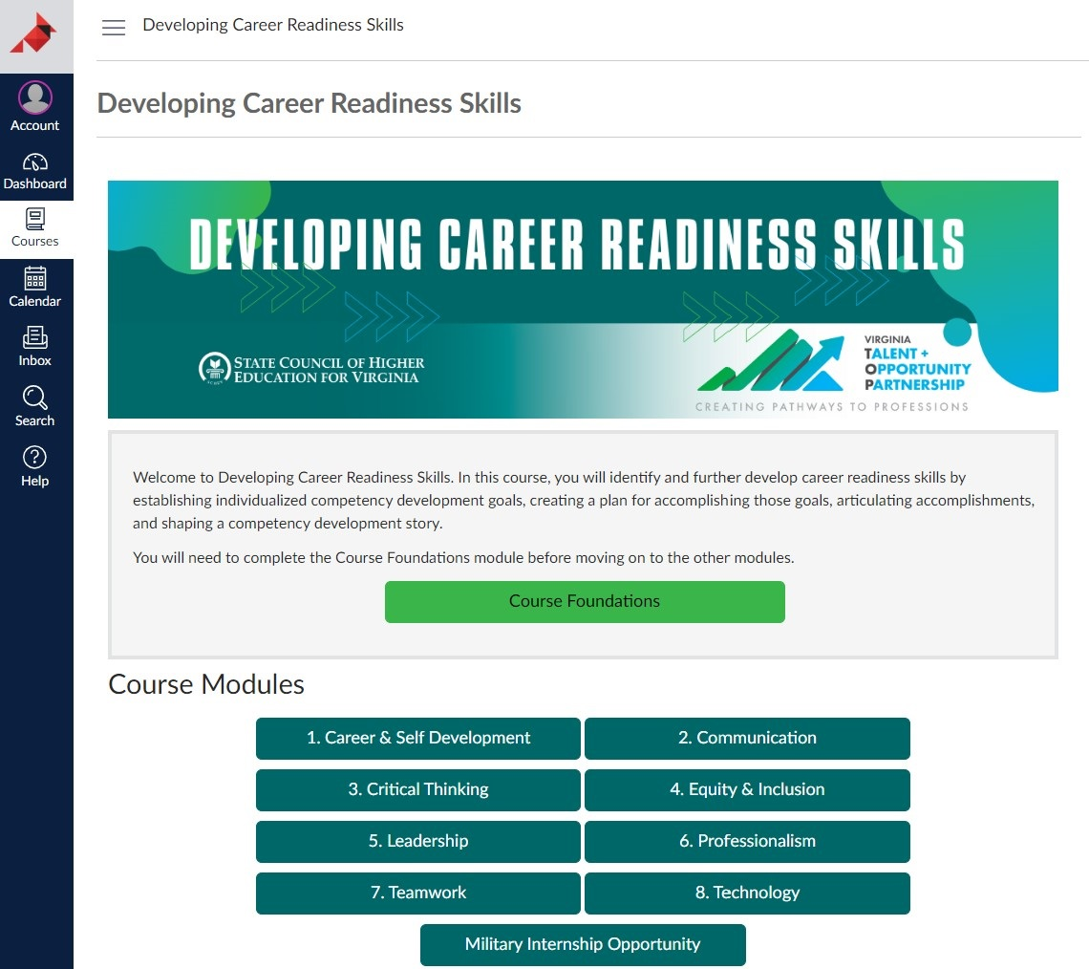
Virginia Talent + Opportunity Partnership
Resources to Support Students
Student Modules: Competency Development
The modules provide:
online training on career-readiness competencies
guided student reflection opportunities through iGROW with V-TOP
information through the Department of Veteran Services for service members preparing to transition into opportunities within VA

Slide 13
Virginia Talent + Opportunity Partnership
Resources to Support Employers
Statewide initiative to facilitate the readiness of students, employers, and institutions to participate in internship and work-based learning (Va. Code § 23.1-903.4).
Employer Readiness
  Launched an employer readiness toolkit
  Launched employer readiness modules: “Developing an Internship Program” (free, online resources)
  Awarded Regional Collaborative Grants to eight regions (up to $250,000 over two years)
  Procured staffing agency for small businesses
  Developed criteria and allocate the matching funds to employers (in progress)
  Facilitate and celebrate the second Virginia Intern Day – July 27, 2023

Slide 14
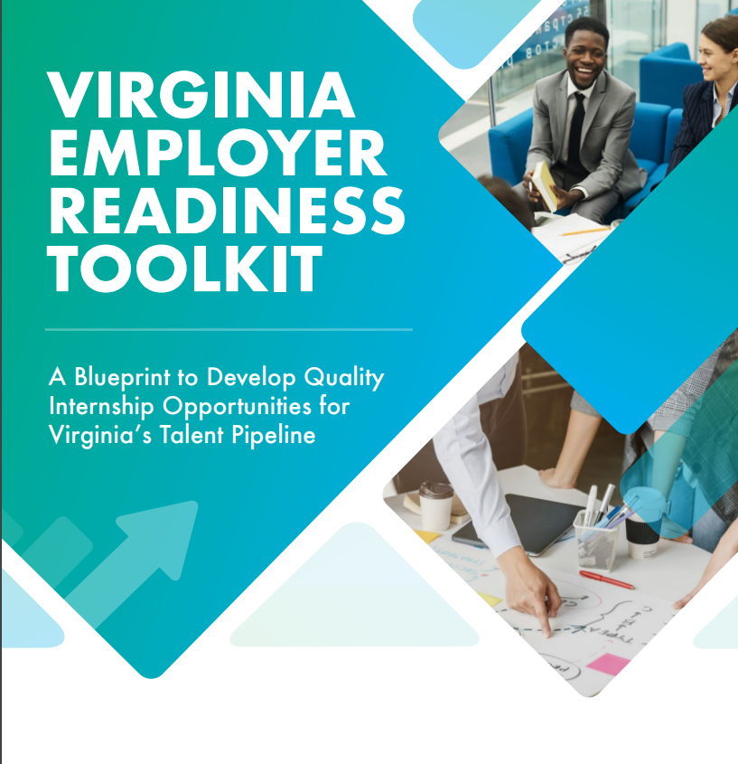
Virginia Talent + Opportunity Partnership
Resources to Support Employers
Employer Readiness Toolkit: Blueprint to Develop Quality Internship Opportunities
The toolkit is designed to:
build and expand internship and work-based learning opportunities;
provide information and resources to employers as they consider implementing internships; and
helps with the readiness of employers to host quality work experience for students
Access the Employer toolkit

Slide 15
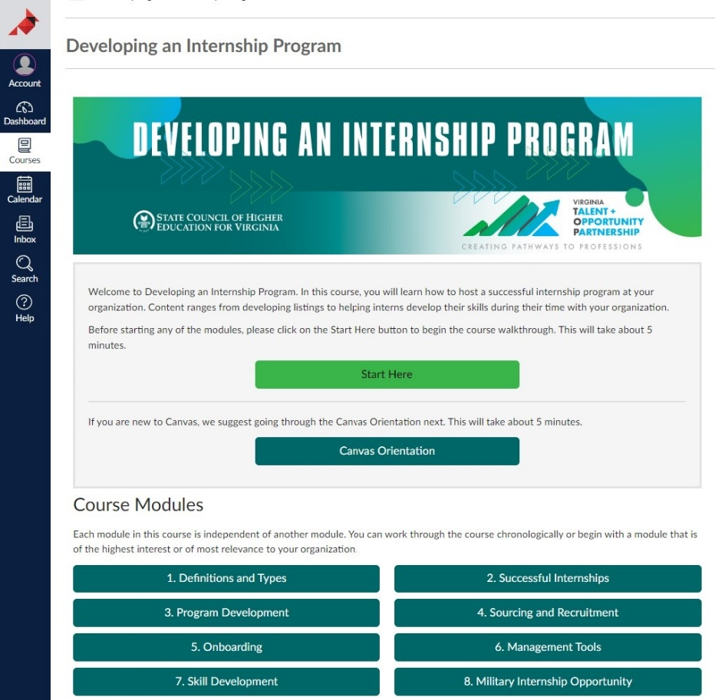
Virginia Talent + Opportunity Partnership
Resources to Support Employers
Employer Modules: Developing an Internship
The modules are designed for:
small businesses;
businesses just starting an internship program;
businesses with limited or no dedicated HR; and
businesses providing internships and work-based learning experiences for transitioning service members

Slide 16
Virginia Talent + Opportunity Partnership
Resources to Support Institutions
Statewide initiative to facilitate the readiness of students, employers, and institutions to participate in internship and work-based learning (Va. Code § 23.1-903.4).
Institutional Readiness
  Awarded Vision Grants to eight institutions ($25,000 each); award additional grants (in progress).
  Developed a Federal Work-Study toolkit.
  Awarded professional development scholarships to faculty and staff whose career involves expanding internship and work-based learning opportunities.
  Award the first grants to institutions to transform Federal Work-Study into internships [allocated funds in the amount of $630,0000 for FY 2023 and $930,000 for FY2024] (in progress).
  Design and launch “Career Champions” modules for faculty and staff who assist students with career planning (in progress).
  Complete the work for the Council of Presidents Workgroup on Data Governance (in progress).

Slide 17
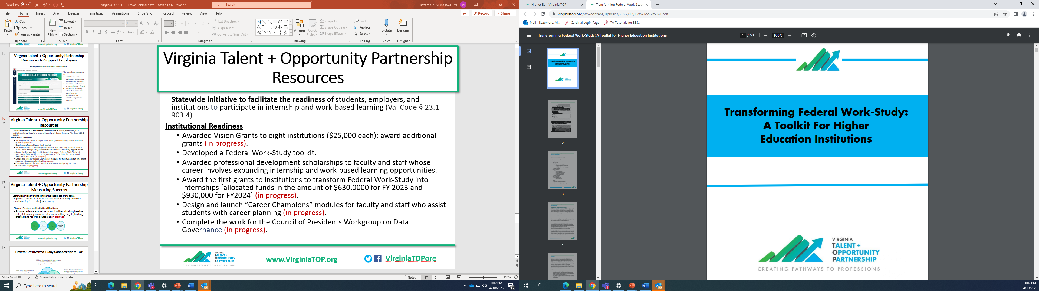
Virginia Talent + Opportunity Partnership
Resources to Support Institutions
Institutional Readiness Toolkit: Transforming Federal Work-Study
The toolkit is designed to:
provide information and resources to institutions as they consider transforming FWS jobs to be more like internships;
provide a framework to transform first and second-year experiences where learning outcomes are connected to career competencies vs. a degree program; and
help institutions modify current FWS programs to off-campus opportunities at nonprofits, state, and local government agencies

Slide 18
Virginia Talent + Opportunity Partnership
Measuring Success
Statewide initiative to facilitate the readiness of students, employers, and institutions to participate in internship and work-based learning (Va. Code § 23.1-903.4).
  Student, Employer and Institutional Readiness
  Procured external evaluators to assist with establishing baseline data, determining measures of success, setting targets, tracking progress and reporting outcomes (in progress).

Slide 19
How to Get Involved + Stay Connected to V-TOP
• Celebrate the annual Virginia Intern Day on July 27, recognizing interns
(Stay tuned for more information)
•Review the employer toolkit and ensure your internship program follows best practices
• Stay tuned for more information about support for small businesses and eligibility for matching funds for intern wages and other subsidies
• Subscribe to the V-TOP monthly newsletter
(on the Home page)
• Consider completing the employer and/or the student readiness modules
• Follow V-TOP on social media at VirginiaTOPorg
(FB & Twitter)

Slide 20
Contact Information
Alisha Bazemore Assistant Director for Innovative Work-Based Learning Initiatives AlishaBazemore@schev.edu
Lynn Seuffert Senior Associate for Strategic Planning and Policy Studies LynnSeuffert@schev.edu
Ashley Crute Associate for Innovative Work-Based Learning Initiatives AshleyCrute@schev.edu

