Slide 1
College and University Enrollment Projections
Tod R. Massa
Resources & Planning Committee
October 23, 2023

Slide 2
§ 23.1-203. 4. Duties of Council generally.
4. Review and approve or disapprove all enrollment projections proposed by each public institution of higher education. The Council's projections shall be in numerical terms by level of enrollment and shall be used for budgetary and fiscal planning purposes only. The Council shall develop estimates of the number of degrees to be awarded by each institution and include those estimates in its reports of enrollment projections. The student admissions policies for the institutions and their specific programs shall remain the sole responsibility of the individual boards of visitors; however, all four-year institutions shall adopt dual admissions policies with the community colleges, as required by § 23.1-907..

Slide 3
§ 23.1-304(C). Per student enrollment-based funding.
C. In order to assist the General Assembly in determining the per student amount provided for in subsection A and its relation to the per student amount provided to private nonprofit institutions of higher education pursuant to the Tuition Assistance Grant Act (§ 23.1-628 et seq.), each private nonprofit institution of higher education eligible to participate in the Tuition Assistance Grant Program shall submit to the Council its Virginia student enrollment projections for that fiscal year and its actual Virginia student enrollment for the prior fiscal year in a manner determined by the Council. The student admissions policies for the private institutions and their specific programs shall remain the sole responsibility of the governing boards of the individual institutions.

Slide 4
What does Council approval mean?
Approval for use by state entities for planning
Planning for new classrooms and other college facilities
Modeling of potential impact on institutional budget and student financial aid
Planning for state and local services
Estimating adequacy of educational opportunities for Virginians
Endorsement of the feasibility of the projections

Slide 5
Projections and IPS
The enrollment projections and degree estimates are used for many of institutional performance standards.
The metrics are focused on meeting 95% of the specific projections used.
There are no penalties for exceeding enrollment projections – by any amount.

Slide 6
Overall notes and trends
Total enrollment increase from 519K to 532k in 2029
Significant variance institutional projections of in-state FTIC from HS
Aggressive targets to increase FTIC enrollment at independent colleges
Increase in out-of-state distance undergrads by 10k, 6k at the public four-years

Slide 7
The process
Staff initiates the process in February of odd-numbered years
After consultation with Op-Six, SCHEV provides instructions to institutions, which include an assessment of the current environment
Institutions submit initial plans in May
The projections remain “draft” through the six-year planning process
Council approves projections in October

Slide 8
Public Four-year Notes
Overall decrease in in-state FTIC
Shift in undergraduate distance enrollment- 12k to 18k in-state
Undergraduate distance enrollment moves from 6.8% to 8.9% of total
Continuing students comprise 73% of annual undergraduate projections

Slide 9
Key findings and trends
We remain on track to meet The Virginia Plan goal to add a cumulative 1.5 million degrees and credentials by 2030
Council continues to estimate that, by 2030, 70% of Virginia’s working-age population will have an associate’s or bachelor’s degree or other relevant workforce credential

Slide 10
Other findings: four-year publics
Overall decrease in in-state FTIC enrollment (1.7% or 484 students)
Even split between institutions that project growth and those that project lower enrollments
Undergraduate “distance” enrollment increases from 6.8% to 8.9% of total
Continuing students comprise 73% of annual undergraduate projections

Slide 11
In-State, First-time in College (FTIC), All Institutions

Slide 12
In-State, First-time in College (FTIC), Public Four-year Institutions

Slide 13
Major Changes in Enrollment
There has been much focus on enrollment losses since 2012.
Such focus misses the 16% growth in in-state undergraduates from 2005 to 2012.
The public four-years that have decreased the most have also lost more than they gained leading to 2012.

Slide 14
Enrollment Changes

Slide 15
Admissions
Patterns in applications and admission mirror national trends.
Data are all specific to public four-year institutions in the following slides.

Slide 16
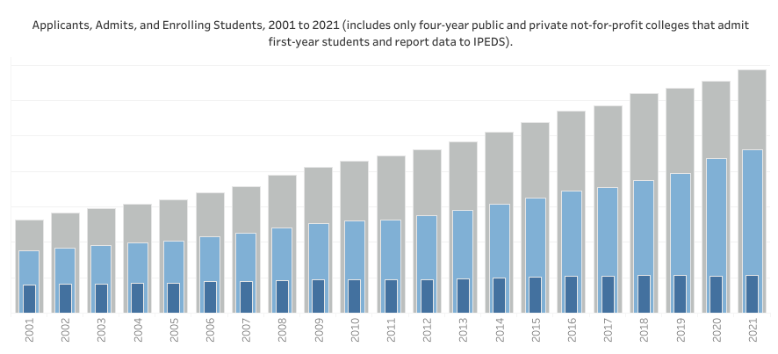
Nationally, Apps & Admits Rates Have Increased

Slide 17
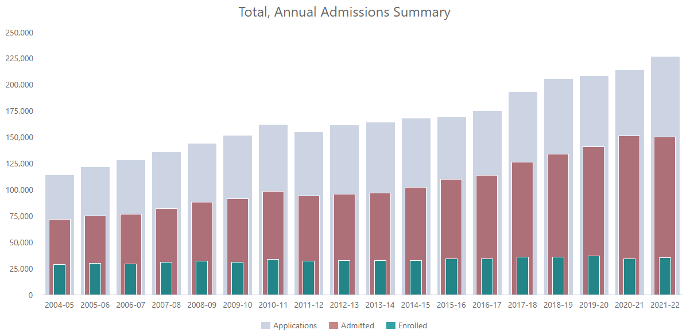
A Similar Pattern in Virginia (All Undergraduates)

Slide 18
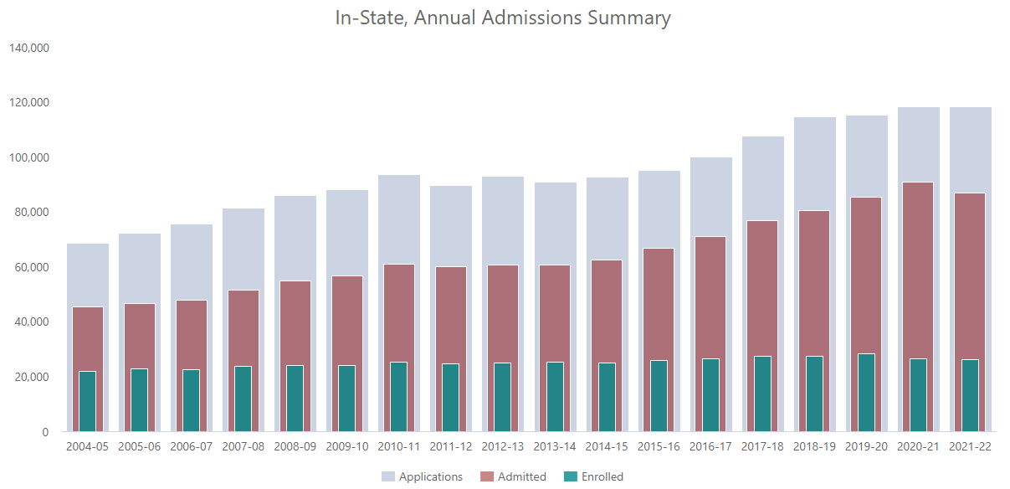
In-State Undergraduates

Slide 19
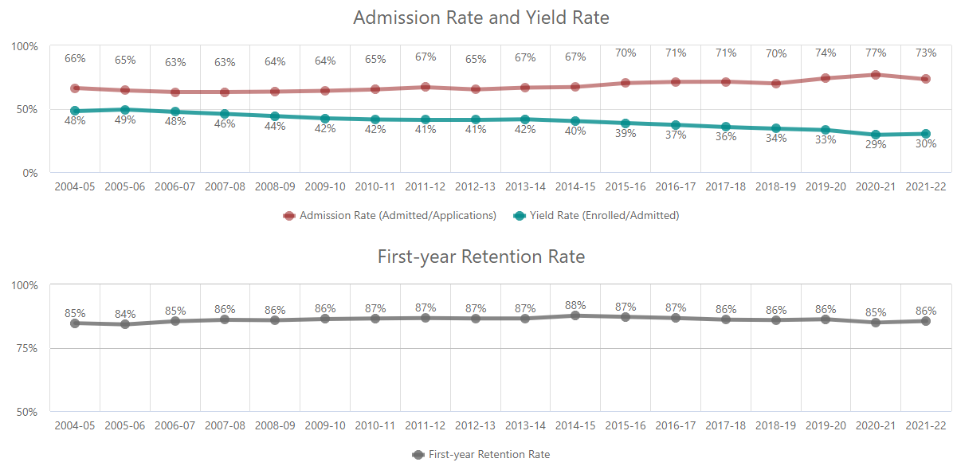
In-State Undergraduates at Public Four-years

Slide 20
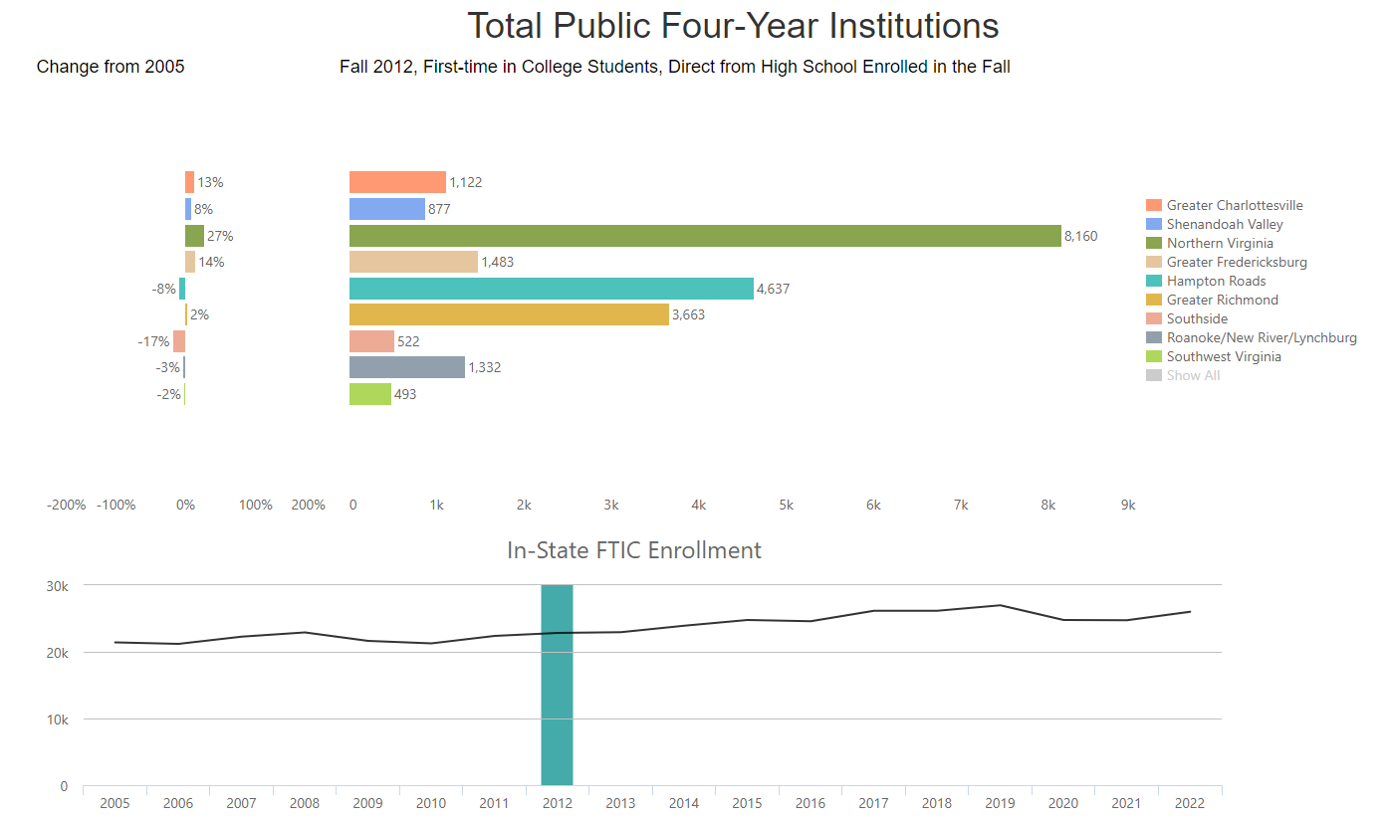
Growth by Student Origin, 2005 to 2012?

Slide 21
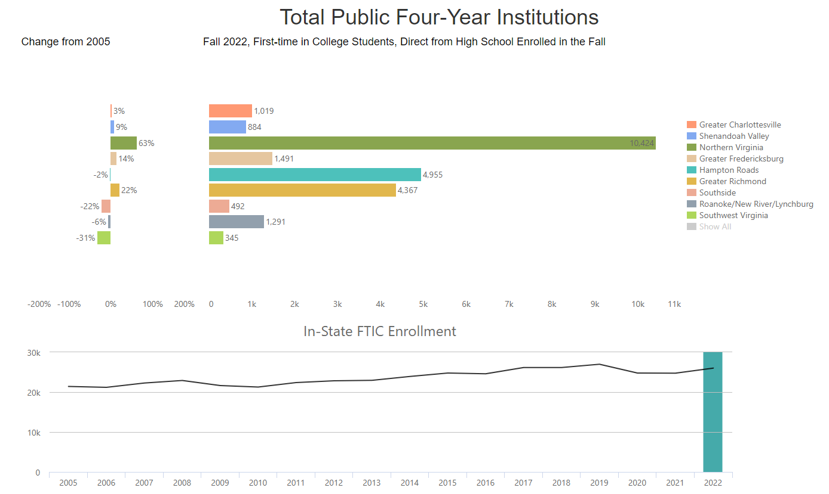
Growth by Student Origin, 2005 to 2022?

Slide 22
Applications from NoVa have Grown
The proportion of total applications from NoVa has changed significantly at the institutions that grew.
The largest increase was 20 percentage points since 2004 at VCU.
11 pp at UVa, 10 pp at VT & W&M.
7pp ODU, 6 pp at GMU, JMU

Slide 23
Northern VA Applicants
42% of all public four-year applicants
68% of GMU applicants

Slide 24
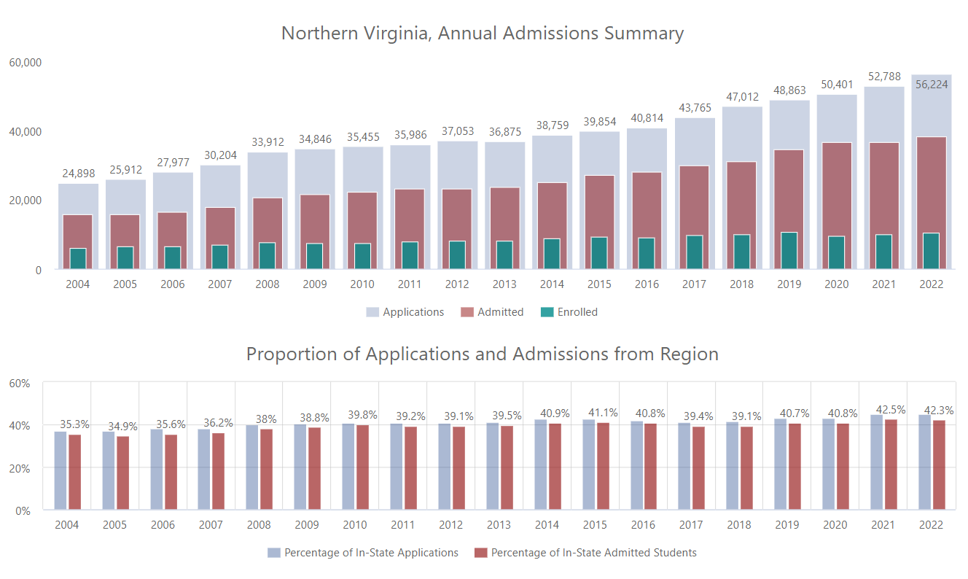
Total Public Four-years

Slide 25
Going Forward
The proportion of applicants and enrollments from NoVa is unlikely to decrease substantially in the next decade.
School- and Division-level projections anticipated from Weldon-Cooper will allow further analysis.

Slide 26
Degree Estimates - All Institutions

Slide 27
“Best State for Education by 2030”

Slide 28
Conclusions
The 2023 enrollment projections are not dramatically different from prior years.
Growth areas are on in-state FTIC enrollments at the independents and master's level enrollments (both sectors).
In-state FTIC continues to vary widely, with modest increases in new transfers.
We remain on track to achieve 1.5 million undergraduate awards by 2030

Slide 29
Conclusions (continued)
In general, we find the projections feasible.
There are some institutions whose projections might be seen as ambitious, they may wish to revise those and the parallel financial plans.

Slide 30
Discussion

Slide 31
Additional Material

Slide 32
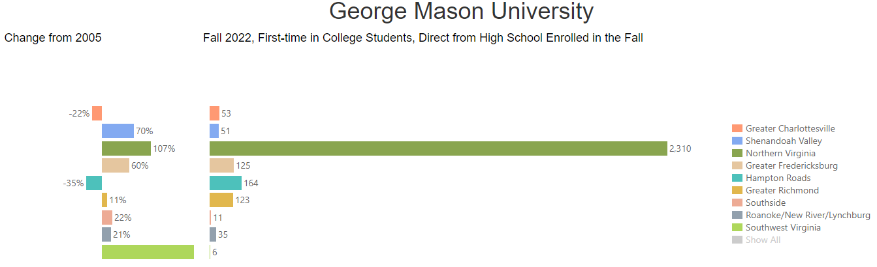
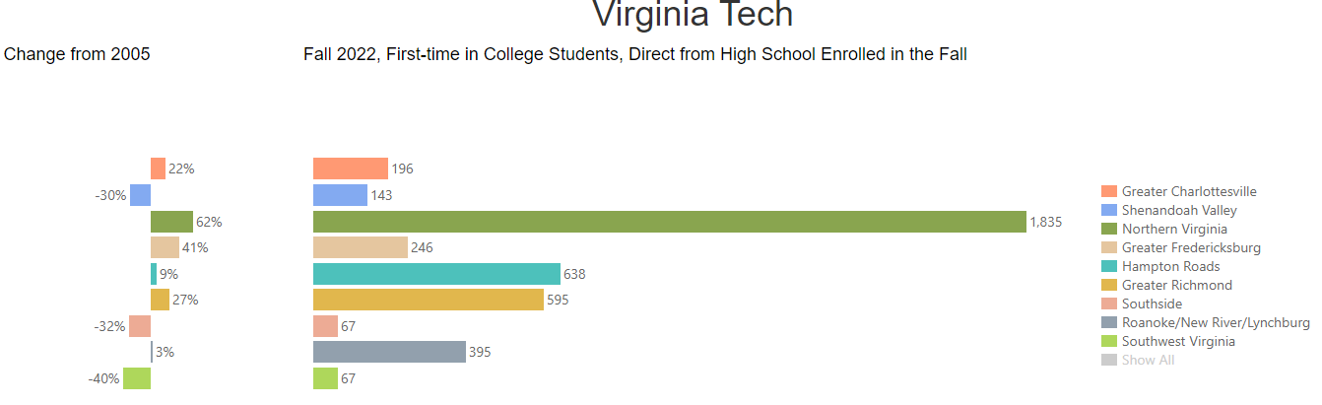
2005 to 2012, GMU & VT

Slide 33
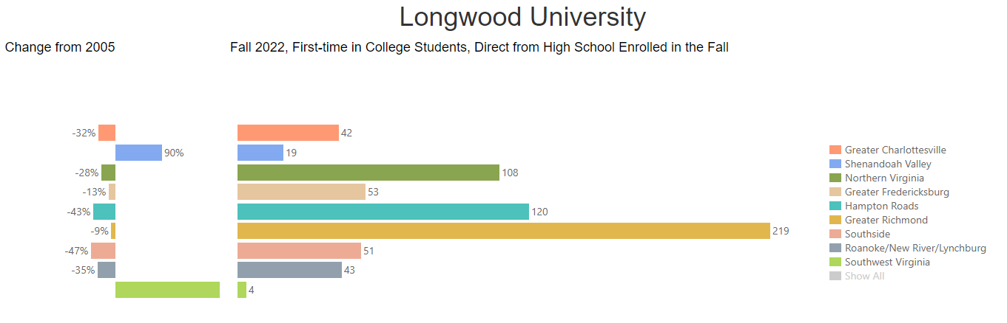
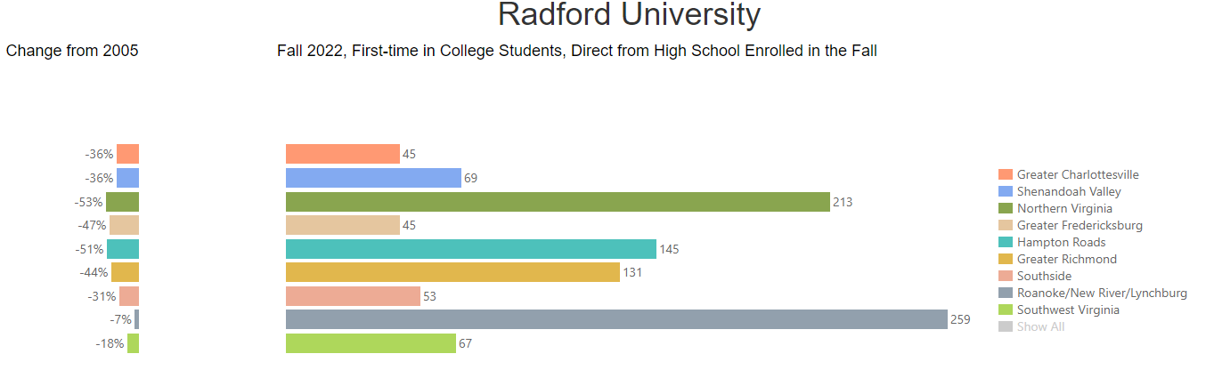
2005 to 2012, LU & RU

Slide 34
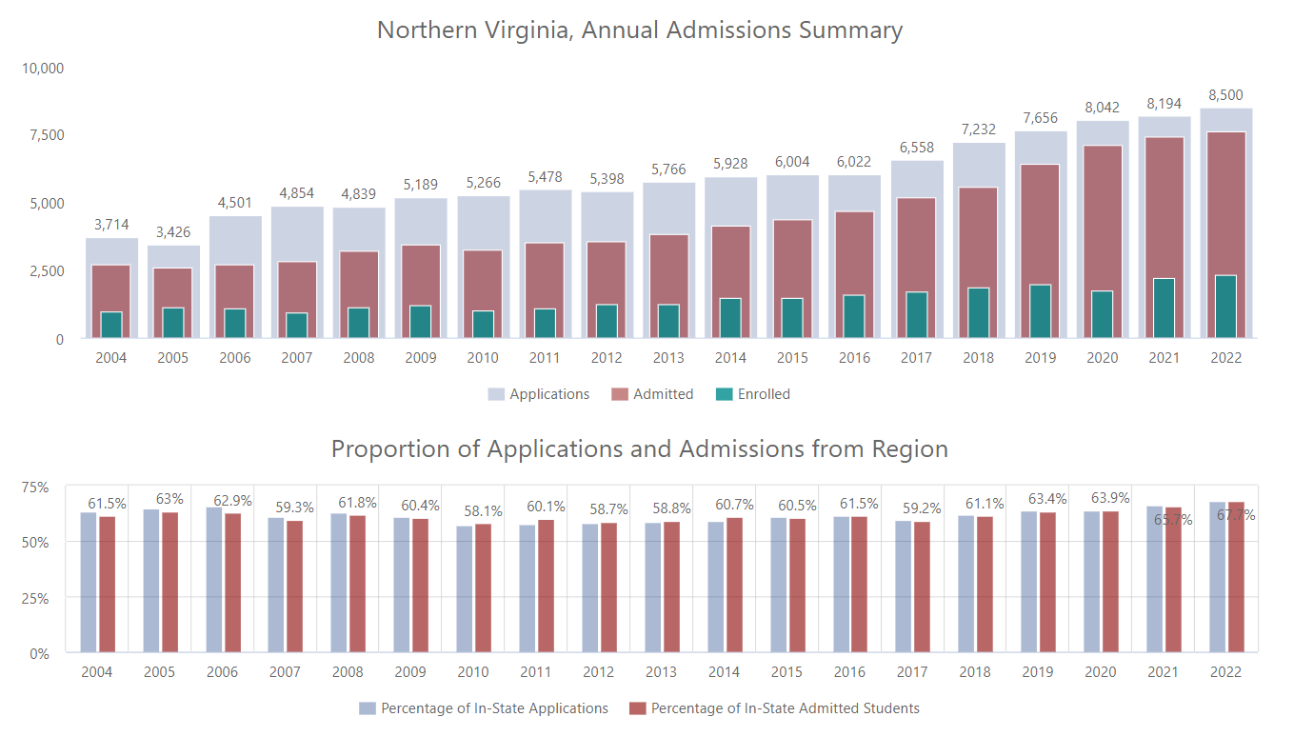
George Mason University

Slide 35
Links
B13: First-time in College Admissions Trends
B14: Admission Draw by Region
Sector Projection Summaries
Proposed 2023 Enrollment Projections

