Slide 1
Key Findings from
The Pathways to Opportunity Plan
2023 Annual Report
SCHEV Council
January 9, 2024
Emily Salmon, Acting Director of Strategic Planning and Policy Studies

Slide 2
Council Objectives for Today
Review requirement for the Annual Report.
Summarize the main components of the Annual Report as well as key findings and activities that support The Plan.
Outline the next steps toward implementing The Plan.

Slide 3
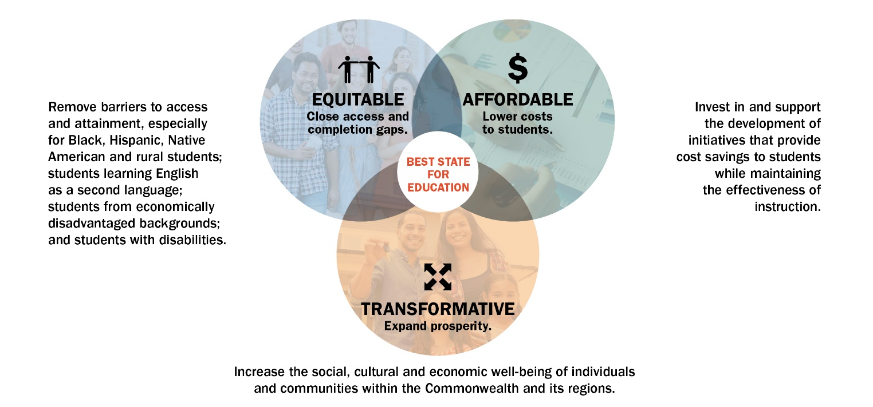
Plan Reporting Requirement
SCHEV staff is charged via Senate Joint Resolution 53 (Regular Session, 2022) to submit an annual report on progress toward the statutory goals for the state.
Notes:
https://lis.virginia.gov/cgi-bin/legp604.exe?221+ful+SJ53ER&221+ful+SJ53ER
Due Jan 11, 2023 (before GA session convenes).
SCHEV must report annually on the Commonwealth's progress toward achieving these goals and targets to the Governor, the General Assembly, institutions of higher education, and the public.

Slide 4
Main Components
The Annual Report includes a(n):
  Brief summary of The Plan and its key elements.
  Assessment of progress toward the three goals based on The Plan’s five measures and key findings from that assessment compared to the 2019-20 baseline (first Annual Report).
  Synopsis of SCHEV activities and initiatives over the past twelve months that directly supported The Plan’s goals and strategies.
  Appendices that detail the prior and current biennial priority initiatives.

Slide 5
Attainment Objective – Key Findings
Attainment Objective: By 2030, 70% of 25- to 64-year-old Virginians will possess a post-secondary certificate, certification or higher.
  SCHEV 2020 estimate: 58.3%*
  Lumina 2021 estimate: 59.3%
Notes:
*The ACS Census survey data collected during this time aligned with the Covid-19 pandemic. Accurate estimates rely on a representative sample with weights to project the sample to the population. Typically, the sample is collected throughout the calendar year. However, starting in mid-March 2020, the pandemic limited the ability to reach households and caused higher nonresponse bias than usual. As a result, the U.S. Census did not release standard one-year estimates and instead released “experimental data.” The experimental data represents an unstable sample with experimental weights. Details about the data collection modifications and data implications can be found at https://www.youtube.com/watch?v=kzg_-WnQLqA&t=418s. ACS data are used to calculate the attainment, enrollment and awards measures.
** Lumina did not release attainment data for this year due to experimental weights.
Points needed to reach 70%: 11
Years left: 9
Points needed per year to reach 70%: 1.2%
Historic points per year: 0.7%
With 9 years remaining until 2030, Virginia needs to add 1.2 points per year.
Virginia has averaged .07 points per year since 2015.

Slide 6
Measures - Overview
Five Measures from The Plan assess progress toward goal achievement.
  Two-year time-lapse for 2023 Annual Report: 2021-22 academic year.
  Baseline to measure progress: 2019-20 academic year.
  Year-over-year changes will likely be gradual, ideally in a positive trajectory.
  Measures include: attainment, enrollment, awards, borrowing and wages.
  Data for each of the five measures are disaggregated by race/ethnicity, GO Virginia region, income and gender to identify gaps and work to close them in order to meet Attainment Objective (70% by 2030).

Slide 7
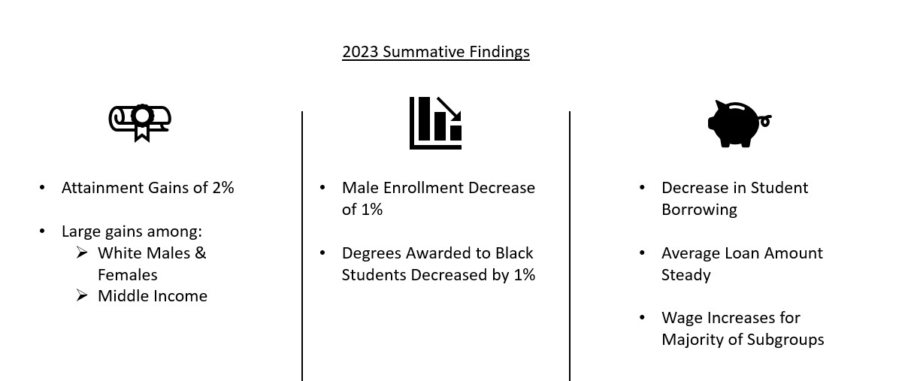
Measures - Summative Findings for 2023
The most recent data (2021-22) were largely unchanged from the baseline year (2019-20) data with a few notable changes.

Slide 8

Key Findings – Attainment Measure
Attainment: Percent of 25- to 64-year-old Virginians with an associate degree or higher.
Those who have the lowest attainment within each subgroup remain unchanged from 2019-20.
Attainment gains compared to the 2019-20 baseline academic year within each subgroup include:
  Total attainment increased from 50% to 52%.
  White attainment increased from 54% to 59%.
  Middle income attainment increased from 37% to 41%.
  *By gender - Men increased - males from 46% to 48% and females from 54% to 56%.

Slide 9

Key Findings – Enrollment Measure
Enrollment: Fall headcount of public and private undergraduates.
The subgroups with enrollment gaps (where enrollment does not reflect the population) remain unchanged since 2019-20 with one exception (Richmond since 2020-21).
Subgroups that have enrollment declines compared to the 2019-20 baseline academic year :
  Non-resident alien enrollment decreased from 3% to 2%.
  Male enrollment decreased from 44% to 43%.

Slide 10
Key Findings – Awards Measure
Awards: Undergraduate degrees and credentials produced each year.
  Success gaps may exist where the percentage of total awards is less that the percentage of enrolled students.
  Subgroups with success gaps remain unchanged since 2019-20 with two exceptions: Previous success gaps were closed for Hispanic/Latinx and Asian students in the 2021-22 academic year.
  The success gap widened for black students; the percent of total awards to black students decreased from 14% to 13% in the 2021-22 academic year.

Slide 11

Key Findings – Borrowing Measure
Borrowing: Average debt of graduates.
Those groups with the largest percentage of undergraduates who are borrowing remain unchanged.
Changes from the 2019-20 baseline year include:
  Percentage of undergraduates borrowing decreased across the board. The decrease could possibly be attributed to Virginia’s moderated tuition and fees; student loan advocacy work; more generous Pell grants; national trends and increased awareness.
  Average loans stayed largely within $1,000 of the 2019-20 amounts.

Slide 12
Key Findings – Wages Measure
Wages: Graduates’ wages 10 years post-completion.
  Those groups with the widest wage gaps remain unchanged from 2019-20.
  Change from the 2019-20 baseline: Wages increased for all groups except for Race Unknown (median decreased from $64,939 to $63,543) and Hispanic which stayed flat (median at ~$65,000).

Slide 13
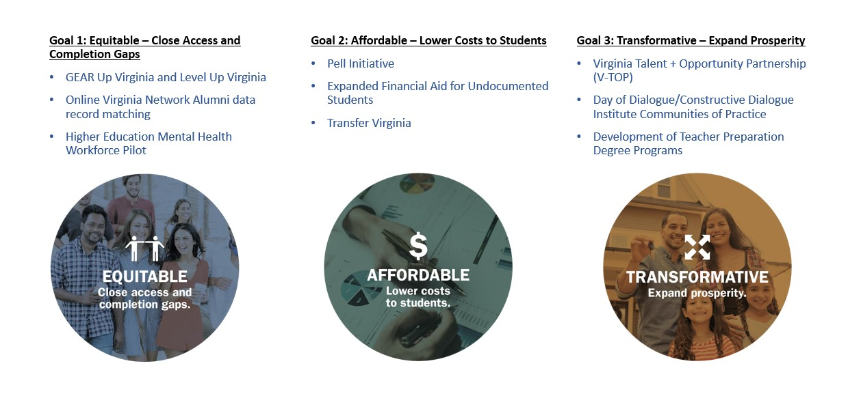
2023 Supporting Activities
The following represent a sample of SCHEV activities that support The Plan’s goals and corresponding strategies:

Slide 14
Next Steps
Throughout 2024:
  Provide Council routine updates on priority initiatives.
  Discuss specific initiatives in detail at various Council meetings.

