Slide 1
New Economy Workforce
Credential Grant FY 2023 Annual Report
Resources and Planning Committee
March 18, 2024
Tom Allison
Assistant Director of Finance Policy & Innovation

Slide 2


Program Overview
New Economy Workforce Credential Grant (WCG) established by 2016 General Assembly.
VCCS branded as FastForward (higher ed centers also participate in WCG).
Three purposes:
Trains workers in programs aligned with high-demand occupations (closing gap between supply and demand).
Makes that training and credentialing more affordable for workers.
Increases the interest of current and future Virginia workers in technician, technologist, and trade-level positions.
https://www.schev.edu/home/showpublisheddocument/3633/638435830614930000

Slide 3
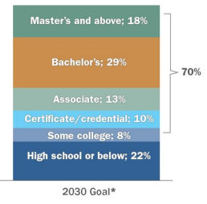
Program Overview
Pathways to Opportunity sets goal of 70% postsecondary attainment by 2030.
SCHEV estimated that 10% would fall into certificate / credential category.
According to the Lumina Foundation, 7% of working age Virginians earned a certificate or credential in 2021.

Slide 4
Program Overview
Virginia Board for Workforce Development, in consultation with Virginia Office of Education Economics, maintains list of high-demand fields.
Workforce Board recommends which WCG programs align with the high-demand list.
Institution boards approve training programs aligned to those high-demand fields.
If additional high-demand fields are identified outside of the annual review process by the board, then eligible institutions may submit approved updates to the board.

Slide 5
Program Overview
Pay-for-performance system breaks cost of program into thirds:
1st third paid by the student.
Some financial aid is available.
2nd third paid by the state to the institution for training completion.
Student pays for 2nd third if training incomplete.
3rd third paid by the state to the institution for completion of credential.
Maximum reimbursement per program completion: $3,000
Budget language: No program can receive more than 25% of grant funds.

Slide 6
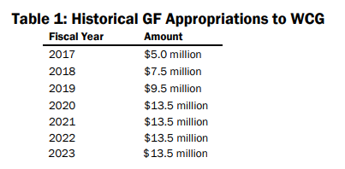
Program Overview
Eligible institutions: public 2-year institutions & higher education centers.
SCHEV charged with administering and assessing the program.
Funding: $13.5 million (FY 2023).

Slide 7
Program Highlights
Institutions reported 13,428 enrollments in FY 2023, an 9% increase from FY 2022 and the most since the inception of the program.
Completion and credentialing rates remained relatively stable.
95% complete training.
71% go on to earn credential.
WCG still makes up relatively small proportion of VCCS enrollments (Fall 2023 headcount in for-credit programs was 151,034).

Slide 8
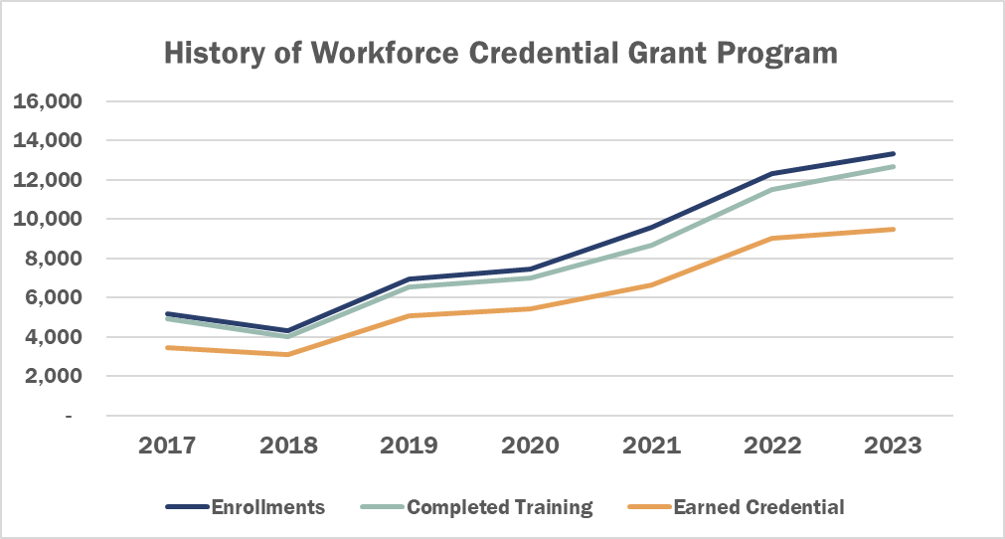
Program Overview
As enrollments have grown, student success has held steady.

Slide 9
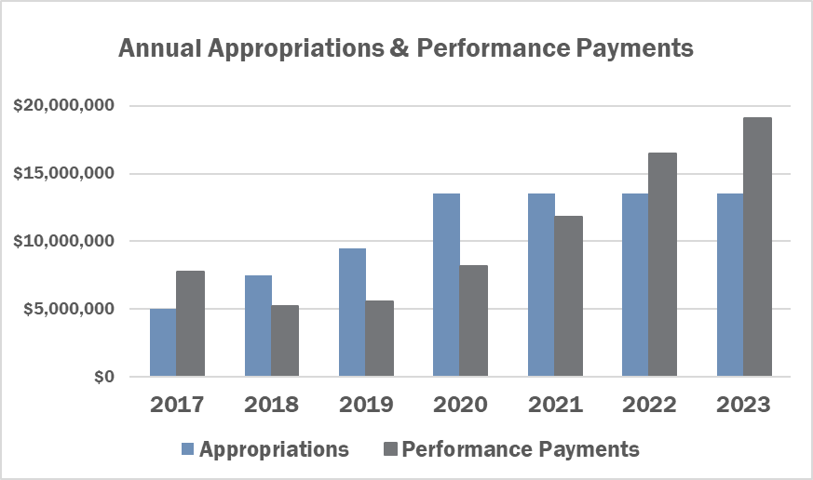
Program Overview
In FY 2022, performance began exceeding appropriations.

Slide 10
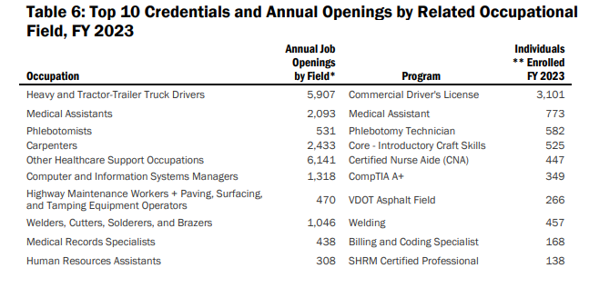
Program Highlights
Enrollments do not exceed annual projected openings.
Not a perfect analysis of Demand – Supply; For example, some individuals may earn credential through non-WCG programs and fill open jobs.

Slide 11
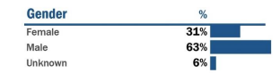
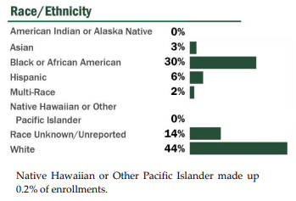
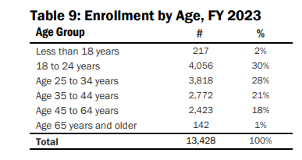
Demographics
Over two-thirds (9,228) of FY 2023 WCG students had not previously entered a postsecondary training or credential program.

Slide 12
Wage Analysis
Wages were matched through the Virginia Longitudinal Data System with Virginia Employment Commission (VEC) wage records.
Excludes individuals not in wage system: unemployed, wages in another system, or self-employed.
Occupation not reported.
No indication of hours worked.
Only used records where one year of pre- and post-wages were matched:
26,935 students had wages successfully matched.
19,545 credential earners with wages successfully matched.

Slide 13
Wage Analysis
Annual wages for training completers increased $9,350, or 38%.
Credential earners’ median wages increased $10,158.
Median wages increased in all industries.
Students who earned credentials in construction and extraction earned the highest median wages at $52,442.
Installation, Maintenance, and Repair fields saw median wage increases of $15,401.

Slide 14
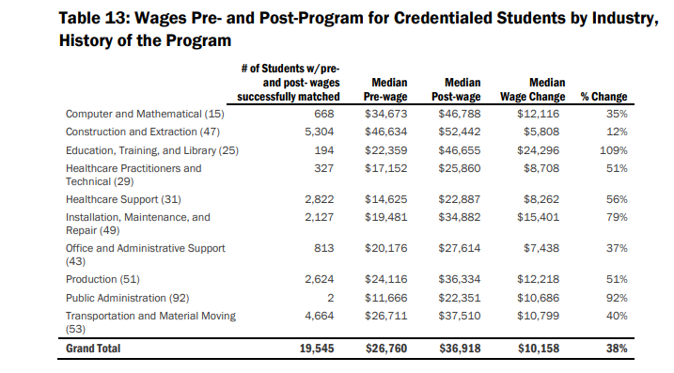
Wage Analysis

Slide 15



Student Costs
Average Tuition: $849.
Average General Fund Reimbursed to Providers: $2,014
Financial aid available
Workforce Financial Assistance (FANTIC)
G3
Virginia Ready Scholars.

Slide 16
2024 Legislative Update
FY 2024 budget amendments increased appropriation to $18.5 million.
Reflecting Council's recommendation, Governor Youngkin's introduced budget and conference report increased appropriation to $22.5 million and $23.8 million.
Bill to raise GF reimbursement limit from $3,000 to $4,000 passed in 2023 session to take effect on July 1, 2024.

Slide 17
Other Issues
Federal legislation:
Congressional House of Representatives’ Committee on Education & the Workforce reported the Bipartisan Workforce Pell Act, which would expand Pell Grant eligibility to students enrolled in programs like those offered through WCG.
SCHEV submitted WCG data to new workforce agency (Virginia Works).
SCHEV participating in Noncredit Mobility Academy through State Higher Education Executive Officers Association.
CDL programs exceed 25% cap of total GF reimbursement (a cap put forth in budget language).

Slide 18
Questions
Tom Allison
tomallison@schev.edu
202-689-9590

Slide 19
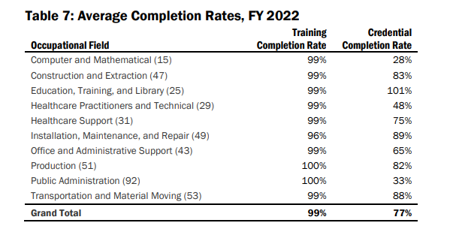
Program Highlights
*Credential completion rate exceeds 100% due to more students earning credential than completing training

