Slide 1


Virginia Talent + Opportunity Partnership
www.VirginiaTOP.org

Slide 2
Agenda
Background
Purpose
Goal
Regional Collaboratives
Top Employer Recognition
Staffing Agency Services
Credit-bearing Outcomes
www.VirginiaTOP.org

Slide 3
Virginia Talent + Opportunity Partnership
Background
The Virginia Talent + Opportunity Partnership (V-TOP) is a formally established collaboration between the State Council of Higher Education for Virginia (SCHEV), the Virginia Chamber Foundation, and the Virginia Business Higher Education Council. V-TOP is funded through the Commonwealth Innovative Internship Fund.
Purpose
V-TOP is grounded in statute: Statewide initiative to facilitate the readiness of students, employers, and institutions to participate in internship and work-based learning (Va. Code § 23.1-903.4).
  Grants to institutions to expand paid and credit-bearing student internships and other work-based learning opportunities in collaboration with Virginia employers.
  Statewide initiative to facilitate the readiness of students, employers, and institutions
of higher education to participate in internship and work-based learning.
www.VirginiaTOP.org

Slide 4
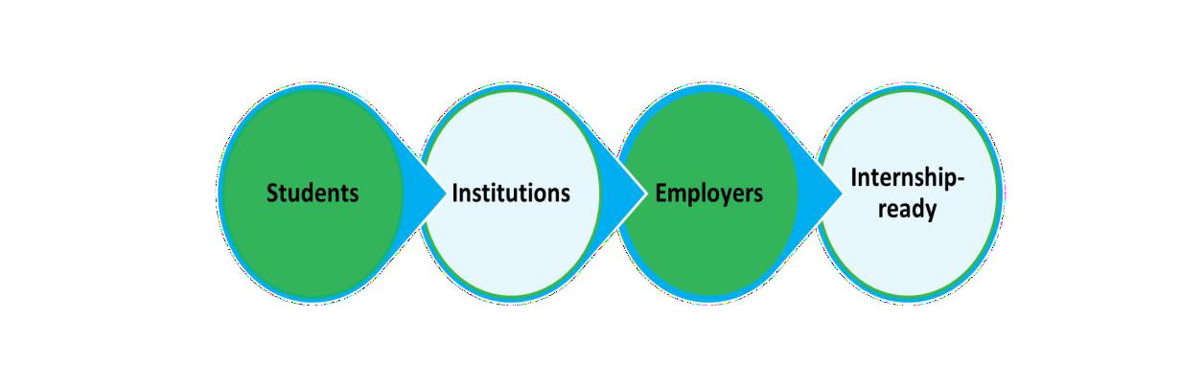
Virginia Talent + Opportunity Partnership
Goal
Have the most internship-ready students, employers, and institutions
of higher education.
Every graduate of a Virginia two-year and four-year institution has participated in at least one paid or credit-bearing student internship or work-based learning (WBL) opportunity.
www.VirginiaTOP.org

Slide 5
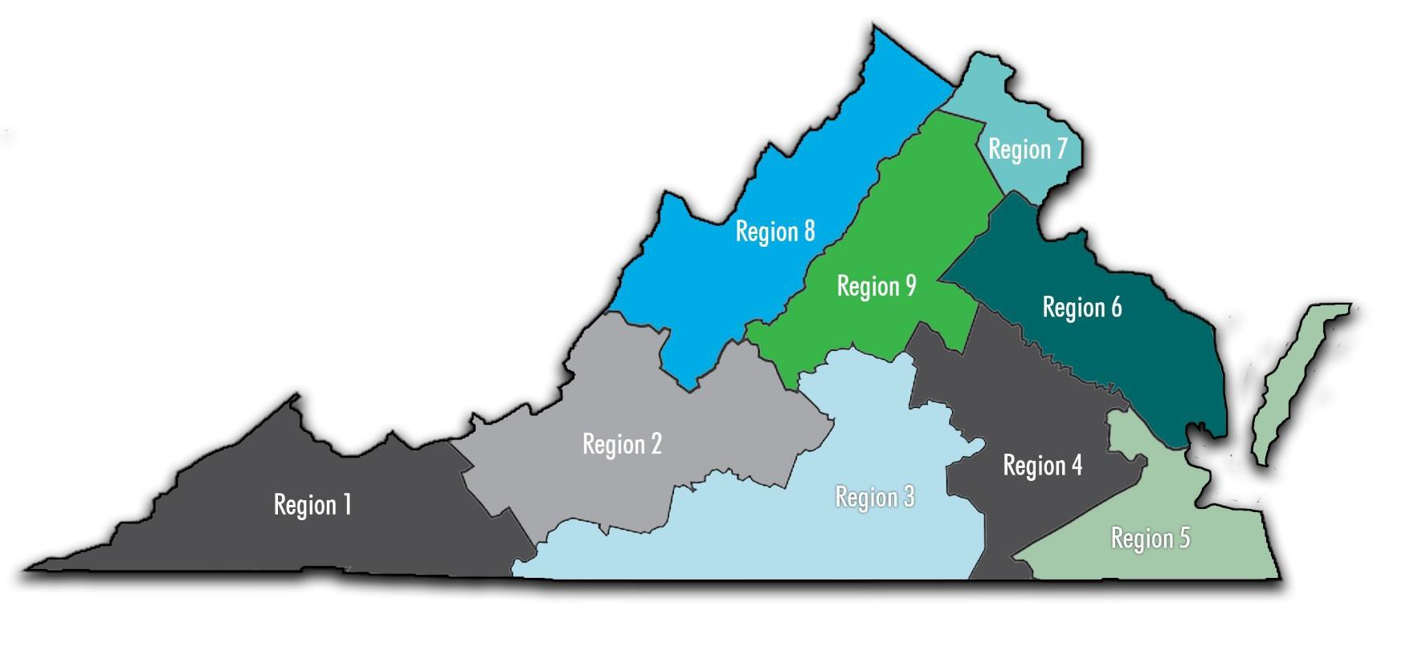
V-TOP Regional Collaboratives
Led by VA Public Institutions or Higher Education Centers
R1: UVA-Wise University
R2: Virginia Tech
R3: Institute of Advanced Learning and Research
R4: Virginia Commonwealth University
R5: Old Dominion University
R6: University of Mary Washington
R7: Northern Virginia Community College
R8: James Madison University
R9: University of Virginia
V-TOP Regions
www.VirginiaTOP.org

Slide 6

V-TOP Regional Collaboratives
Goal
Funds one or two people who are responsible for thinking every day about how to:
  Identify and link existing work-based learning activities
  Present those opportunities to employers
  Support employers, students, and institutions of higher education
www.VirginiaTOP.org

Slide 7

Regional Collaborative Partnerships
Required Partners
PK-12
Public and private colleges and universities
Regional chambers of commerce
Economic development partnerships
Industry groups
Employers
Other relevant organizations in the region
www.VirginiaTOP.org

Slide 8
Employer Readiness
Top Employer Recognition:
Recognized 136 Top Virginia Employers for Interns Awards (2024)
Selection process was based on:
  Intern engagement through mentorship programs
  Senior leadership exposure
  Specialized support for various student demographics
Roughly 85% of the recipients offered paid internships
All nine regions hosted activities to recognize the top employers within their region.
V-TOP will host Virginia Intern Day festivities for the top employers and student interns in Richmond and statewide on July 25 as part of the national recognition of Intern Day.
www.VirginiaTOP.org

Slide 9
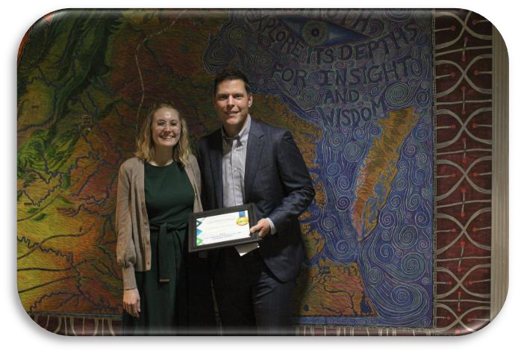
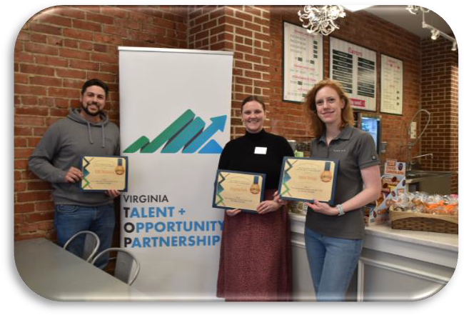

Regional Top Employer Recognition
Region 1
Region 2
Region 3
UVA-Wise
VA Tech
ILAR
Employer Meet & Greet
Top Employer: 1
Ice Cream Social
Top Employers: 12
Employer Meet & Greet
Top Employers: 5
www.VirginiaTOP.org

Slide 10
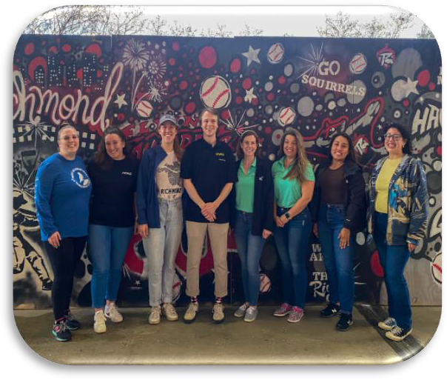
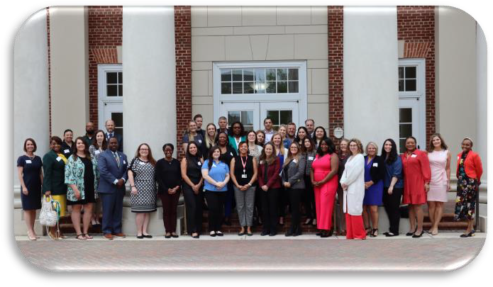
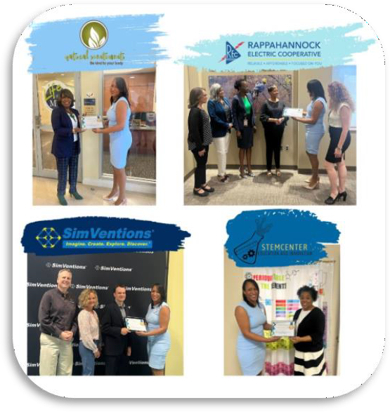
Regional Top Employer Recognition
Region 4
Region 5
Region 6
VCU
ODU
UMW
Employer Panel & Networking
Top Employers: 20
Richmond Flying Squirrels Game
Top Employers: 35
Certificate and Cupcake Delivery
Top Employers: 7
www.VirginiaTOP.org

Slide 11
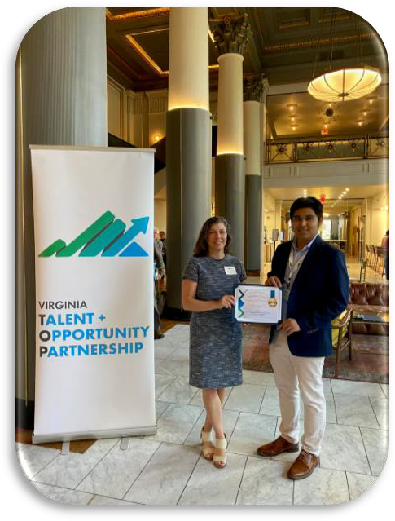
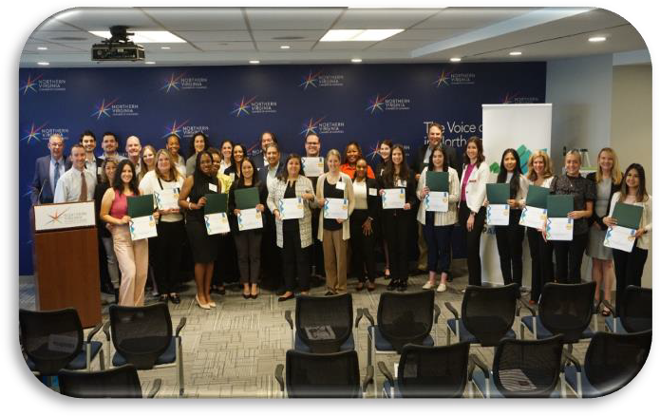
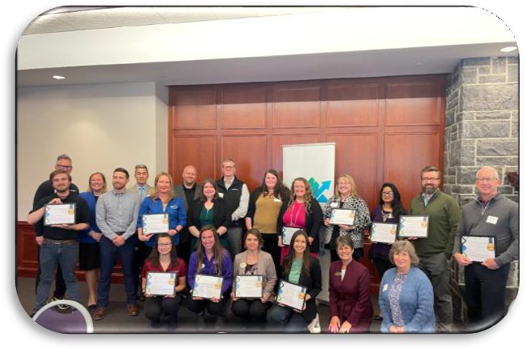
Regional Top Employer Recognition
Region 7 | Region 8 | Region 9
NOVA | JMU | UVA
Employer Panel and Networking
Top Employers: 27
Employer Luncheon
Top Employers: 14
Coffee Chat
Top Employers: 15
www.VirginiaTOP.org

Slide 12
Employer Readiness
Staffing Agency Services:
Acquired the assistance of a staffing agency, iQuasar, to help employers recruit and connect with Virginia students seeking internship opportunities
V-TOP considers small to midsize employers to include 250 or fewer employees.
  This service includes job description development, marketing and advertising of internship
opportunities, sourcing, screening, interview planning and onboarding
Matching funds services may apply for employers who have 150 or fewer employees.
  This service includes a 50% match of an intern’s wage, including FICA, and a 50% match of
additional workplace subsidies, such as housing, transportation, clothing, etc.
www.VirginiaTOP.org

Slide 13
Staffing Agency Services
Staffing Agency Services by the Numbers:
103 Participating employers – various phases of the process
68
Internship opportunities posted
27
Students placed in an internship
11 Placements from Virginia institutions of higher education
$16 Average hourly wage for students
www.VirginiaTOP.org

Slide 14

Internship Outcomes
Virginia Credit Bearing Internships
22,946
23,103
21,228
19,455
AY19-20
AY20-21
AY21-22
AY22-23
This data only provides one piece of Virginia's internship and work-based learning landscape.
Data sourced from the SCHEV’s Credit-bearing report
www.VirginiaTOP.org

Slide 15
Contact Information
Alisha Bazemore
Assistant Director for Innovative Work-Based Learning Initiatives alishabazemore@schev.edu
Ashley Crute
Associate for Innovative Work-Based Learning Initiatives ashleycrute@schev.edu
Carolyn Sutphin
Associate for Innovative Work-Based Learning Initiatives carolynsutphin@schev.edu
www.VirginiaTOP.org

Slide 16

Questions
www.VirginiaTOP.org

