Slide 1

Virginia Military Survivors & Dependents Education Program (VMSDEP)
October 7, 2024
Notes:
Good morning again Mr. Chairman

Slide 2
Background
Virginia has substantial active-duty military and veteran presence
DVS has developed a “compact” with veterans
VMSDEP provides tuition & mandatory fee waiver, stipend for some recipients
Code of Virginia defines VMSDEP eligibility criteria
VMSDEP and its precursor programs have existed for decades, very little general funding until recently
Notes:
As you all know, there’s a large active duty, and veteran, presence in Virginia.
Just remind you that there’s a specific state agency, the Department of Veterans Services, with the mission to help veterans in a variety of ways.

Slide 3
Major VMSDEP program changes and VMSDEP participation trends
Eligibility: dependents of veterans 90% permanently disabled (in addition to 100% permanently disabled) 2006
Eligibility: dependents of veterans whose death or disability due to military service in general (in addition to combat-related) 2019
4-year enrollment
Residency: Allowing physical presence, rather than domicile, in Virginia for 5 years prior to eligibility 2014
Eligibility: Spouses 2006
2-year enrollment
07 | 08 | 09 | 10 | 11 | 12 | 13 | 14 | 15 | 16 | 17 | 18 | 19 | 20 | 21 | 22 | 23
Sources: State Council of Higher Education for Virginia and Code of Virginia.
Notes:
So basically, the reason you asked us to look into this program is because in the last few years it has really grown by a lot.
I’ll have some more detailed numbers as we go, but this is just showing some of the major expansions in eligibility and changes in the residency requirements.

Slide 4
General Assembly appropriated substantial funding to offset forgone revenue impact of VMSDEP
2024 General Assembly appropriated new general funds for FY25 and FY26:
$20M annually in “base budget”
Additional $45M annually for FY25 and FY26
SCHEV began allocating new general funds to institutions in August 2024
Notes:
As part of this process, as you may recall you added new general funding for institutions to compensate for the foregone revenue as the program has grown.
You added $20M to the base, and there’s another $45M contingent on revenue for this fiscal year and the next.
SCHEV is starting to allocate that funding.

Slide 5
Despite rapid growth, VMSDEP is relatively small percentage of total enrollment at most institutions
Institution | VMSDEP participation (2023–24, unduplicated) | Total enrollment (Fall 2023) | VMSDEP as % of total enrollment
ODU | 1,233 | 22,541 | 5.5%
CNU | 220 | 4,503 | 4.9%
NSU | 293 | 6,045 | 4.8%
UMW | 176 | 3,808 | 4.6%
VMI | 66 | 1,560 | 4.2%
VCU | 999 | 28,594 | 3.5%
RU | 234 | 7,531 | 3.1%
LU | 140 | 4,544 | 3.1%
W&M | 251 | 9,762 | 2.6%
GMU | 892 | 40,184 | 2.2%
JMU | 480 | 22,758 | 2.1%
VT | 699 | 38,294 | 1.8%
UVAW | 27 | 1,922 | 1.4%
UVA | 275 | 25,944 | 1.1%
VCCS | 2,062 | 153,629 | 1.3%
Notes:
It’s important to put the enrollment levels in context of the total size of each school.
You can see that at ODU, CNU, and some others its in the five percent range.

Slide 6
Most VMSDEP participants are undergraduates, but increasingly more are graduate students
Most VMSDEP participants are undergraduates, but increasingly more are graduate students
Most VMSDEP participants are biological child of a veteran
Non-combat-related eligibility, rather than combat-related, has been growing recently
Source: SCHEV FA-22 report
Notes:
This shows that the vast majority of VMSDEP students are undergraduates.
But the proportion of those taking graduate courses has been increasing quickly.
It’s doubled over the last decade and has been about 11% recently.

Slide 7
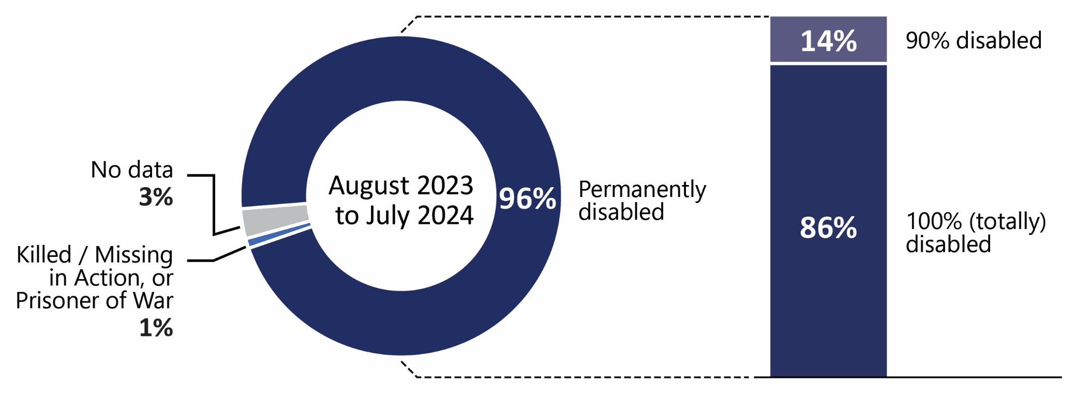
Nearly all VMSDEP participants receive benefits because of a disability
14%
90% disabled
96%
Permanently disabled
No data
3%
August 2023 to July 2024
86%
100% (totally) disabled
Killed / Missing in Action, or Prisoner of War
1%
Source: DVS VMSDEP portal database, latest 12 months of usable data (August 2023 to July 2024)
Notes:
Somewhat surprising to me is that recently, very few of the participants are eligible due to killed or missing in action.
Nearly all of the eligibility is related to disability, and you can see the breakdown there that it’s primarily 100% disabled.

Slide 8
No residency data available for substantial portion of participants
DVS data on how students met the VMSDEP domicile/presence requirement is missing for some veterans
However, based on available data:
2/3 met the residency requirement by entering military service in Virginia
1/3 met the residency requirement by verified domicile or physical presence five years prior to applying
Source: DVS VMSDEP portal database, latest 12 months of usable data (August 2023 to July 2024)
Notes:
We took a look at the residency part of the data, and there’s a big chunk of residency data that is missing.
For those in the file that do have data, it’s about 2/3 eligible for entering service in Virginia, the remaining 1/3 met the five year requirement prior to applying.

Slide 9
Escalating VMSDEP costs raised concerns about impact on tuition charged to other students
Institutions addressed forgone revenue in different ways, but VMSDEP impact on tuition unclear
Institutions used various means to compensate for forgone revenue
Tuition & fees from other students (7 institutions)
Reduced or controlled operational spending (6)
General funds (5)
Institutional revenue (5)
Quantifying impact of VMSDEP on tuition is extremely difficult
Notes:
We tried to push institutions to quantify how much impact VMSDEP is having on the cost of tuition, as the waivers have increased. And it’s not that easy.
Institutions thought about it more as a budgeting issue, and cited the different things they try to do to compensate for the foregone revenue.
Seems like it’s a blend of several things they try to do to compensate.

Slide 10
VMSDEP waivers represented varying proportions of tuition revenue prior to general fund infusion
Institution | VMSDEP waiver (2022-23) | Total tuition revenue (FY23) | VMSDEP waiver as % of total tuition revenue
UMW | $1.6M | $18.7M | 8.5%
ODU | 9.1 | 127.3 | 7.2
NSU | 1.9 | 29.4 | 6.4
CNU | 2.3 | 40.9 | 5.6
LU | 1.5 | 25.8 | 5.6
RU | 2.0 | 40.4 | 5.0
VMI | 1.0 | 22.3 | 4.9
VCU | 11.7 | 328.1 | 3.6
GMU | 8.0 | 360.3 | 2.2
JMU | 4.3 | 235.8 | 1.8
W&M | 3.7 | 216.3 | 1.7
VT | 7.8 | 647.0 | 1.2
UVA | 4.3 | 691.0 | 0.6
VCCS | 4.3 | 543.0 | 0.8
Note: Total tuition revenue for VCCS shown as all non-general fund revenue *Excludes VSU, which did not submit information to JLARC, and UVA-W due to total tuition revenue calculations.
Notes:
So let’s go back to FY 23 in the year prior to when you started the process of providing general funds.
In that year, this shows the dollar amount of the waived VMSDEP tuition and fees, and puts it in the context of the total tuition revenue at each school.
You can see it really varies, but at the places near the top, it’s become a pretty large percentage of total revenue, that they aren’t collecting due to the waiver.

Slide 11
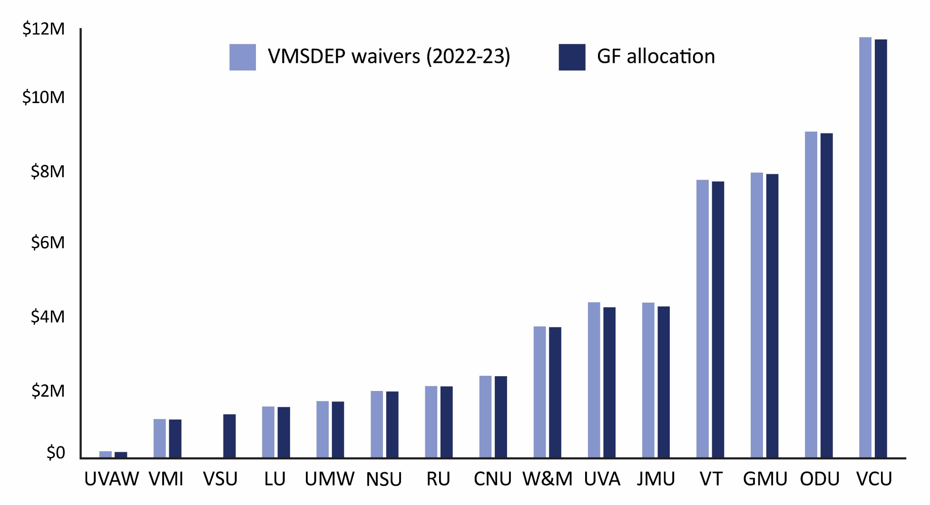
General Fund allocations would have funded nearly all waivers during the 2022–23 academic year
$12M
$10M
VMSDEP waivers (2022-23)
$8M
GF allocation
$6M
$4M
$2M
UVA-W
VMI
VSU
LU
UMW
NSU
RU
CNU
CWM
UVA
JMU
VT
GMU
ODU
VCU
VCCS = $4.3M waivers; $4.2M GF allocation.
Notes:
And here you can see that as of 2022-23, the waiver amounts were very close to what the allocation will end up being.

Slide 12
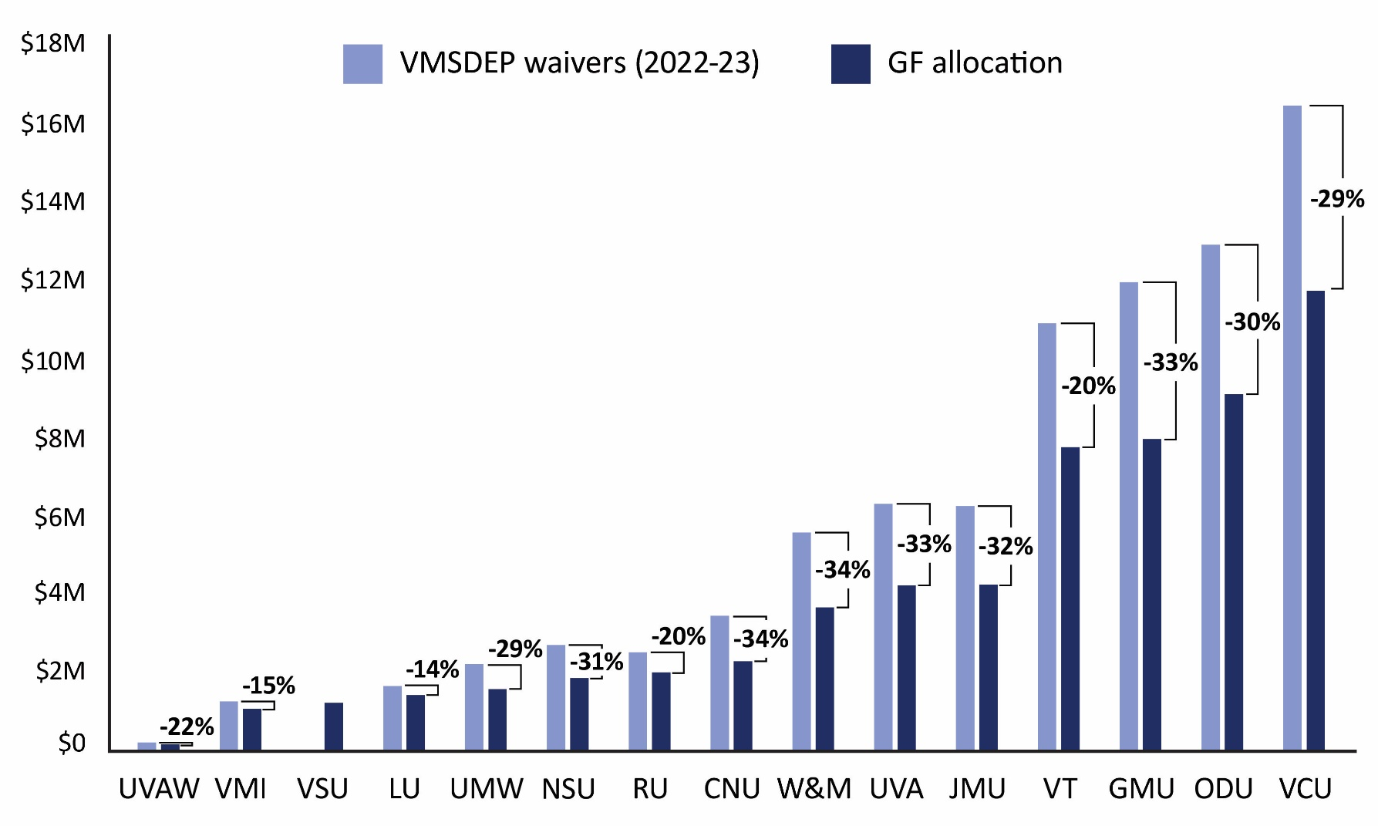
Increased 2023–24 participation pushed forgone revenue higher than FY25, FY26 general fund allocation
$18M
VMSDEP waivers (2024-25)
+29%
$16M
$14M
VMSDEP waivers (2024-25)
+30%
$12M
+33%
GF allocation
+20%
$10M
$8M
+33%
+32%
$6M
+34%
$4M
+34%
+29%
+31%
+20%
$2M
+15%
+14%
+22%
UVA-W
VMI
VSU
LU
UMW
NSU
RU
CNU
CWM
UVA
JMU
VT
GMU
ODU
VCU
VCCS = VMSDEP waiver 54% ($2.25M) more than GF allocation.
Notes:
However, this program is growing very quickly.
And as of this most recently completed spring semester, the general fund allocation to each school will end up being below—in some cases well below—the general fund allocation each school gets.

Slide 13
Accurate projections of future VMSDEP growth are challenging
Using recent program participation levels and growth to project future participation has been confounded by
Substantial, relatively recent broadening of eligibility criteria
Pandemic-related disruptions during 2020–2022
Ability to qualify for VMSDEP by moving to and residing in Virginia for 5 years broadens pool of potential participants from Virginia to nationwide
Some data is available, but intentions are hard to predict
U.S. Dep’t of Veterans Affairs knows number of veterans in Virginia, disability ratings; ACS has data on spouses and children
Not known whether eligible or potentially eligible students will use benefit or at which institution
Notes:
So we’ve tried some things to project what might happen to this program.
A few things have occurred to us. First, using recent trends to project what might happen in the future can be problematic.
Big changes were made to the program not too long ago, the pandemic really altered enrollment patterns for a couple of years.
And perhaps most problematically, as long as people can reside in Virginia for 5 years then apply (if they meet other eligibility criteria), it’s not just about Virginia veterans, you have to broaden the lens out potentially to the whole country.
The bottom bullet just makes the point that there is some additional data, but some of this is unknowable in terms of whether a child will apply, whether they’ll end up enrolling, and at which school.

Slide 14
Nationally, veteran population and disabled veteran population have been trending in opposite directions
≈22M
Total veteran population
≈18M
≈ 1,300k
Veterans: 100% disability rating
≈600k
≈ 400k
≈ 200k
Veterans: 90% disability rating
‘14 | ‘15 | ‘16 | ‘17 | ‘18 | ‘19 | ‘20 | ‘21 | ‘22 | ‘23
Source: Veterans Affairs Annual Benefits reports.
Notes:
There’s two big factors that matter for future enrollment, but they are trending in opposite directions. This makes it really hard to know which trend will prevail.
On the one hand, the number of veterans (nationally and in Virginia) has been and is projected to continue to trend down.
[Click} on the other hand, the number of veterans with a disability rating has been trending up very rapidly. This is all federal VA data.

Slide 15
No quantitative evidence that VMSDEP participation has peaked or will soon decline
Many factors will play a role in determining future VMSDEP participation
Would need to make very conservative and unrealistic assumptions to conclude that
program participation will soon decline (e.g., no more growth in number of veterans with 90% or higher disability rating, recent publicity is not leading to more applications)
forgone revenue amounts will soon decline (e.g., tuition and fees do not increase, lower proportion of students enrolling in graduate programs)
See appendix for more information about potential future VMSDEP trends.
Notes:
So the best conclusion we can make right now is that we don’t see any evidence that VMSDP participation is peaking or that it will decline.
But it could, though many factors play a role.
We in the appendix have some information about the assumptions one could make to bend the curve down, but they are very conservative and probably not very realistic.

Slide 16
JLARC staff use criteria to decide between recommendations & options
JLARC staff make recommendations when
There are clear criteria against which to determine whether a change should be made
It is clear how the change should be made
JLARC staff propose policy options when
the action proposed is a policy judgment best made by the General Assembly or other elected officials
the evidence indicates that addressing a report finding is not necessarily required, but doing so could be beneficial
there are multiple ways in which a report finding could be addressed, and there is insufficient evidence of a single best way to address the finding
Notes:
Before I move through our options, I want to remind everyone that we have criteria for whether we make recommendations or options.
We propose policy options under a variety of circumstances.
In this case, we are squarely in policy option territory because ultimately, whether you provide this program at all, how you design it, and how you fund it is completely up to you.

Slide 17
JLARC comparison of VMSDEP to similar programs in other states informs potential options
Many states have some type of program that provides an education benefit for veterans, but these programs are structured in widely varying ways
JLARC analyzed individual elements of VMSDEP and 25* similar programs in other states
Eligibility criteria for veteran and spouse / children
Structure, type, and duration of benefit
* States chosen based on proximity to Virginia, relatively high population of veterans, and program similar to VMSDEP. Number of states reviewed = 24 (Texas has 2 programs included in the analysis).
Notes:
Even though these are policy options, we are primarily anchoring this with our detailed comparison to other states.
It occurred to us as we tried to do this that a scale of “generosity” for example, was an oversimplification.
So we compared various aspects of VMSDEP to other state programs, primarily broken down by eligibility, and structure, type, and duration of the benefit.

Slide 18
Several aspects of VMSDEP are very common in other states’ veterans education benefit programs
Nearly all programs reviewed offer an education benefit if the veteran was killed in action (24 of 25 programs reviewed)
Nearly all programs reviewed also offer a benefit for service-related eligibility in addition to combat-related conditions (23 of 25)
All states reviewed offer the benefit to children
No state reviewed reduces the benefit based on family income
Note: More information about VMSDEP compared to other state programs is in the appendix.
Notes:
Some things jumped out to us that Virginia does, that are also very common in other state programs.
For example, almost all of them offer the benefit if the veteran was killed in action, or have a service-related condition.
Interestingly, no states we reviewed reduced the benefit amount based on family income.

Slide 19
Some veterans and other interested stakeholders strongly emphasized VMSDEP’s importance
“…The Commonwealth created this program as a thanks for honorable military service. That ‘thanks’ should be sustained until there is no need for service members to be placed in harm’s way.”
“This benefit has been promised … Changing the benefit eligibility or amount at this point would be a disservice to all Virginia veterans.”
“Virginia receives the most federal funding for Veterans and military, funds can be found for VMSDEP and the program should never be reduced or removed.”
“This program is a critical part of deciding to stay in Virginia. Without it...I would leave with my skills, my business and my taxes.”
“VMSDEP Survey,” JLARC; late July to late August 2024.
Notes:
We tried a survey on this project, and it was met with some resistance.
But we did want to share with you some of the comments from veterans or program recipients about the program.
Here’s some quotes about how important the program has been or is to people. (pause for a moment).

Slide 20
Policy option #1
The General Assembly could…
Appropriate sufficient general funds to cover 100% of institutions’ forgone revenue; OR
Maintain current general fund level and either distribute funds to institutions (i) proportionally according to their percentage of total VMSDEP enrollment or (ii) according to institutions’ relative ability to absorb the forgone revenue.
Notes:
So under the guise of sustainability, you could appropriate enough each year to cover the impact of the waivers.
Or, you could keep the level of general funds you’ve allocated and either divide as SCHEV is doing now according to enrollment, or according to some measure of each institution’s relatively ability to take the financial hit.

Slide 21
Policy option #2
The General Assembly could create a new fund (e.g., Texas model*) with combination of one-time and ongoing appropriations** and apportion funds to institutions.
*In recent years, fund in Texas has covered about 15% of program cost; institutions absorb the remaining costs.
**Fund could be created with excess general fund revenues that would be invested to provide annual contributions toward program costs. Could be combined with set or variable amount of general fund appropriations.
Notes:
Another option is you could do what Texas has done and create a fund.
It could be with excess revenues or other funds, and even combined with general funds.
It’s important to note that the Texas fund has only covered 15% of the total program cost in recent years. Texas requires institutions to absorb the rest of the cost of their program.

Slide 22
Effective dates of any changes could vary based on type of change
Many future participants have already been certified eligible for VMSDEP by DVS
Several thousand already certified, but not yet using benefit
VMSDEP participants and veterans responding to a survey emphasized importance of time between changes and effective date
Minor changes may not need significantly delayed effective date
“VMSDEP Survey,” JLARC; late July to late August 2024.
Notes:
One thing that really came through when we heard from stakeholders was the concept of thinking through the effective dates of any changes you make.
There are future participants that have already been certified as eligible by DVS, but aren’t using the benefit yet. So you’d need to think about them.
It’s probably that minor changes don’t need as much lead time, but major changes would need more lead time.

Slide 23
It is common for other states’ veterans education benefit programs to have an academic requirement
Most of the states reviewed require participants to meet an academic standard (21 of 25 programs reviewed)
VMSDEP’s lack of academic requirement differs from many
Other state-level financial aid programs
Other federal veterans benefit programs
Note: More detailed information about how VMSDEP compares to other state programs is provided in the appendix.
Notes:
One thing we noticed when we reviewed other states is how common it is to have some type of academic requirement.
21 of the 25 programs we looked at had an academic requirement.
This is in contrast to VMSDEP, which doesn’t have any academic requirements.

Slide 24
Common for other states’ veterans education benefit programs to factor in other available aid
Many states reduce waiver value for the state program by factoring in other available aid (17 of 25 programs reviewed)
federal education benefits for veterans
federal financial aid (excluding loans)
state or institutional aid programs
Notes: More information about other available education benefit or aid programs, and detailed information about how VMSDEP compares to other state programs, is provided in the appendix.
Notes:
When looking at other state programs, we noticed its also fairly common to somehow factor in other available aid. 17 of 25 programs did that to some degree.
Now, this has implications for the beneficiary because some may be using these other benefits to support themselves, just in terms of living expenses, etc.
So this reduces the flexibility for participants, depending on how its done.

Slide 25
Majority of states cover undergraduate, but not graduate, education
Less than half of other states fund graduate education (10 of 25 programs reviewed)
Graduate education is a relatively small, but growing portion of all VMSDEP waiver amounts (13%)
Semester of graduate education tends to cost more than undergraduate education
e.g., ODU tuition & mandatory fees: undergraduate - $7,836 graduate - $11,364
Note: More detailed information about how VMSDEP compares to other state programs is provided in the appendix.
Notes:
When we looked at other states, some cover graduate education, some don’t.
Only 10 of the 25 programs we reviewed cover graduate education.
I mentioned it’s been growing quickly in Virginia lately, and obviously it costs more—just showing ODU as an example of the higher tuition for graduate programs.

Slide 26
States take different approaches to determining benefit amount provided
Less than half of other states provide waiver equal to tuition & fees (11 of 25 programs reviewed)
Note: Four states provide a waiver that can be more than tuition & fees (e.g., room & board or full cost of attendance) More detailed information about how VMSDEP compares to other state programs is provided in the appendix.
Notes:
In terms of just the value of the waiver itself, it’s kind of mixed when you look at other states.
11 of the 25 do a full waiver like Virginia.
There’s actually four that provide more than tuition and fees, which can be used for other costs.

Slide 27
Several states prioritize budget predictability, cost containment by using appropriated amount to determine benefit value
Florida equally divides appropriated amount across eligible recipients, which determines benefit value each recipient receives
$16.7M allocated across 3,897 recipients = benefit value of $4,285 per recipient (2023–24)
Ohio, Maryland, and Colorado use similar approaches with varying total funding and benefit amounts
Notes:
There’s a way that a few states use to give themselves some budget predictability and cost containment, and that’s buy treating this kind of like a grant program.
There’s a set appropriation amount, and that gets allocated across the number of recipients each year.
Just showing the Florida program as an example in that first bullet.

Slide 28
Not common for 90% permanently disabled to be an eligibility category in other states’ programs
Not many states reviewed offer the program to families of veterans rated as 90% permanently disabled (6 of 25 programs reviewed)
Most states offer program to families of veterans rated as 100% permanently disabled
Notes: Six states offer benefits only to families of deceased veterans. More detailed information about how VMSDEP compares to other state programs is provided in the appendix.
Notes:
VMSDEP eligibility includes 90% disability ratings, and that’s actually not too common.
Only 6 of the 25 programs offer the program at the 90% disabled rating.
But it’s very common to do it for 100% disability rating, which Virginia also does.

Slide 29
Unlike many states, VMSDEP doesn’t require veterans to have a military connection to Virginia
In about half of other states, veteran must have a service-related tie to the state, such as entered service in that state or was a state resident when KIA (13 of 25 programs reviewed)
Virginia requires service-related tie OR 5 years domicile/physical presence
Other half of states, which do not require that military service be tied to the state, mandate that veteran meet a domicile/physical presence requirement, like Virginia
VMSDEP 5-year timeframe is longer than 7 of these programs
Only 2 other states allow “physical presence” rather than requiring domicile
Notes:
The connection to Virginia, and how other states think about this, is a little mixed.
About half the programs require a tie to the state when they entered service, which Virginia has.
Other states don’t focus as much on that, they focus more on being in the state for a certain period of time.

Slide 30
Service-related (non-combat) eligibility: Recent expansion substantially contributing to increase in participation
Prior to 2019, benefit available if due to service in military combat
KIA, MIA, POW
became rated as at least 90% permanently disabled
Expansion in 2019 to make benefit available because of military service has accounted for about two-thirds of VMSDEP participation growth
Notes:
Finally, for this grouping of options is the service-related, rather than combat related eligibility.
This was a recent expansion, and as you can see in that second bullet the service-related eligibility has been the major component of eligibility growth since 2019.

Slide 31
Service-related eligibility is very common in other states’ programs
Vast majority of other states offer a benefit for service-related in addition to combat-related conditions (23 of 25 programs reviewed)
Notes:
In contrast to the other options we have where we are using the other state programs as the primary basis, this is more about what is driving costs.
You can see it’s very common in other states to also have a service-related eligibility component.
So removing this in Virginia would be pretty unusual.

Slide 32
Summary: Policy options for adjusting eligibility or program requirements to improve sustainability
Policy option | Potential reduction in fiscal impact
Require good academic standing (Option 3) | -- $ $$ $$$
Apply other available federal veterans education benefits before VMSDEP (Option 4) | -- $ $$ $$$
No longer waive tuition and fees for graduate programs (Option 5) | -- $ $$ $$$
Set waiver amount less than tuition & fees, using various methods (Option 6) | -- $ $$ $$$
Reduce or eliminate eligibility if 90% disabled (Option 7) | -- $ $$ $$$
Modify residency requirements (Option 8) | -- $ $$ $$$
Reduce or eliminate eligibility if service-related, but not combat-related (Option 9) | -- $ $$ $$$
Notes:
Pause for a moment, then go

Slide 33
VMSDEP changes will need to balance sustainability and state’s commitment to veterans
Long-term VMSDEP sustainability will likely need to address
Funding provided
Program design
2024 demonstrates level of stakeholder concern when program changes are made to facilitate program sustainability
Current participants
Individuals already determined eligible
Virginia’s reputation as a veteran-friendly state
Notes:
This balance is frankly two opposing things related to how much the program cost, and how it’s designed. And I don’t have to remind you how challenging it has recently been to address program sustainability recently.

Slide 34
Flexibility could be provided in exchange for reduced benefit cost
VMSDEP waiver currently only usable for tuition & mandatory fees
Inability to apply waiver to total cost of attendance (e.g., non-E&G fees, room & board) may complicate using other available benefits or borrowing
Waiver value varies by institution but could be more predictable for state if a standard benefit value were used
Weighted average tuition (as used in Va529 program)
Other set amount
Stipend can be used for any higher education cost, but only provided to Tier II participants.
Notes:
One way to think about these tradeoffs is to make the benefit more flexible from the beneficiaries perspective. Right now, it’s just a waiver of tuition and fees.
You can’t use it for other higher ed costs, like room and board or even other fees.
You could make the benefit more flexible, but give more funding certainty by using a lower benefit amount.

Slide 35
Policy option to provide participants more flexibility, while reducing program costs
Policy option | Potential reduction in fiscal impact
Allow benefit to be used for any higher education-related cost, but provide a lower benefit amount (Option 10) | -- $ $$ $$$
Notes:
Pause, then go

