Slide 1
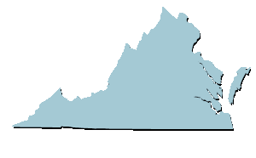
Virginia’s Budget
Virginia Department of Planning and Budget (DPB)

Slide 2
2024-2026 Budget: Nongeneral fund vs. General fund
The General Fund (36.0%)
From income and sales taxes paid by citizens and businesses
Can be used for a variety of government programs
Governor and General Assembly have the most discretion
Nongeneral Funds (64.0%)
Receipts set aside for specific purposes:
motor vehicle and gas taxes for transportation programs
student tuition and fees for higher education
federal grants for specific activities

Slide 3
Where the operating money goes- General Fund 2024-2026

Slide 4
Budgetary authorization for higher education involves several major programs
Educational and General (E&G)
General fund (GF) and nongeneral fund (NGF) sources (tuition and fee revenue)
Student Financial Assistance
General fund and nongeneral fund (tuition revenue and donations)
Sponsored Programs (Research)
General fund and nongeneral fund (federal and private grants)
Institution specific initiatives
Auxiliary Enterprises
Nongeneral fund only (self-supporting activities such as residential facilities, collegiate sports, dining halls, and parking)

Slide 5
Support for educational and general is a shared cost
Source: SCHEV

Slide 6

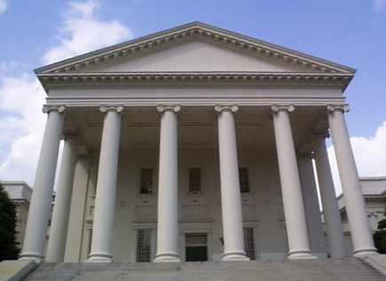





Many factors and perspectives influence budget development:
Priorities of the Governor
Priorities of the General Assembly
Public sentiment
Increases/ Decreases in federal funds
Changes in laws and regulations
Traditional practices
Increase in number of clients

Slide 7
Budget Creation Timeline
BUDGET DEVELOPMENT
AGENCY BUDGET PREPARATION
REVIEW & RECOMMENDATION
DPB issues instructions to agencies
Agencies generate & submit requests
Governor, DPB, Cabinet review
Governor submits document & bill to the General Assembly (GA)
July -September
October -December
APPROPRIATION
EXECUTION
LEGISLATIVE ACTION
Gov’s Review
Budget Bill referred to Money Committees
Conference committee reports bill & GA approves
Governor signs/vetoes bill/ vetoes portions/returns to GA with amendments
DPB, DOA & other agencies implement Appropriation Act
January-March
April-June
Notes:
AGENCY BUDGET PREPARATION
DPB provides guidance on Governor's priorities and instructions for preparing budget requests (Budget Instructions)
Agencies analyze programs and needs as they prepare requests
Agencies submit budget requests to DPB
BUDGET REVIEW & RECOMMENDATION
DPB analyzes budget requests to verify costs, confirm need for services, investigate funding alternatives, identify policy issues, and review performance
DPB, working with the Governor and Governor's Secretaries, prepares proposed budget to reflect Governor's priorities
Governor makes final decisions regarding what to include in the budget
Governor submits budget to General Assembly

Slide 8
Board’s Purpose in Budget Construction
Guidance, Stewardship, and Accountability
Serve as fiduciaries of public and family resources.
Ensure budgets align with the institution’s mission and Commonwealth priorities for access, affordability, and quality.
Provide strategic oversight, not operational control.
Use the budget as a tool to advance long-term institutional goals.

Slide 9
Core Responsibilities
Set Strategic & Fiscal Parameters – Define revenue, expenditure, and tuition assumptions early.
Balance Affordability & Sustainability – Protect students and institutional viability.
Promote Transparency & Accountability – Require clear data, tradeoffs, and justifications.
Assess Risks & Contingencies – Understand financial exposures and future obligations.
Encourage Shared Governance – Support collaboration among leadership, faculty, and students.

Slide 10
Hallmarks of Effective Board Stewardship
Informed – Understand financial drivers, policy context, and state expectations.
• Thoughtful – Balance access, quality, and fiscal prudence.
• Accountable – Make transparent, mission-driven decisions.
Collaborative – Engage constructively with administration and stakeholders.
• Forward-Looking – Monitor outcomes and adjust strategies for long-term success.

Slide 11
Best Practice - Budget Workshop
The three big objectives, in my opinion, are: - To present an overview of the university's financial structure and performance. - To outline the budget process, timeline, and factors that impact it (legislative actions, economic conditions, enrollment projections, etc). - To provide a venue for questions and dialogue prior to the tuition recommendations

