Slide 1
Governance 101
Armand Alacbay
American council of trustees and alumni (ACTA)

Slide 2

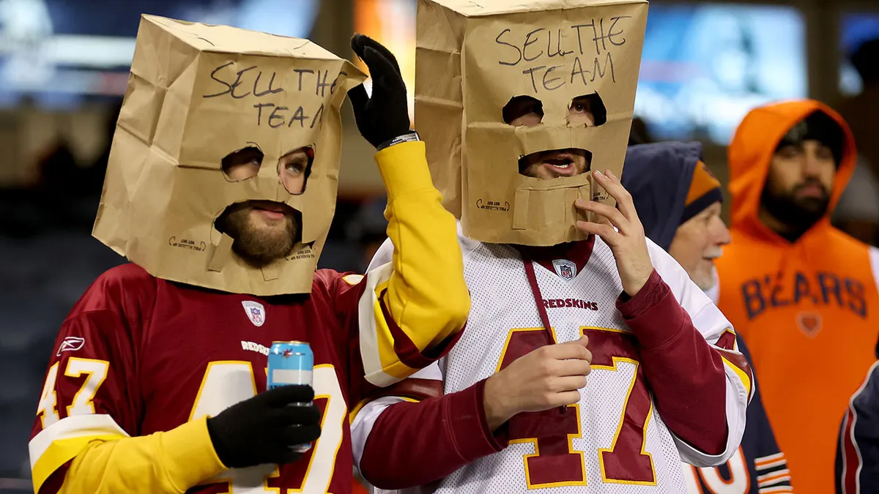
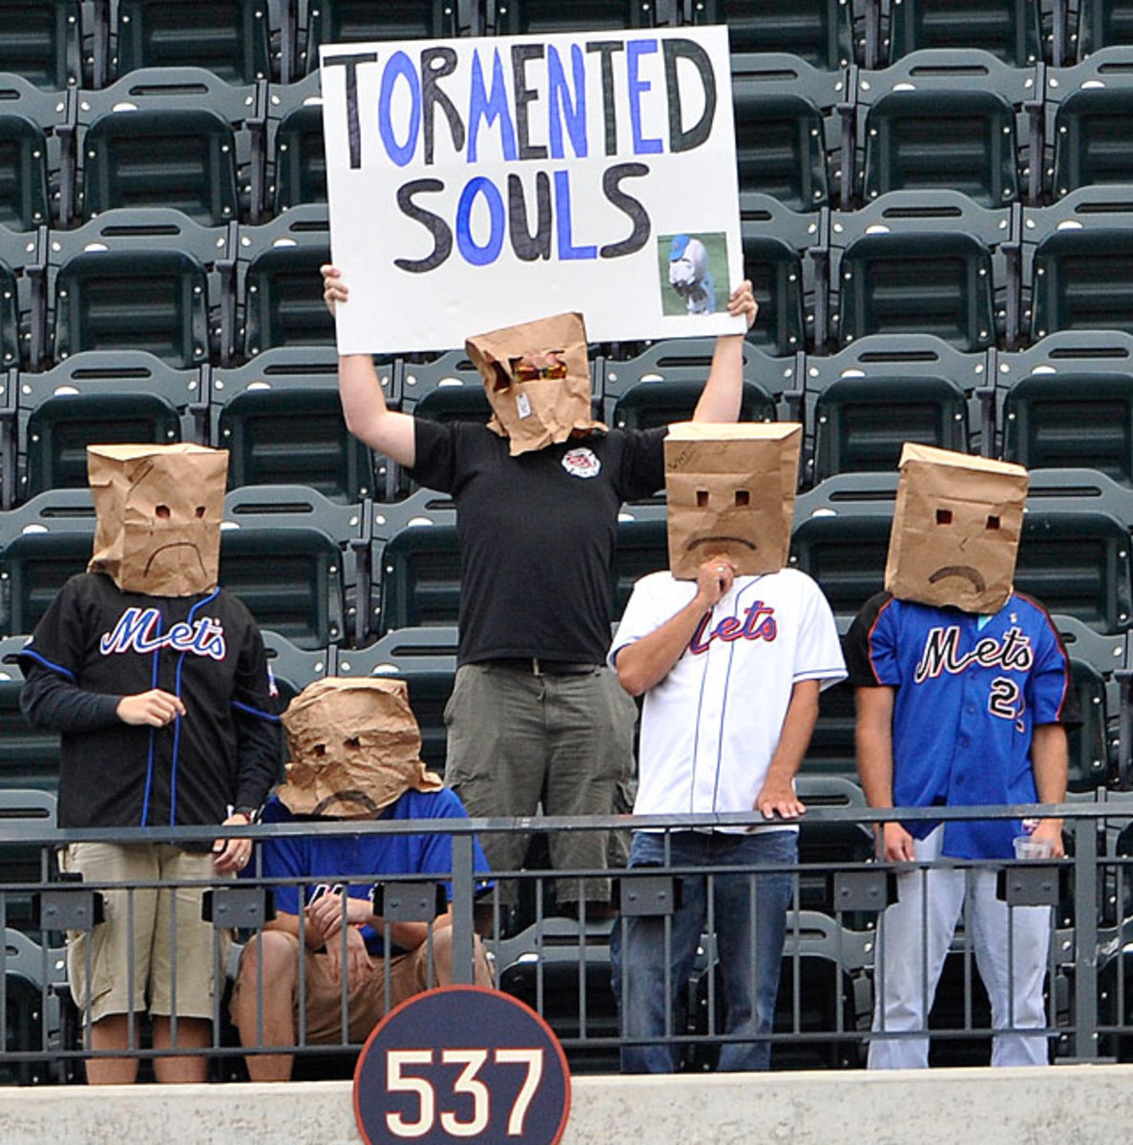
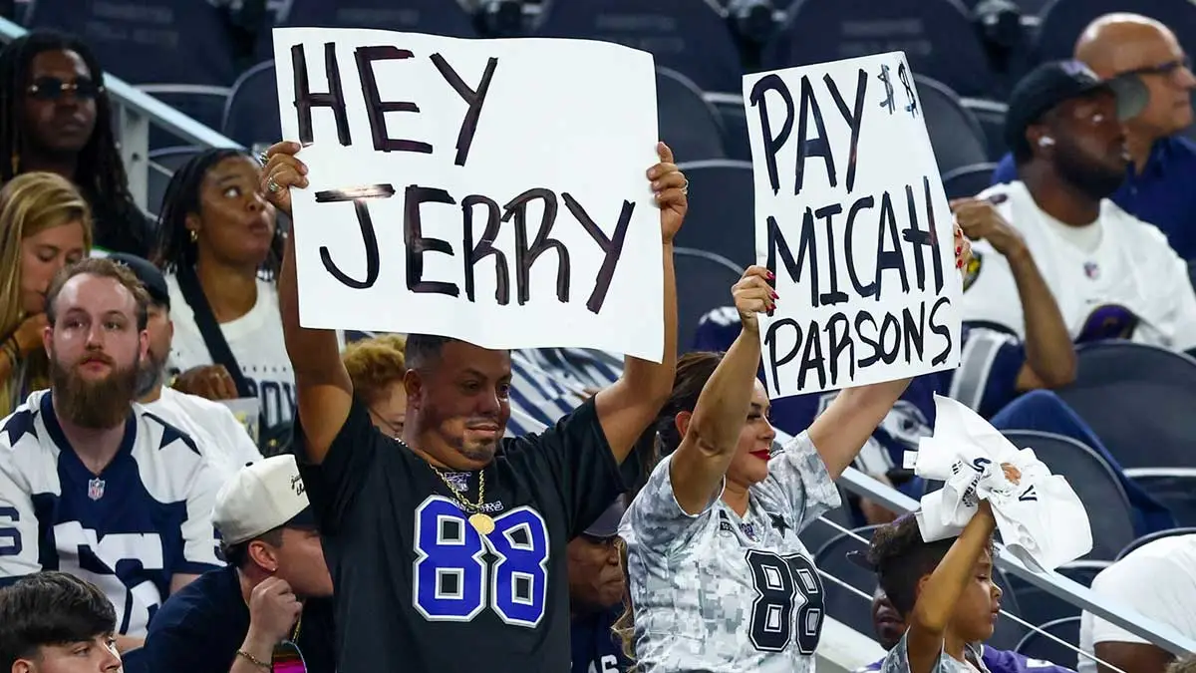
Notes:
Trusteeship is like being the owner of a professional sports franchise. Individually, you might have little to do directly with the product on the field, but you are still the ones responsible for it.

Slide 3
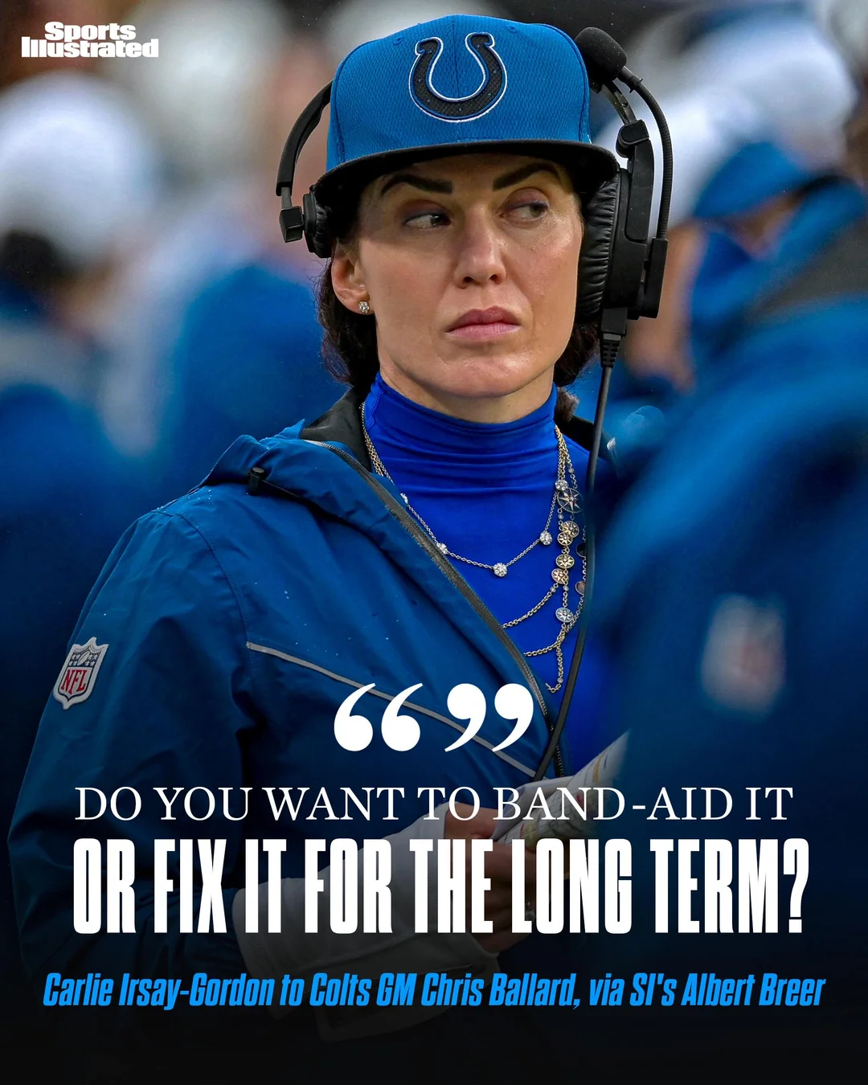

Slide 4
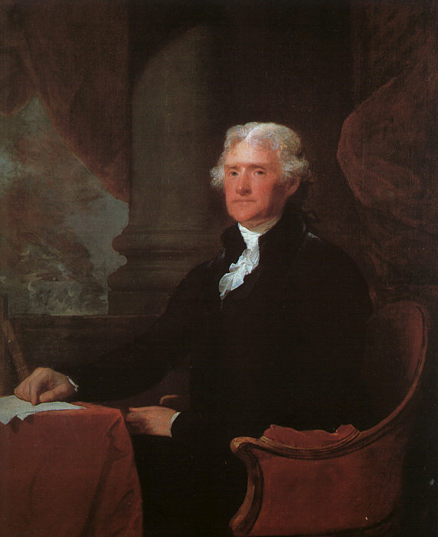
“It will be then for the wisdom & discretion of the visitors to devise & perfect a proper system of government, which, if it be founded in reason & comity, will be more likely to nourish, in the minds of our youth, the combined spirit of order & self respect, so congenial with our political institutions, and so important to be woven into the American character.”
Report of the Board of Commissioners for the University of Virginia to the Virginia General Assembly (1818)

Slide 5
§ 23.1-1304. Governing boards; additional duties; educational programs.
B. Educational programs for the governing boards of public institutions of higher education shall include presentations relating to:
1. Board members' primary duty to the citizens of the Commonwealth;

Slide 6
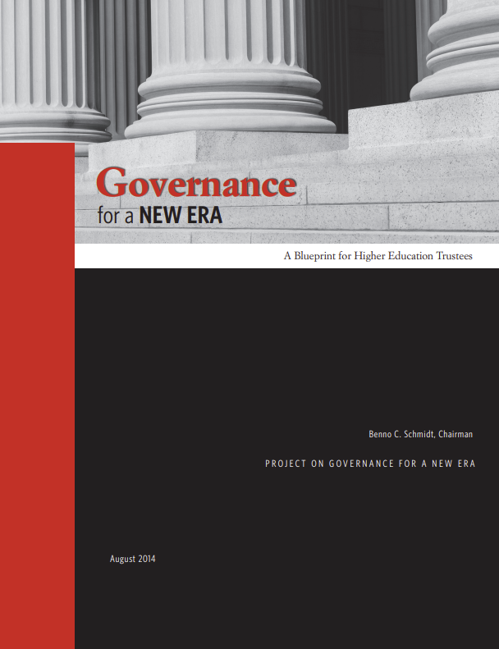
“Board members should be receptive to all, but
beholden to none. Their indispensable value to
students, institutions, and to the nation rests upon
their independent judgment.”

Slide 7
General Principles
Before meetings
  Set expectations
  Complete set of materials to Visitors at least 7-10 days before
  Concise (no “death by PowerPoint”) but comprehensive board books
At meetings
  Be judicious about consent agendas
  Allocate time for substantive discussion

Slide 8
General Principles
Before meetings
  Set expectations
  Complete set of materials to Visitors at least 7-10 days before
  Concise (no “death by PowerPoint”) but comprehensive board books
At meetings
  Be judicious about consent agendas
  Allocate time for substantive discussion
  Consider tasking Governance committee to assess adequate information flow to Visitors

Slide 9
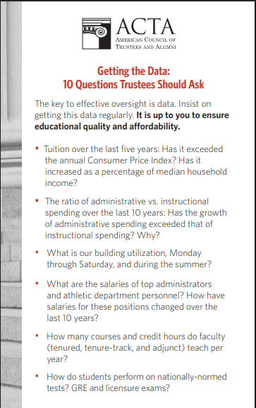

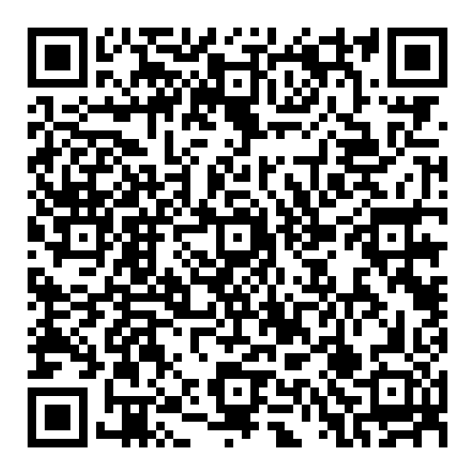
Notes:
https://www.goacta.org/resource/implementing_governance_for_a_new_era/; https://www.goacta.org/wp-content/uploads/2020/05/10-questions-trustees-should-ask.pdf

Slide 10
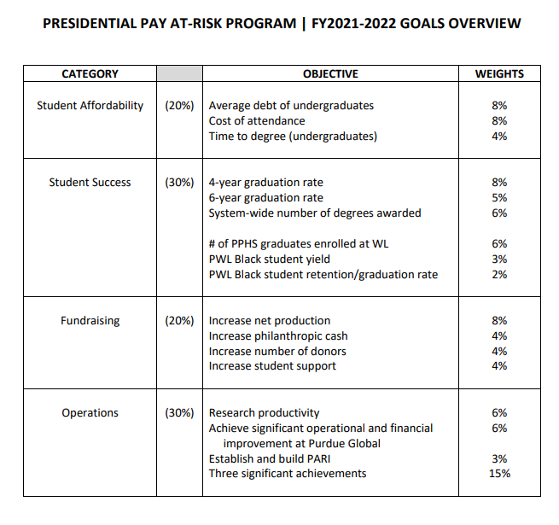

Metrics and Evaluation
Purdue University model: at-risk metrics
Notes:
https://www.purdue.edu/uns/images/2022/president-metrics.pdf

Slide 11
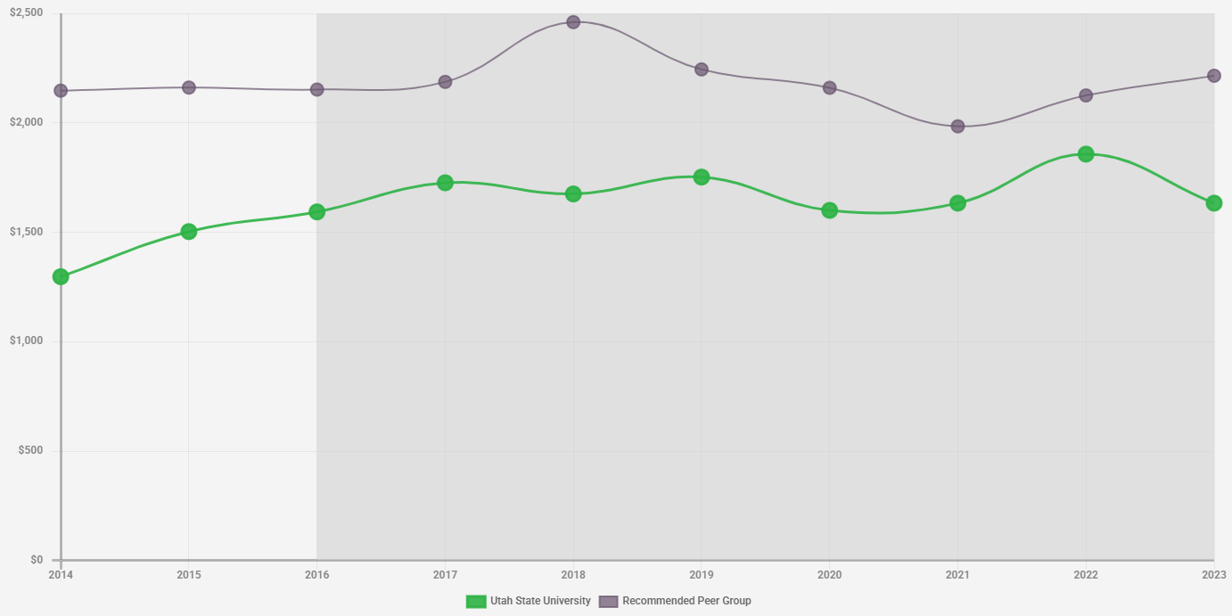
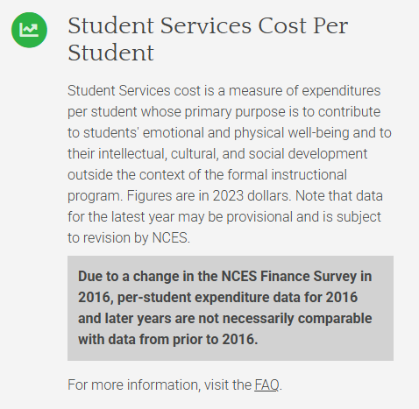
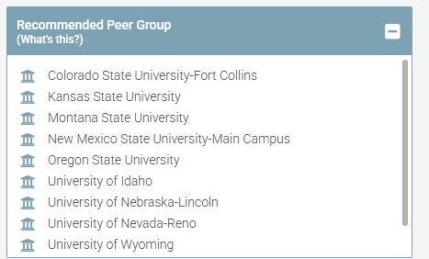

HowCollegesSpendMoney.com

Slide 12
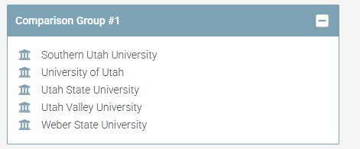
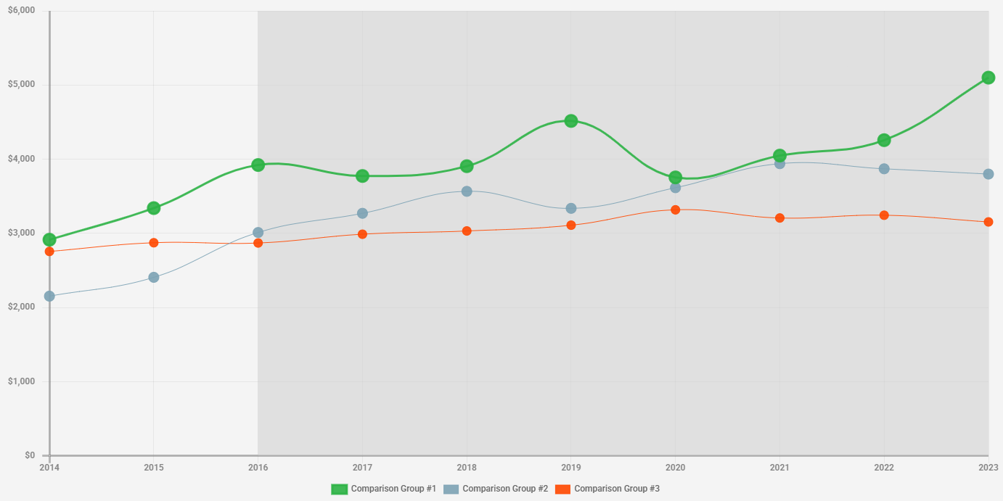
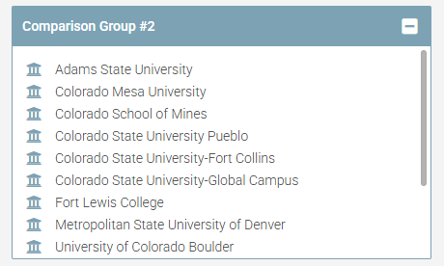
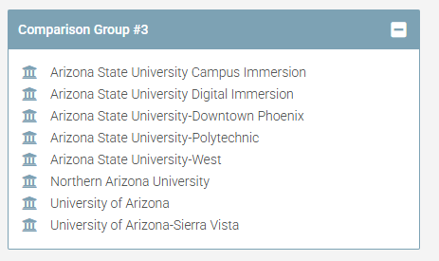
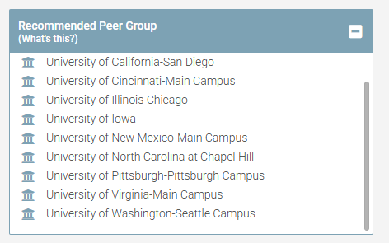
HCSM Comparison Builder allows users to create their own groups of peers

Slide 13

Academic Program Review
Every 5-10 years, typically 7
Input should come jointly from Academic Affairs and Finance committees
“The price for academic program bloat for all is impoverishment of each.”
-Robert C. Dickeson
Notes:
Questions to ask:

Slide 14
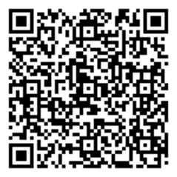
Facilitating Meaningful Prioritization
History, development, and expectations of the program
External demand for the program
Internal demand for the program
Quality of program inputs and processes
Quality of program outcomes
Size, scope, and productivity of the program
Revenue and other resources generated by the program
Costs and other expenses associated with the program
Impact, justification, and overall essentiality of the program
Opportunity analysis of the program

Slide 15


Slide 16


Education results

Slide 17
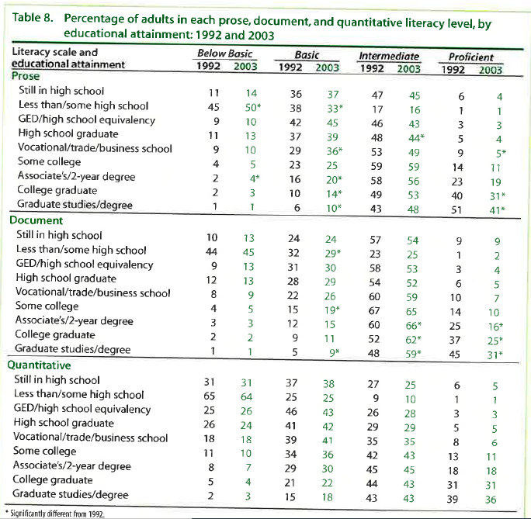
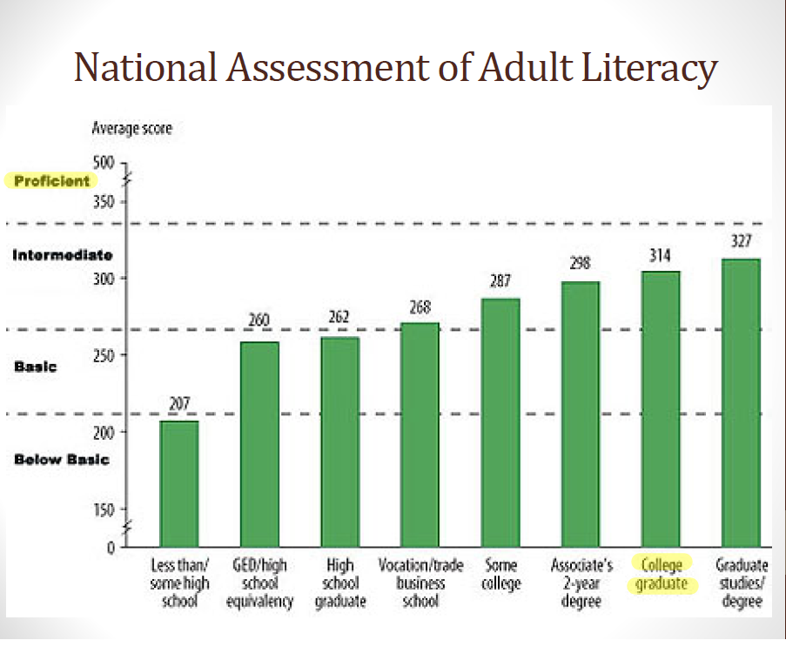

Notes:
National statistics

Slide 18
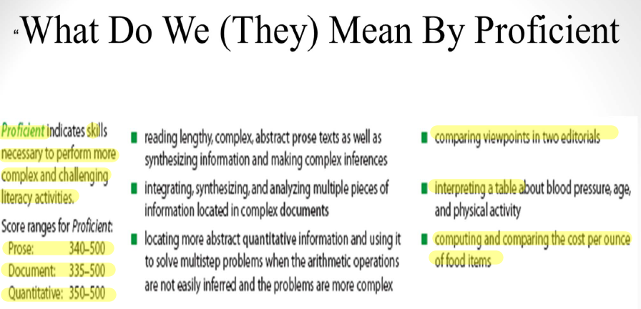
Notes:
National statistics

Slide 19
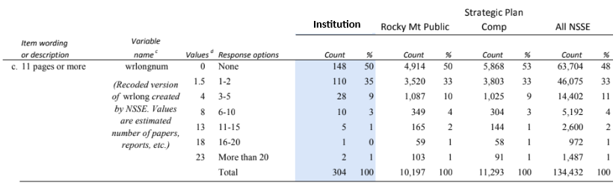
National Survey of Student Engagement (NSSE)
During the current school year, about how many papers, reports, or other writing tasks of the following lengths have you been assigned?

Slide 20
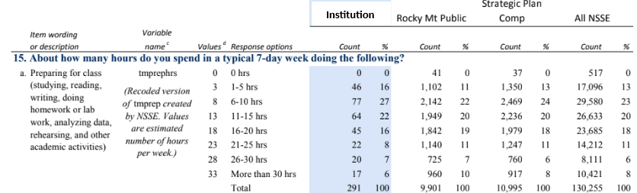
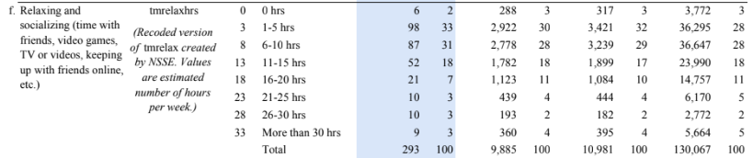
National Survey of Student Engagement (NSSE)
56%
41%

Slide 21

“Large numbers of college students report that they experience only limited academic demands and invest only limited effort in their academic endeavors.”
Class of 2009: 36% with no significant learning improvement
Notes:
Lowest performers most likely to be unemployed, living at home, and in credit card debt after graduation.

Slide 22

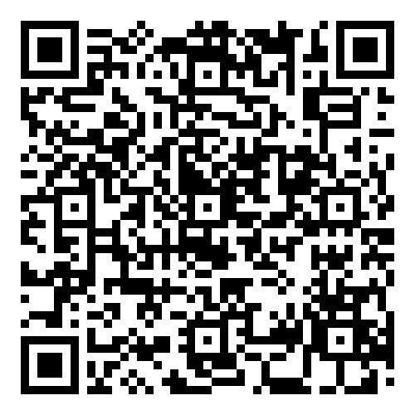
Collegiate Learning Assessment (CLA)
Notes:
https://www.goacta.org/wp-content/uploads/ee/download/are_they_learning.pdf - Nationally-normed. Learning outcomes: measures the delta. Inexpensive.

Slide 23
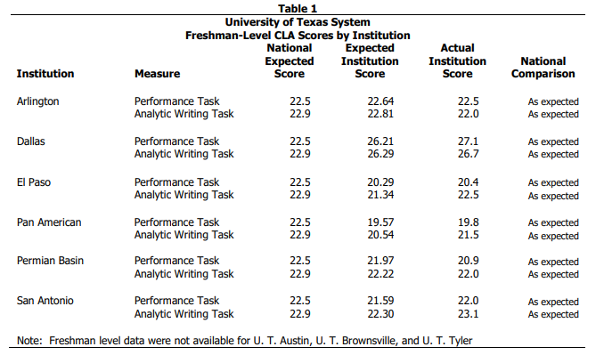
Notes:
https://www.utsystem.edu/ipa/commission/StudentLearningAssessment-021606.pdf

Slide 24
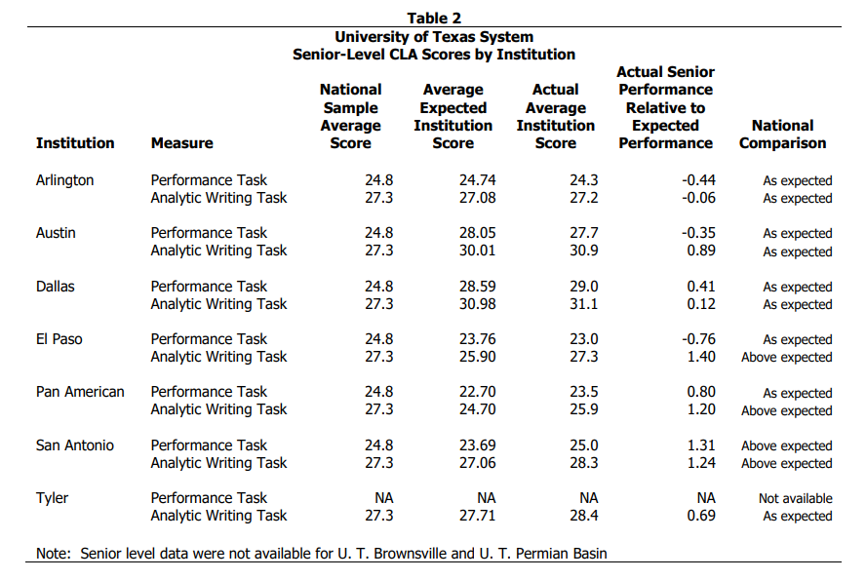
Notes:
https://www.utsystem.edu/ipa/commission/StudentLearningAssessment-021606.pdf

Slide 25

www.WhatWillTheyLearn.com

Slide 26
What Will Students Learn in the Classroom?
ACTA’s What Will They Learn?® project grades the core curricula at colleges and universities on an “A+” through “F” scale based on how many of the seven WWTL subjects they require students to study. This year, only 7 of over 1,100 colleges earned an “A+”.
Subjects Areas Evaluated
Composition
Foreign Language
Literature
U.S. Government & History
Economics
Mathematics
Natural Science

Slide 27
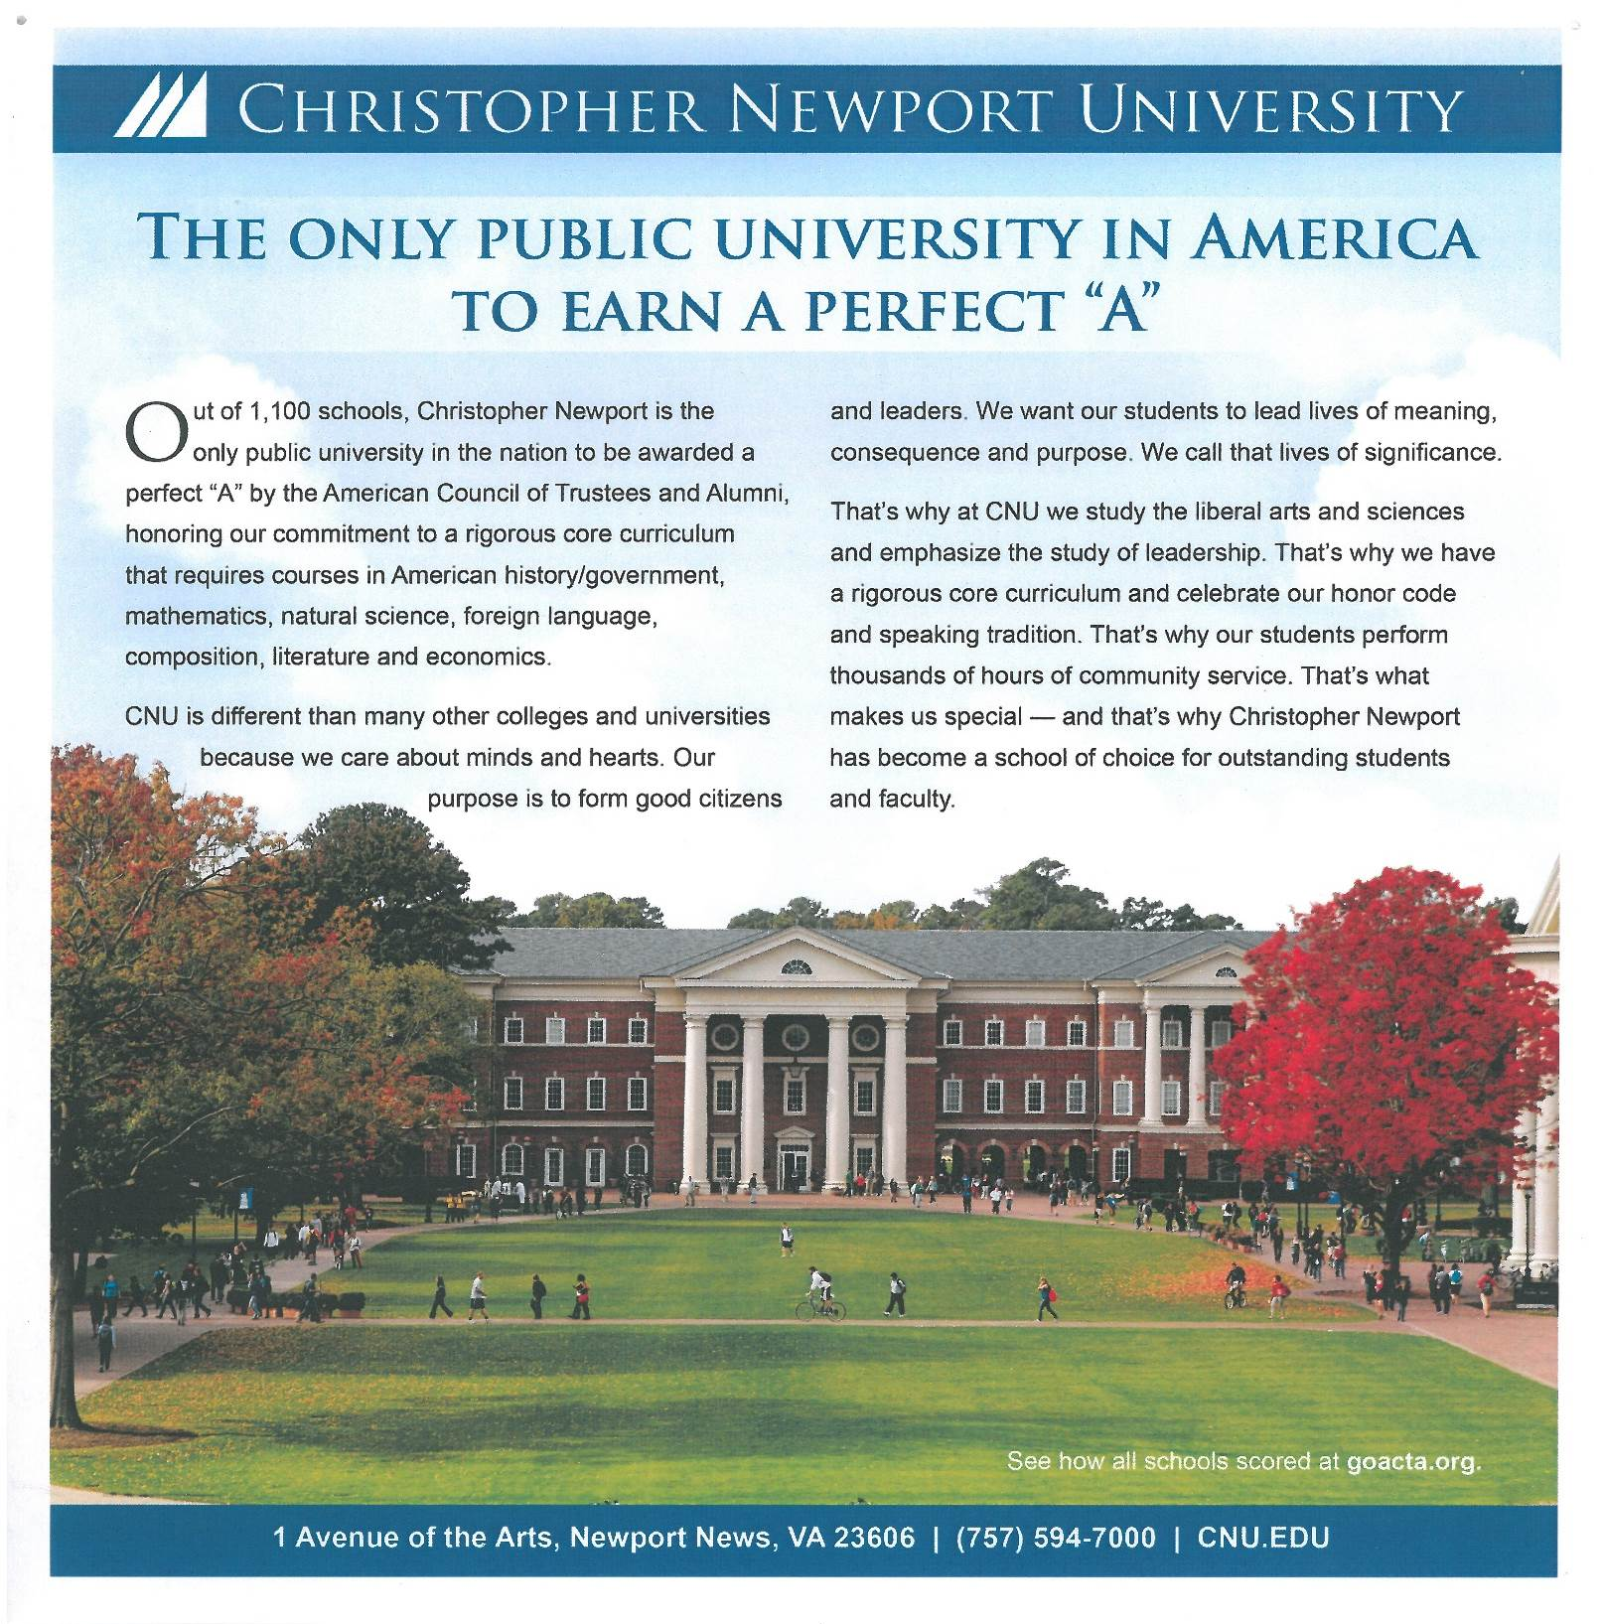

Slide 28
Freedom of Expression and Intellectual Diversity

Slide 29
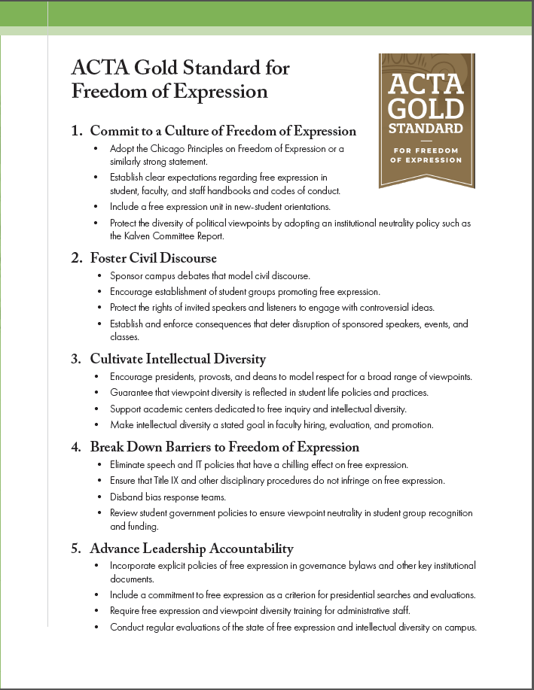
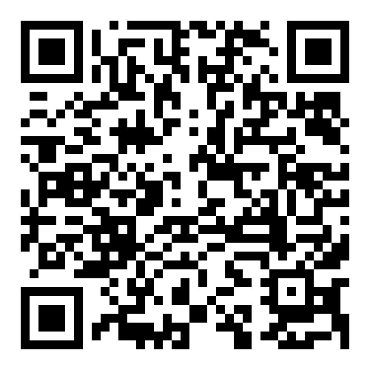
ACTA Gold Standard for Freedom of Expression™

Slide 30

https://www.goacta.org/campus-freedom-initiative/va-report-card/

