Slide 1
Strategic Planning and Making Informed Decisions Steve Cummings Secretary of Finance

Slide 2
Common Metrics
Decision-makers need a set of common data metrics to govern effectively
Secretary of Finance, Secretary of Education and SCHEV created “Fact Packs” in partnership with universities
The Fact Packs are now the publicly available, certified source of data being used by Boards, money committee staff, university leadership, legislators, Governor, students, applicants and other decision-makers
These inform the revised and enhanced Six Year Planning process, which was historically a compliance and budget request exercise

Slide 3
Fact Pack Data – Key Drivers
Enrollment – headcount, acceptance rate, yield rate, realistic projections by type (in-state, out of state, FTIC, FTE) and modality (online, dual enrollment, etc.)
Program Alignment & Performance - retention and graduation rates
Post-Completion Outcomes – wages, debt relative to earnings
Financial Effectiveness & Sustainability – revenue trends by source, expenditure trends and detail, tuition discounting, administrative and personnel trends, institutional financial health ratios

Slide 4
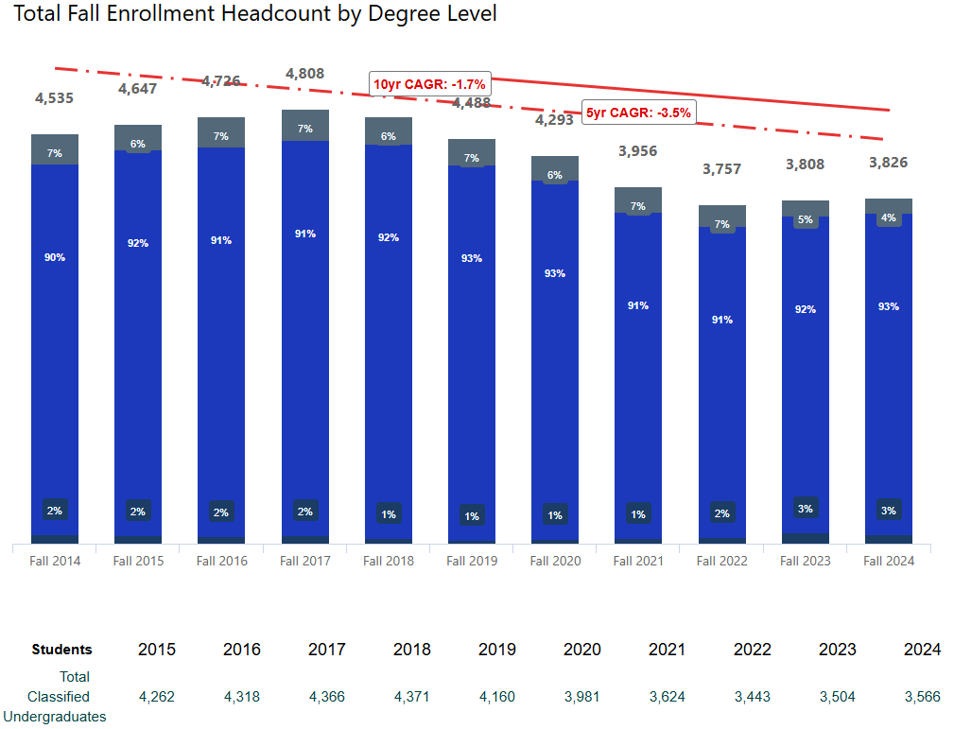
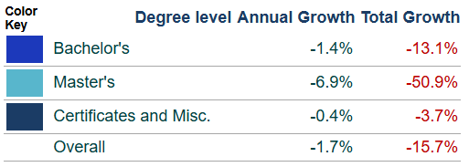
Enrollment
Demographic cliff putting pressure on IHEs, many already seeing lower enrollment, selectivity and yield
Ten schools experienced decline in enrollment over the last decade
Many experiencing post-covid bump
Does not account for modality (part time, online, dual enrollment, etc.)
At least two IHEs project 40% to 60% of total headcount to be distance learning by 2030

Slide 5
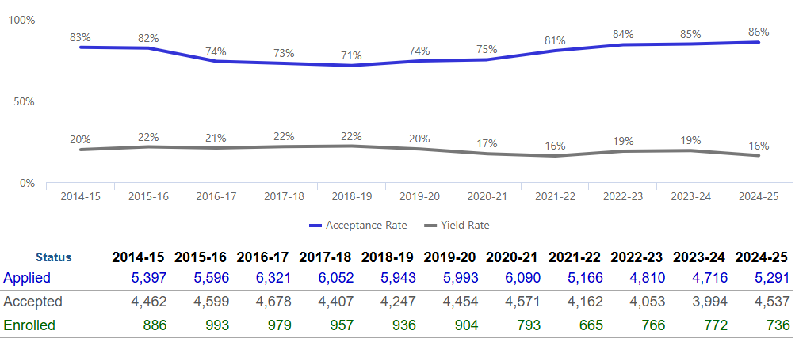
Enrollment
Outside of selective IHEs, many schools facing pressure to decrease selectivity amidst falling yields
Nine schools have acceptance rates of 85% or higher

Slide 6
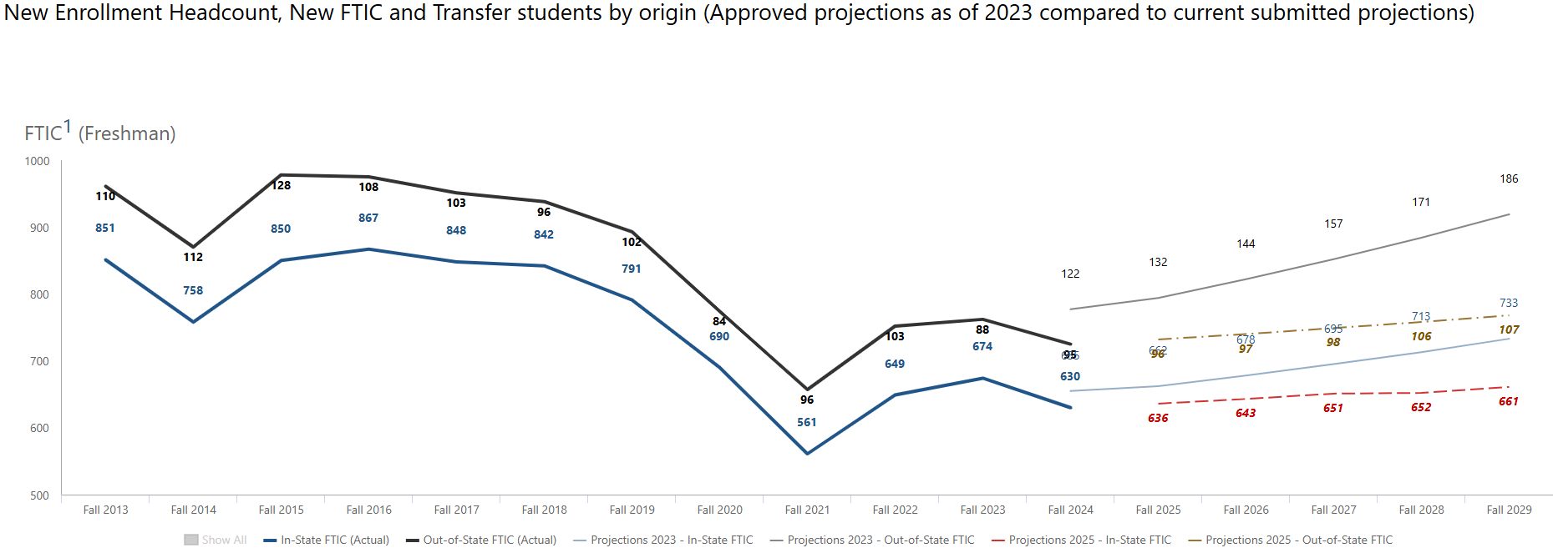
Enrollment
Enrollment projections should be grounded in historical data and informed by overall demographic trends, including enrollment modality

Slide 7
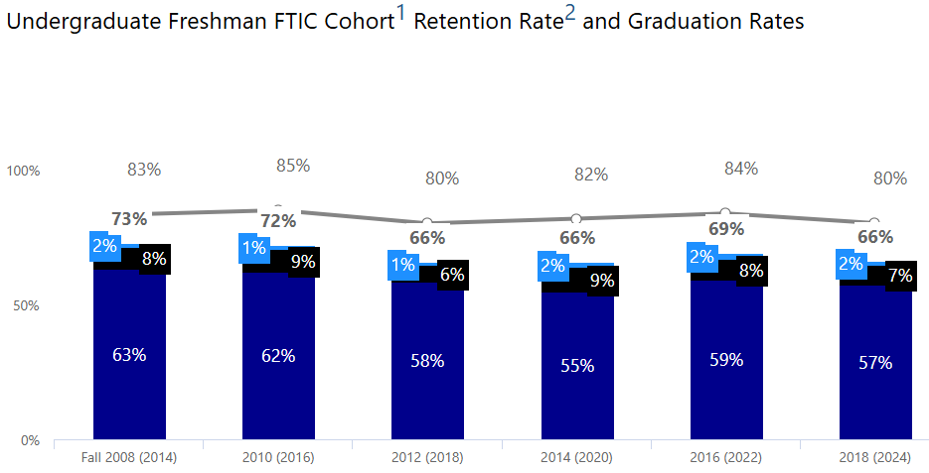
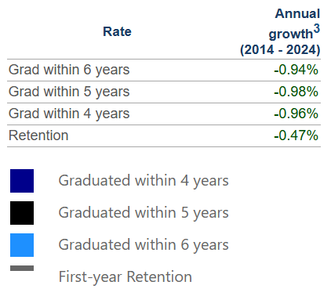
Program Alignment & Performance
Graduation rates generally improved over last decade with flat retention, but some IHEs saw worsening outcomes
Five schools have grad rates below 60%

Slide 8
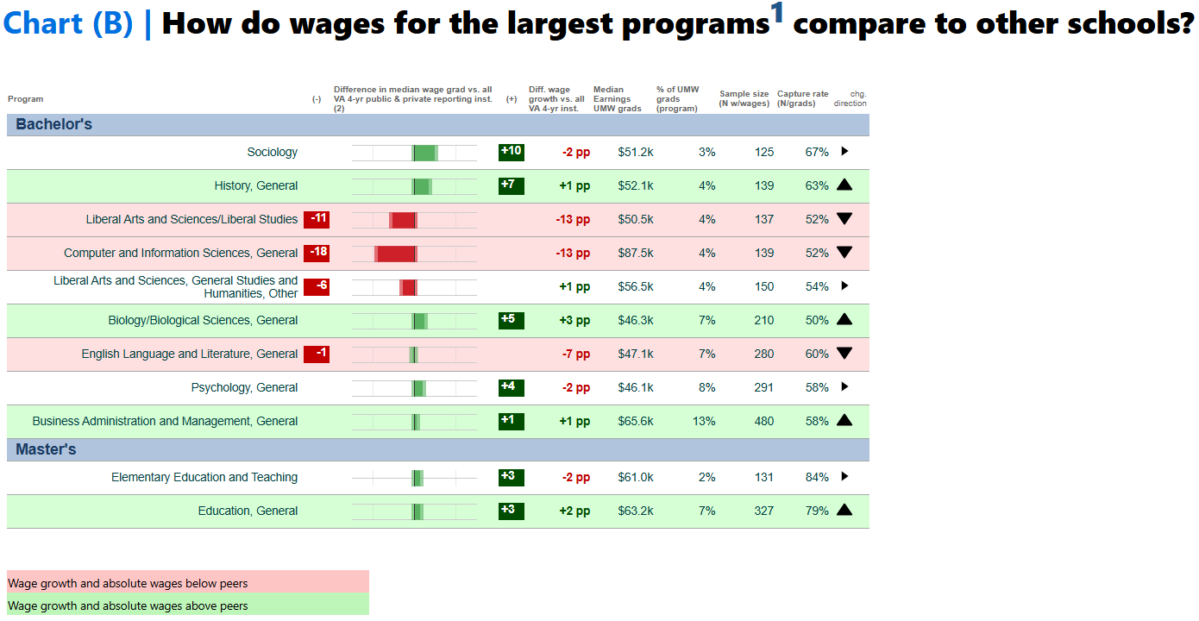
Post Completion Outcomes
Important to ensure that programs are being offered in high-growth and high-enrollment areas, with strong outcomes

Slide 9
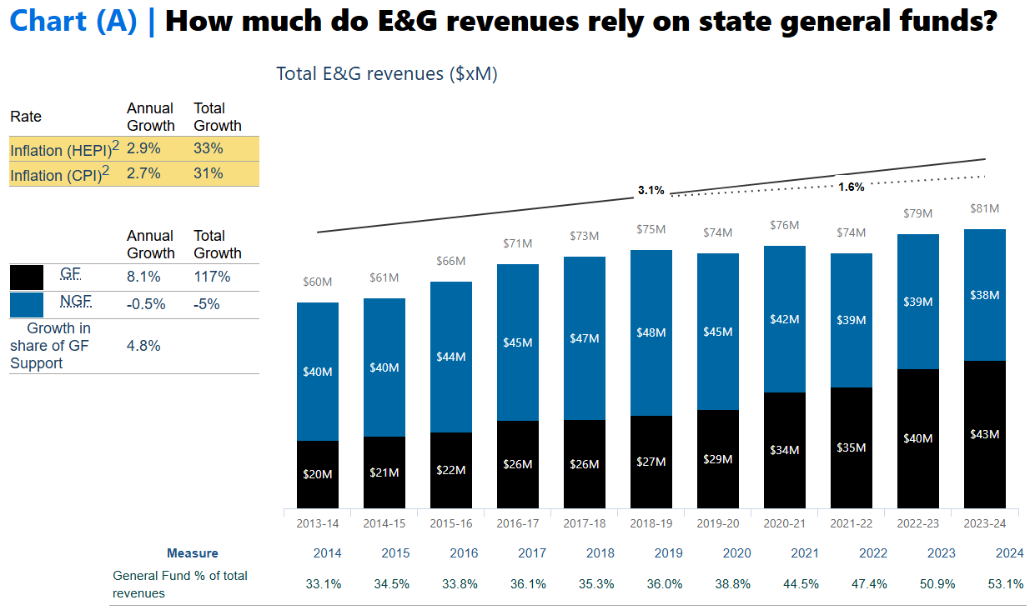
Financial Effectiveness & Sustainability
General Fund as % of total revenues has increased for schools with declining enrollment and tuition revenue

Slide 10
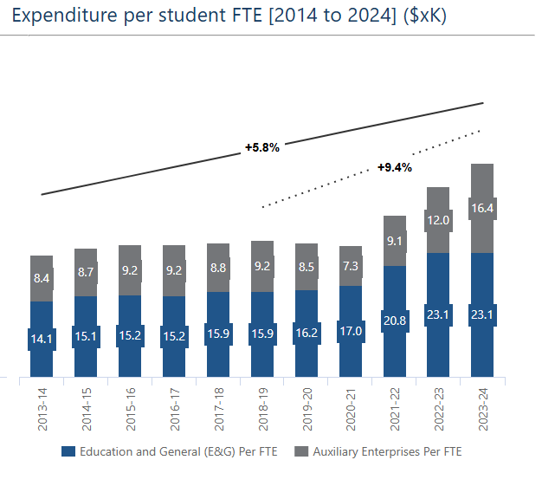
Financial Effectiveness & Sustainability
Total expenditures per student have grown ~40% over the last decade
All institutions with declining enrollment have experienced growth in spending per student
Non-academic spending and scholarship/student aid are the most common spending drivers

Slide 11
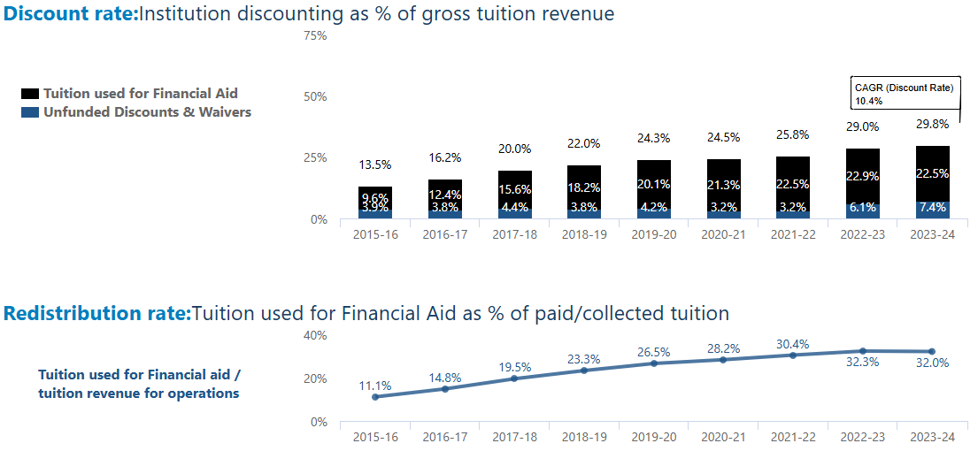
Financial Effectiveness & Sustainability
Tuition discounting has increased for most schools in order to attract students, constraining revenue

Slide 12
Six Year Plan Overhaul
Mandated strategic, six-year plan where each institution develops academic, financial and enrollment strategies that align with state’s overarching goals
Plans approved by each BOV and SCHEV
Previously a compliance exercise focused on budget requests and not tied to institution’s strategic plan
Fact Pack data and trends are now used to inform plans and meetings
Institutions are provided overall demographic and enrollment trend data, to inform their enrollment projections
Pro-Forma added for next six years projecting revenue, expenses, tuition increases necessary, etc. to forecast surplus/deficits
University president, provost, CAO/CFO and sometimes Board members present Plans to Op-Six

Slide 13
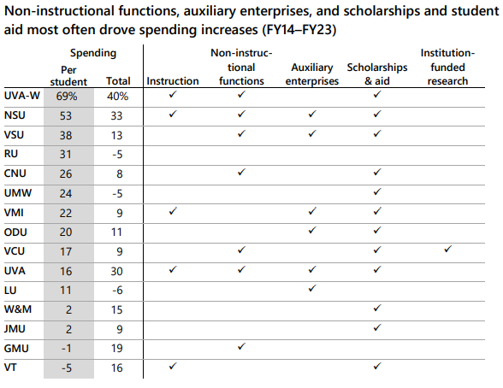
JLARC - Efficiency

Slide 14
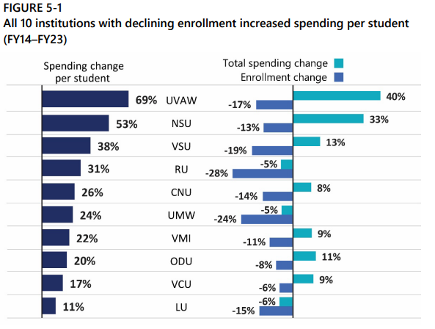
JLARC - Efficiency

Slide 15
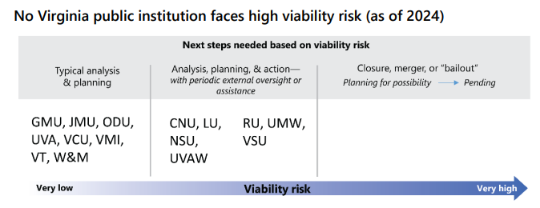
JLARC - Viability

Slide 16
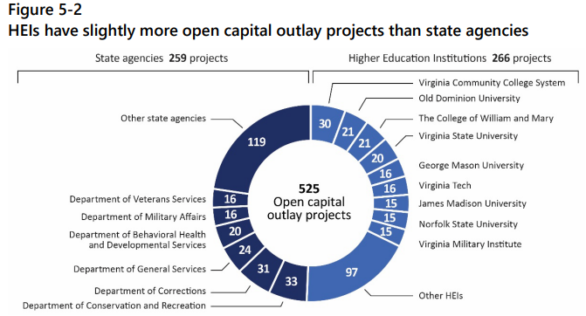
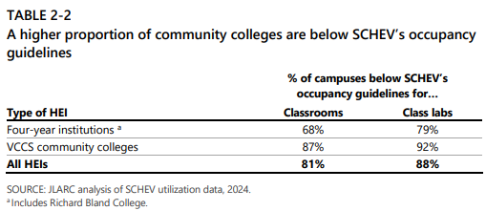
JLARC – Capital Maintenance and Construction
Many higher education institution facilities have lower utilization today versus pre-pandemic, and this should be continuously quantified and monitored to make better capital allocation decisions

